Slide 1
Storyboard
Fait par émile dion

Slide 2
The moment this morning I don't

Slide 3
That each step that I take is on my way home

Slide 4
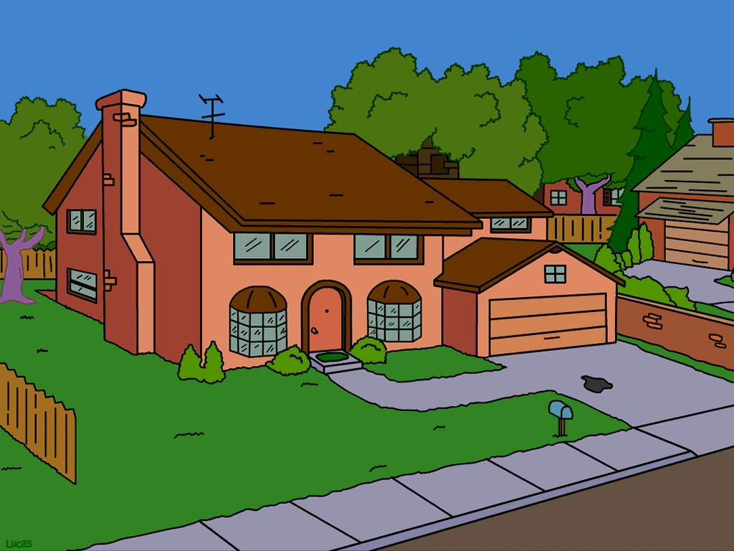
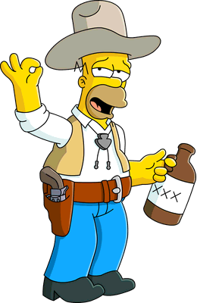
'Cause a bottle of vodka

Slide 5
DOH! JE NAIS PUS DE BIERE
Still I run out of vodka

Slide 6
Sitting here wasted and wounded

Slide 7
But I laughed so hard I think I died

Slide 8
Just to see through this payphone
Bonjour flanders
Pourrais tu me donner de la bière
Bien sure ont est ami alors je vais t’en donner

Slide 9
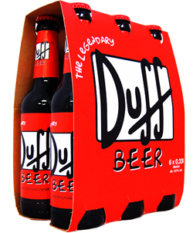
I'll just close my eyes and vodka!
Voila de la bière mon ami

Slide 10
Mean I'm not lonely I've got nothing to prove

Slide 11
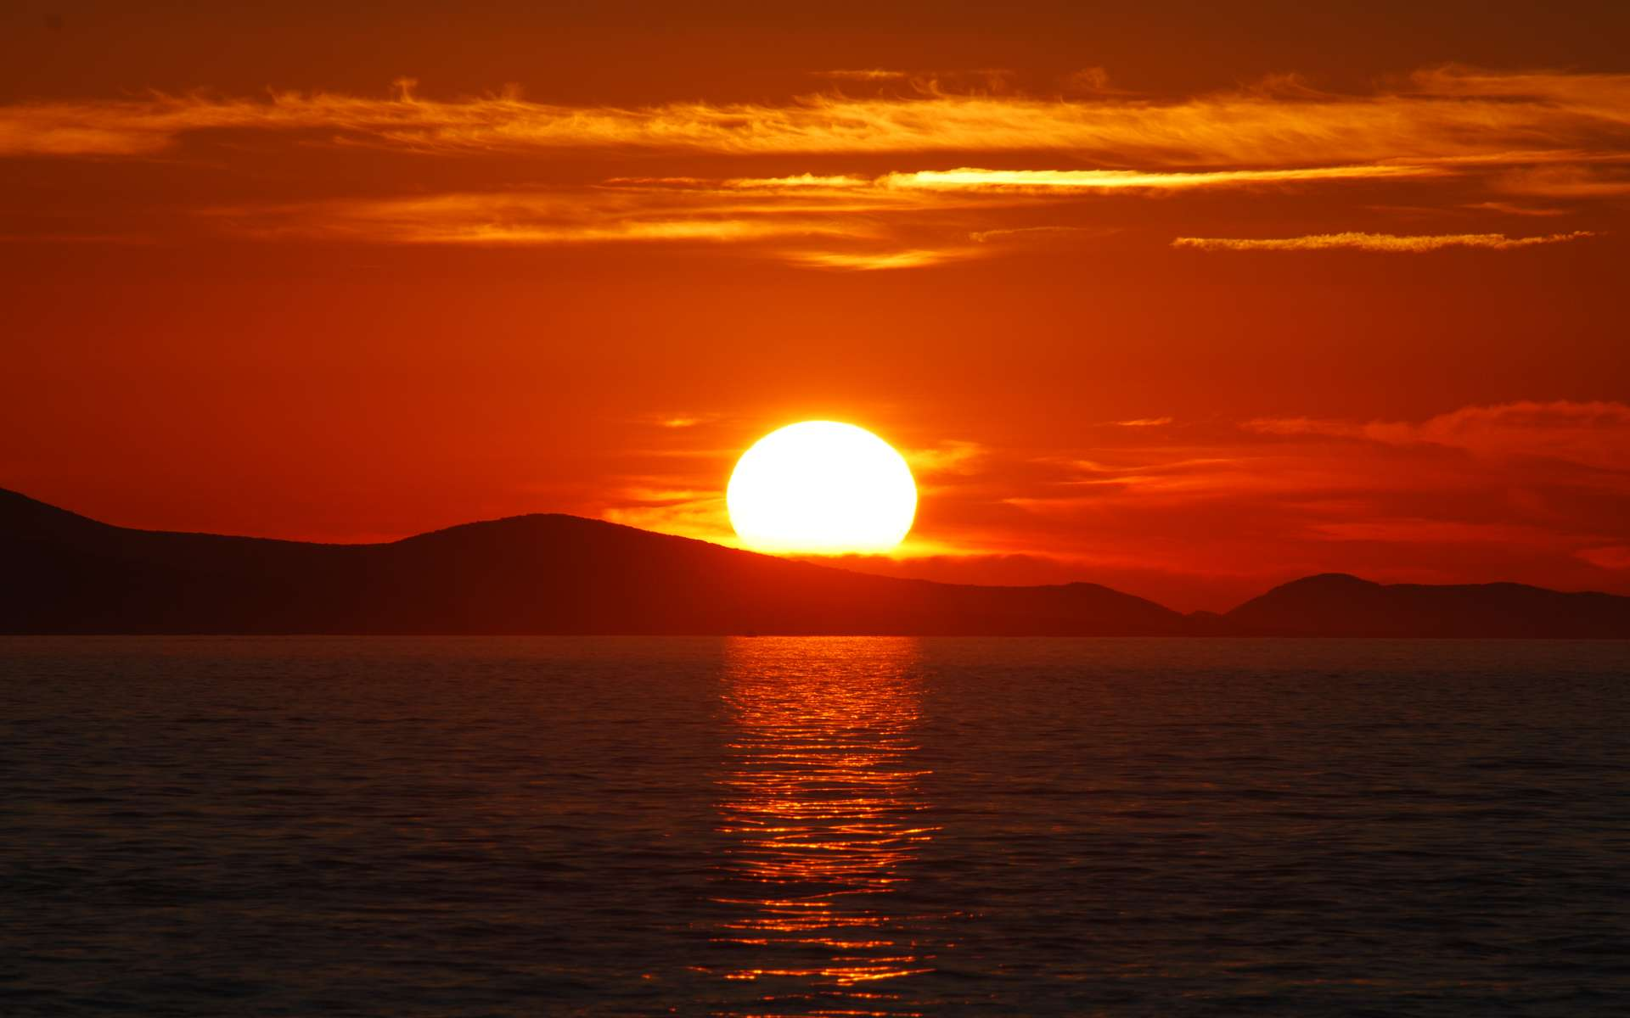
Tonight I won't be alone

