Slide 1
BD fait par: Alexis Jacques

Slide 2
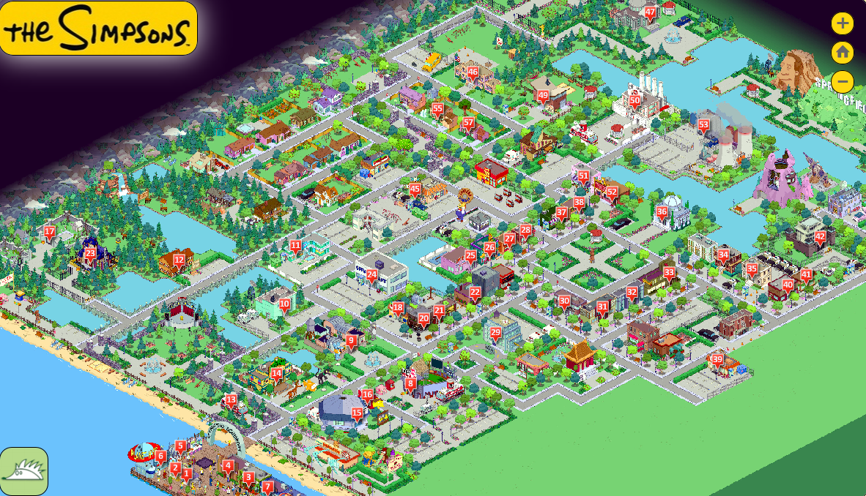
Grand plan ensemble
Taken my hearing

Slide 3
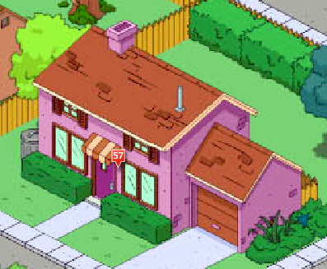
Plan general
Trapped in myself

Slide 4
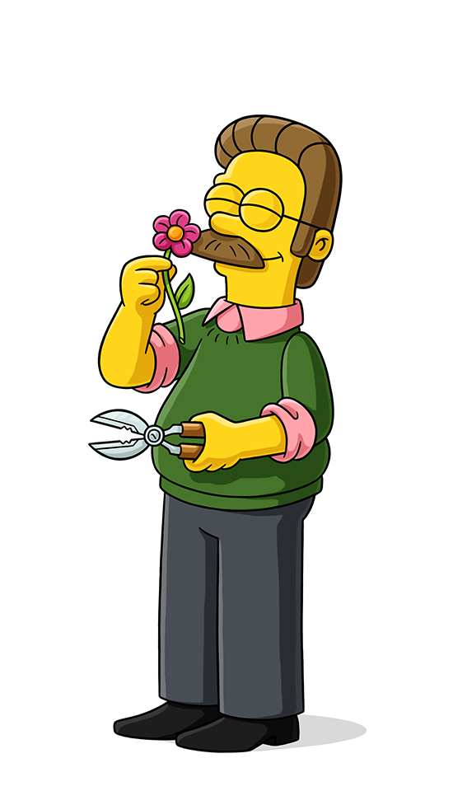
Plan americain
Taken my speech

Slide 5
Plan epaule
Oh please god,wake me

Slide 6
Extrème gros plan
Hold my breath as I wish for death

Slide 7
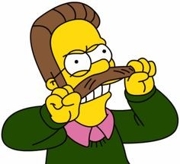
Plan pied
Absolute horror

Slide 8
Plan tete
I cannot live

Slide 9
Plan ceinture
Oh please god,wake me

Slide 10
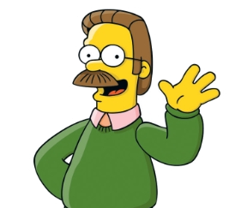
Plan buste
Im waking up I can not see

Slide 11
Plan ensemble
But cant look forward to reveal

