Slide 1
Albert Einstein
“In the middle of difficulty lies opportunity. ”
Made by: Antoine et Ludovic

Slide 2
Biography
Born: March 14 1879 (Allemagne)
Die: April 18 1955 (76 years old) (U.S.A)
Because a Anévrisme

Slide 3
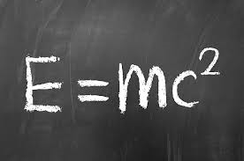
Theorie of Relativity restraint
The theorie of the gravitation, general relativity
His more important invention is the formule E=mc2
His Theorie

Slide 4
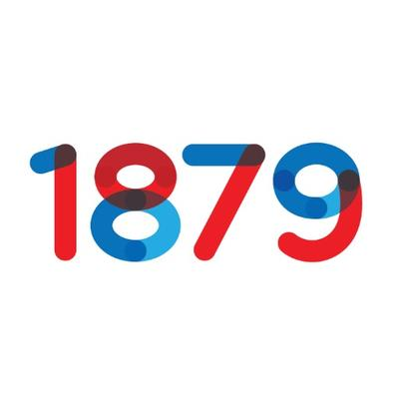
His Invention
various type of fridge:
gas absorption fridge
a diffusion system
electromagnetic system
Furthermore
Hearing aid

Slide 5
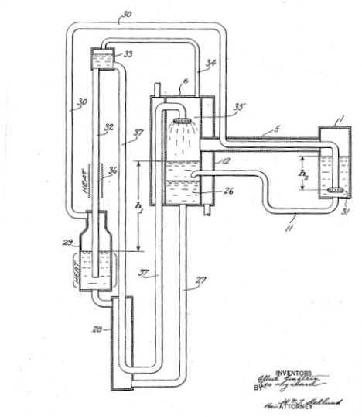
impact of him today
Because of his intelligence and his inventions, Albert contribute to the development of the sciences today and furthermore, his theorie and inventions have change the world like the fridge, he are in all of home today and we all use it. His theorie change the world to like the formule E= mc2, because this formule help the sciences for never.

Slide 6
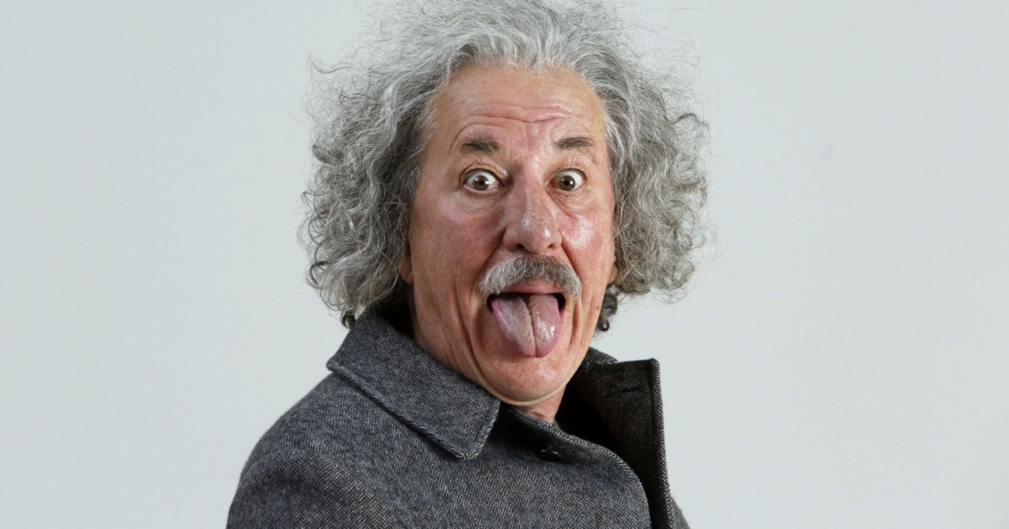
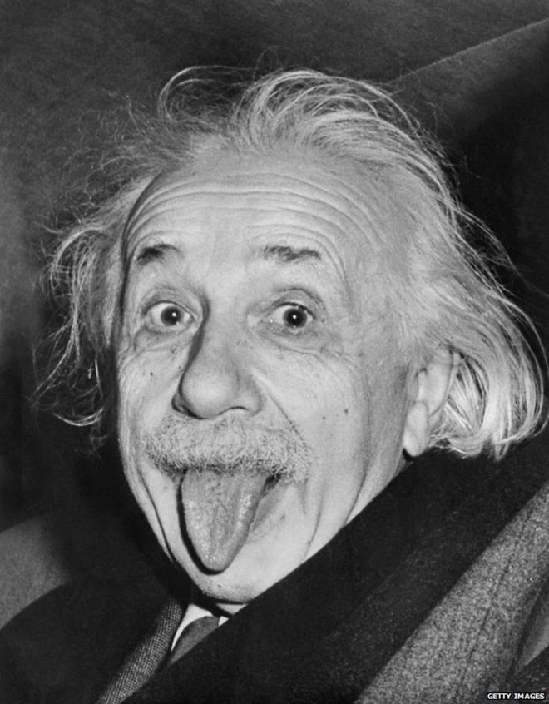
Life is like a bicycle, you have to move forward so you do not lose your balance.
Quote

