Slide 1
Bd fait par Billy Roy:

Slide 2
Grand plan d’ensemble
This ain't a song for the broken-hearted

Slide 3
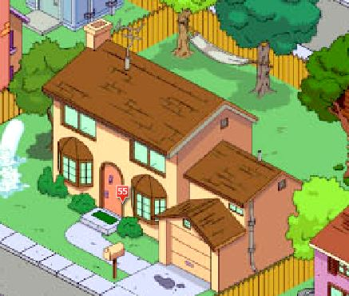
Plan général
It's now or never

Slide 4
Plan américain
I just want to live while I'm alive

Slide 5
Plan épaule
For Tommy and Gina who never backed down

Slide 6
Extrême gros plan
My heart is like an open highway

Slide 7
Plan pied
Tomorrow's getting harder make no mistake

Slide 8
Plan tête
I ain't gonna live forever

Slide 9
Plan ceinture
I did it my way

Slide 10
Plan Buste
It's my life

Slide 11
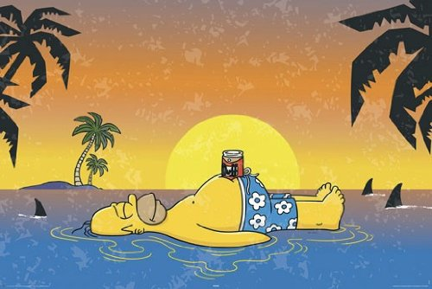
Plan d’ensemble
'Cause it's my life

