Slide 1
Simpsons
BD
Fait par: Edouard Grenier

Slide 2
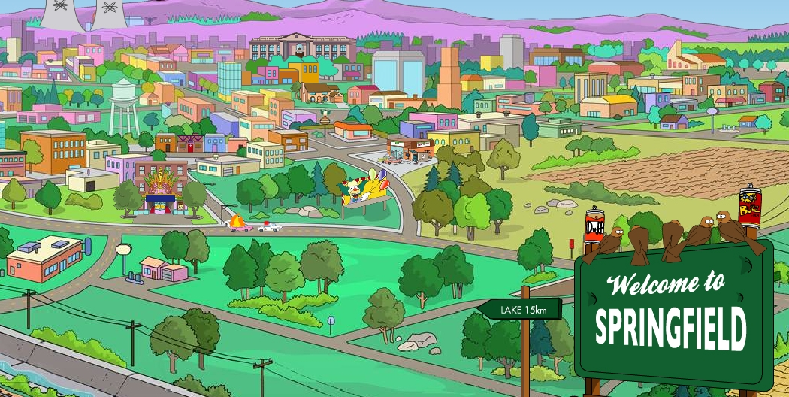
Said can I take you home where we can be alone

Slide 3
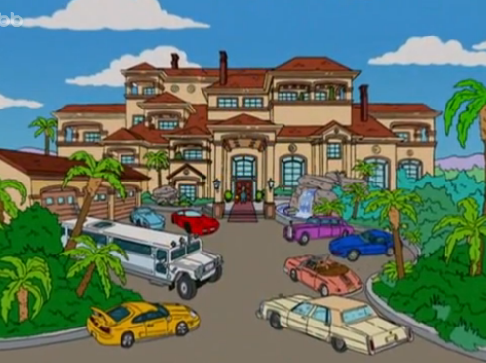
An next we were movin on

Slide 4
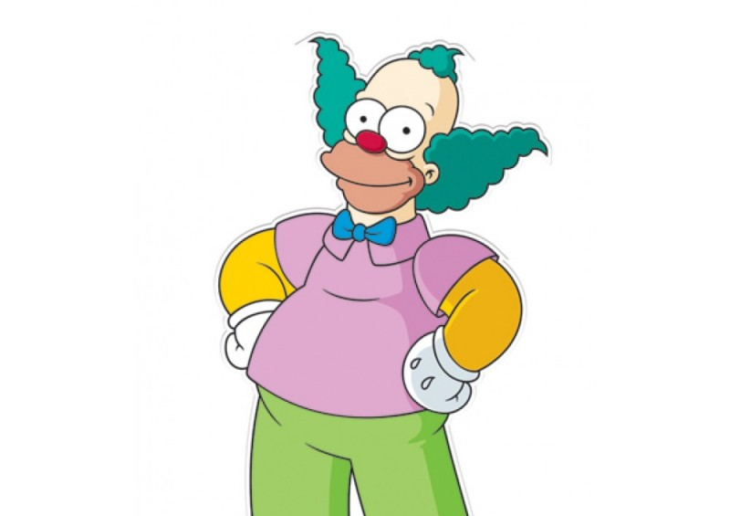
I saw him dancin there by the record machine

Slide 5

The beat was goin strong

Slide 6
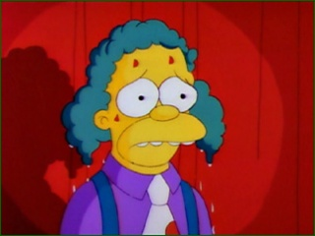
An I could tell it wouldnt be long

Slide 7
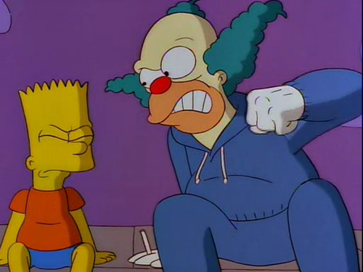
So come an take your time an dance with me

Slide 8
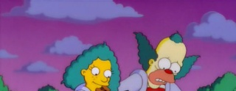
He smiled so I got up and asked for his name

Slide 9
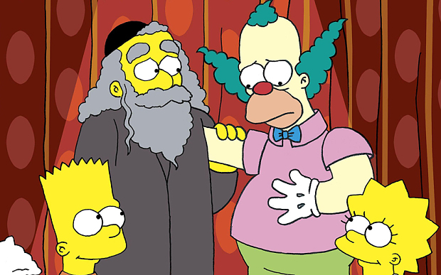
He was with me, yeah me

Slide 10
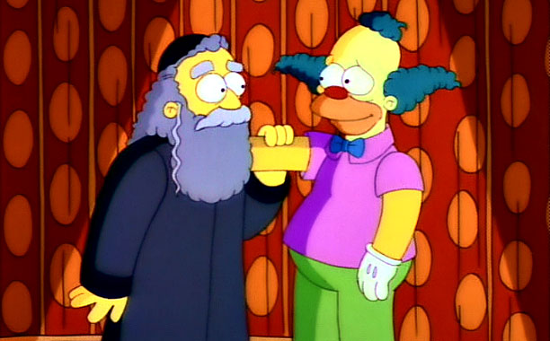
He was with me, yeah me, singin

Slide 11
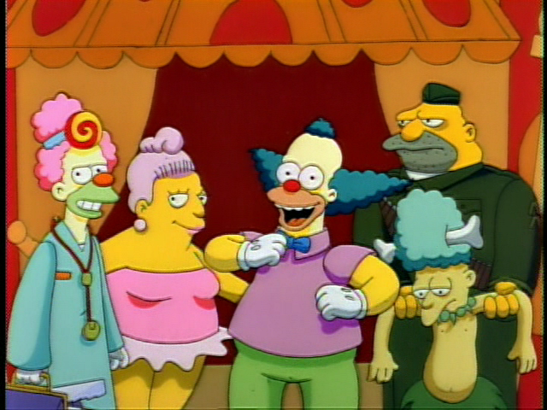
So put another dime in the jukebox, baby

