Slide 1
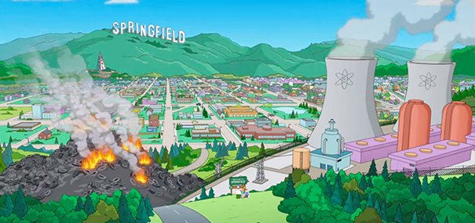
Once upon a time Not so long ago Tommy used to work on the docks

Slide 2
Union's been on strike He's down on his luck...it's tough, so tough Gina works the diner all day Working for her man, she brings home her pay

Slide 3
For love - for love She says: We've got to hold on to what we've got 'Cause it doesn't make a difference If we make it or not

Slide 4
Y’a plus de bière Homer je suis désoler
We've got each other and that's a lot For love - we'll give it a shot We're half way there Livin' on a prayer

Slide 5
Take my hand and we'll make it - I swear Livin' on a prayer

Slide 6
Tommy got his six string in hock Now he's holding in what he used To make it talk - so tough, it's tough

Slide 7
Gina dreams of running away When she cries in the night Tommy whispers: Baby it's okay, someday We've got to hold on to what we've got 'Cause it doesn't make a difference

Slide 8
If we make it or not We've got each other and that's a lot For love - we'll give it a shot

Slide 9
We're half way there Livin' on a prayer Take my hand and we'll make it - I swear Livin' on a prayer
Je veut de la bière!!
Merci de m’aider !

Slide 10
We've got to hold on ready or not You live for the fight when it's all that you've got We're half way there

Slide 11
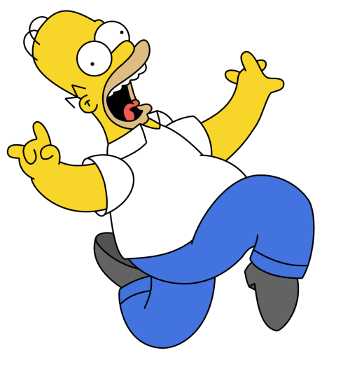
La Bière est de retour !!!
Livin' on a prayer Take my hand and we'll make it - I swear Livin' on a prayer

