Slide 1
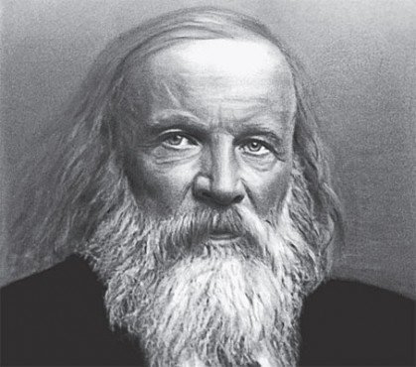
Dimitri Mendeleev
Made by: Joey Turcotte and Remi cote

Slide 2
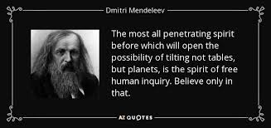
Mendeleev’s Quote

Slide 3
Name: Dimitri Ivanovich Mendeleev
Born in: Febuary 8, 1834
Death: Febuary 2 1907
Nationality: Mendeleev is Russian
Discovery: The Periodic table

Slide 4
Biography
Mendeleev was born in the village of Verkhnie Aremzyani, near Tobolsk in Siberia. Mendeleev became a professor at the Saint Petersburg Technological Institute and Saint Petersburg State University in 1864. «Mendeleev was born in the small Siberian town of Tobolsk as the last of 14 surviving children (or 13, depending on the source) of Ivan Pavlovich Mendeleev, a teacher at the local gymnasium, and Mariya Dmitriyevna Kornileva. Dmitri’s father became blind in the year of Dmitri’s birth and died in 1847. To support the family, his mother turned to operating a small glass factory owned by her family in a nearby town. The factory burned down in December 1848, and Dmitri’s mother took him to St. Petersburg, where he enrolled in the Main Pedagogical Institute. His mother died soon after, and Mendeleev graduated in 1855. He got his first teaching position at Simferopol in Crimea.»
-Source: https://www.britannica.com/biography/Dmitri-Mendeleev

Slide 5
Other contributions
«Important contributions in determining the nature of solutions; defining the critical temperature of gases; work in transforming the petroleum industry in Russia; and introducing the metric system in Russia.»
-Source: https://learnodo-newtonic.com/dmitri-mendeleev-contribution

Slide 6
Impact nowadays
«Thanks to the periodic table, specifically the work of Mendeleev and also the work of other scientists, we are better able to understand patterns and relationships between elements. This helps society in a variety of applications, allowing us to use the elements in mining, engineering and other science based occupations. Having the elements meticulously arranged on the periodic table also allowed us to make synthetic elements.»
-Source: https://mendeleevperiodictableinfo.weebly.com/how-is-todays-periodic-table-used-what-has-its-affect-on-society-been-and-what-does-each-part-of-it-mean.html0,

