Slide 1
bd
Fait par keven sylvain

Slide 2
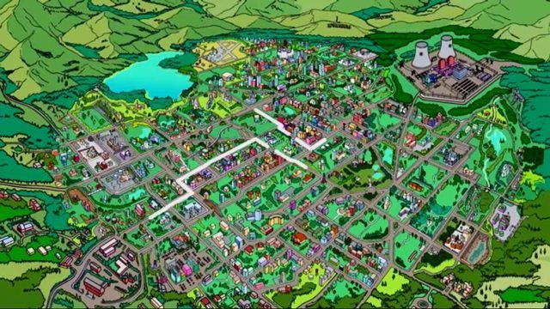
Another night slowly closes in

Slide 3
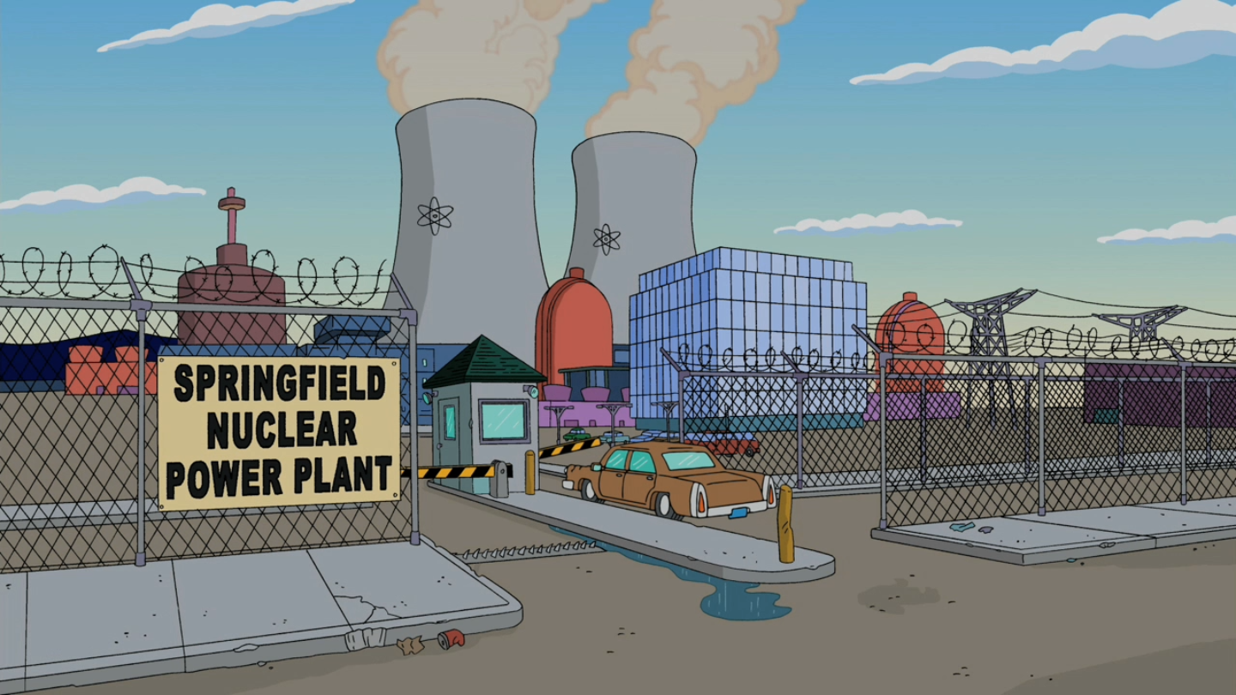
Im in too far, Im in way too deep over you

Slide 4
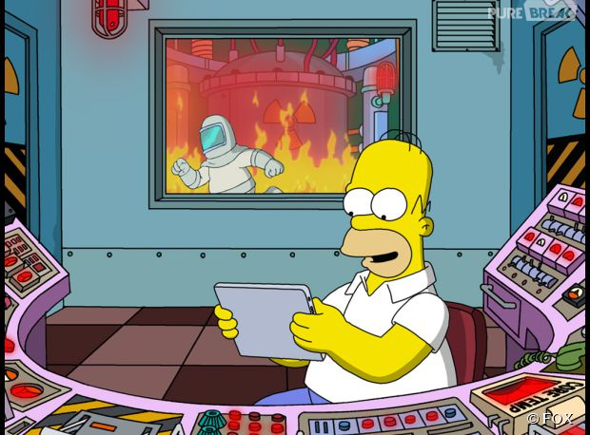
Remember: after the fire, after all the rain

Slide 5
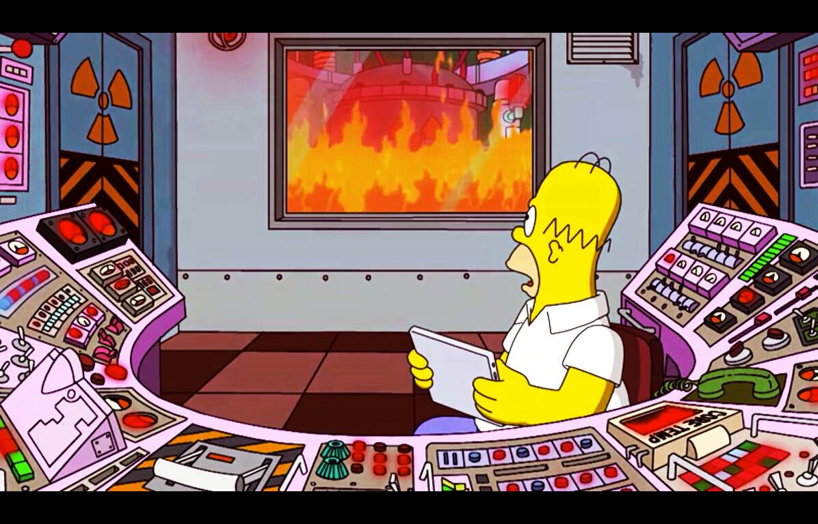
I will be the flame. I will be the flame.

Slide 6
Watching shadows move across the wall,
I feel so frightened.

Slide 7
I wanna run to you, I wanna call,
But Ive been hit by lightening

Slide 8
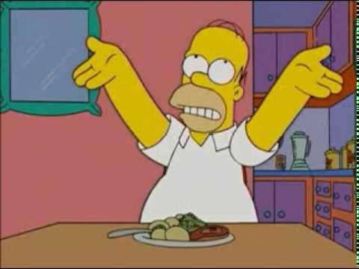
Just cant stand up for fallin apart.
Cant see through this veil across my heart, over you.

Slide 9
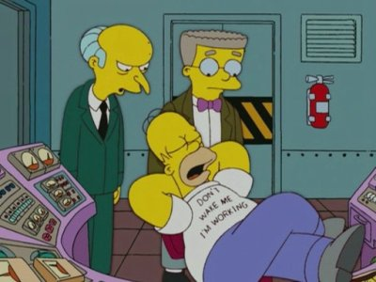
Wherever you go, Ill be with you.
Whatever you want, Ill give it to you.
Whenever you need someone to lay your heart and head upon.

Slide 10
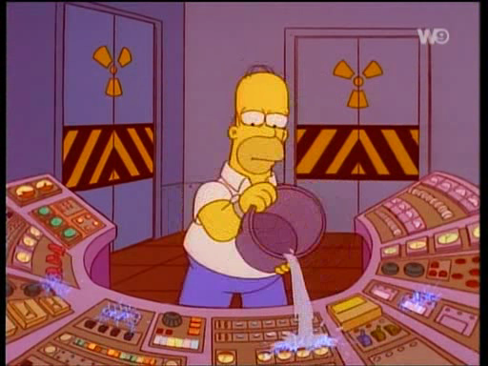
Im going crazy, Im losing sleep.
Im in too far, Im in way too deep over you.
Youll always be the one.
You were the first, youll be the last.

Slide 11
Whatever you want, Ill give it to you.
Wherever you go, Ill be with you.
And whatever you want, Ill give it to you.

