Slide 1
BD fait par :Marc-Olivier Drouin

Slide 2
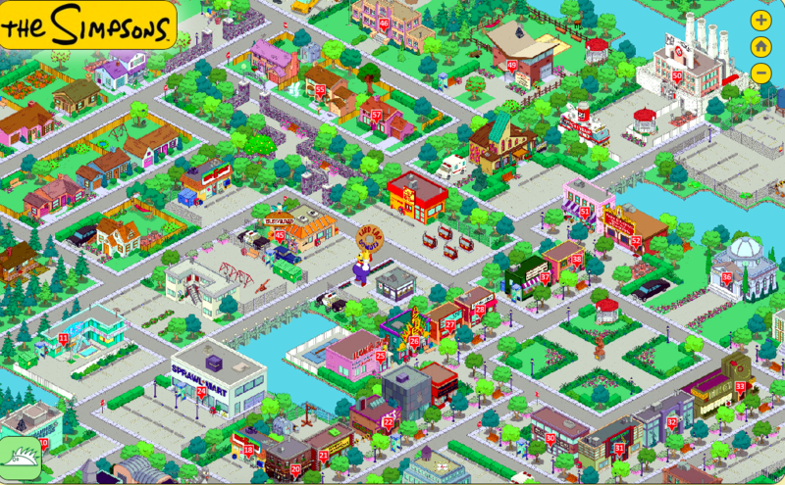
Ricky was a young boy, He had a heart of stone.

Slide 3
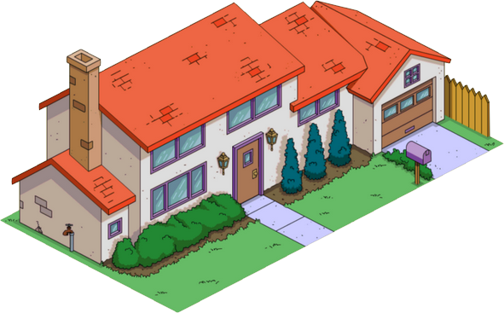
Lived 9 to 5 and worked his fingers to the bone.

Slide 4
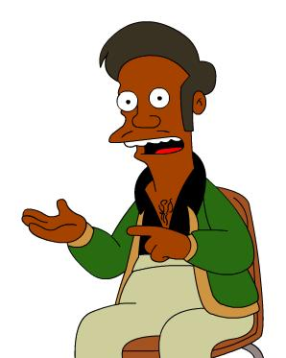
Just barely got out of school, came from the edge of town

Slide 5
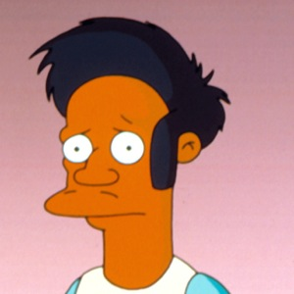
Fought like a switchblade so no one could take him down.

Slide 6
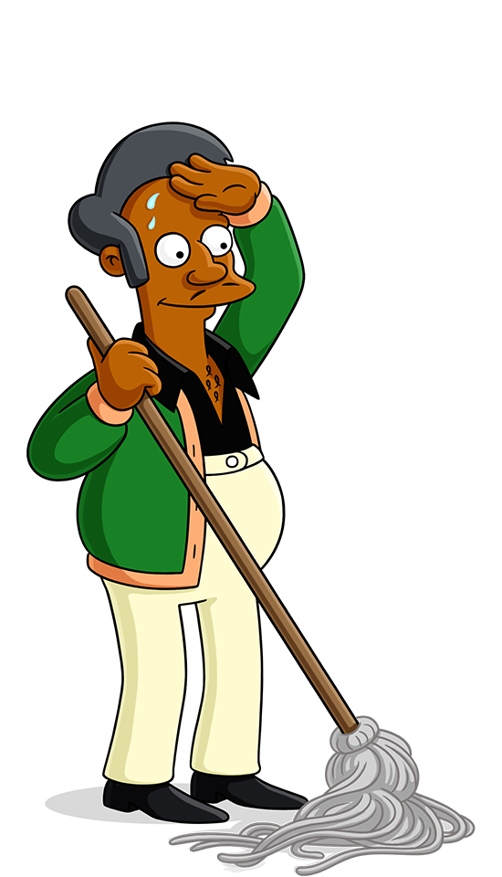
He had no money, oooh no good at home.

Slide 7
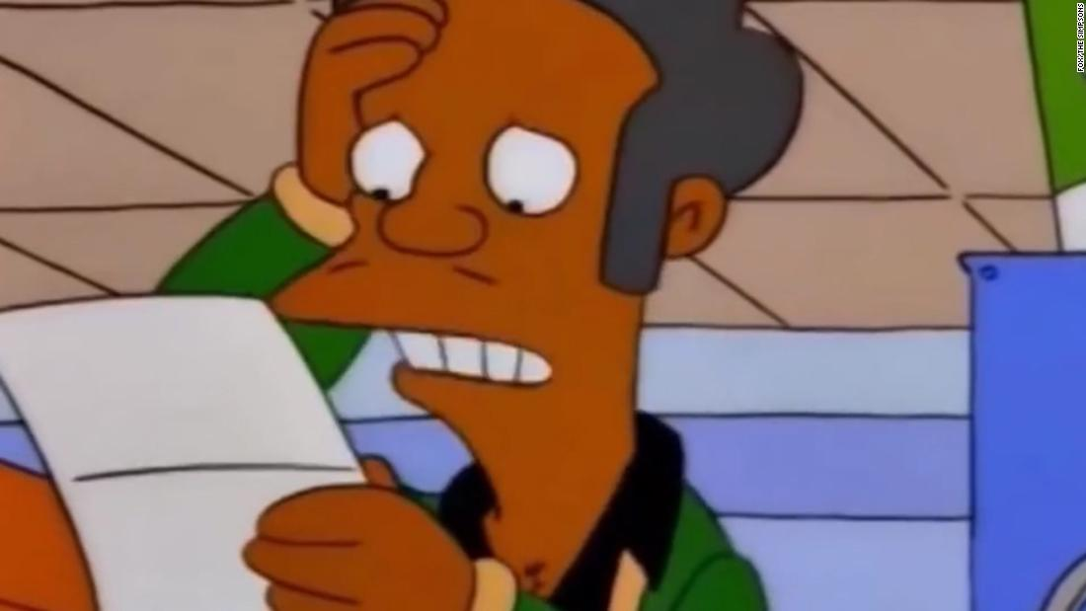
He walked the streets a soldier and he fought the world alone

Slide 8
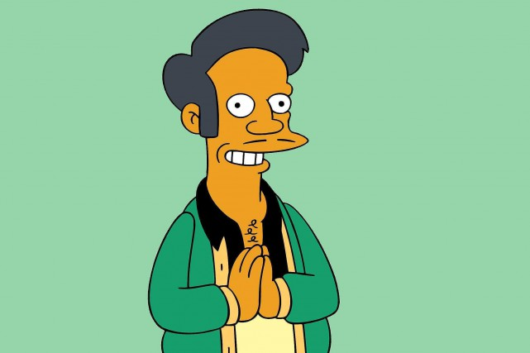
And now it's

Slide 9
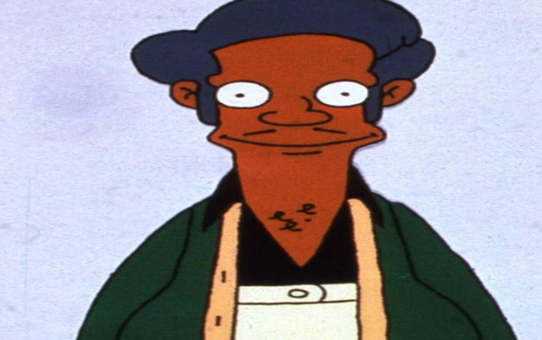
18 and life You got it

Slide 10
18 and life you know

