Slide 1
Marie Curie
By: Anna, Sandrine and Noémie

Slide 2
She’s born Maria Salomea Skłodowska, November 7th, 1867, in Warsaw.
She discovered the radium and polonium.
She developed mobile radiography units to provide X-ray services to fields hospitals, during world War 1.

Slide 3
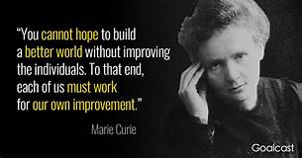
Quote

Slide 4
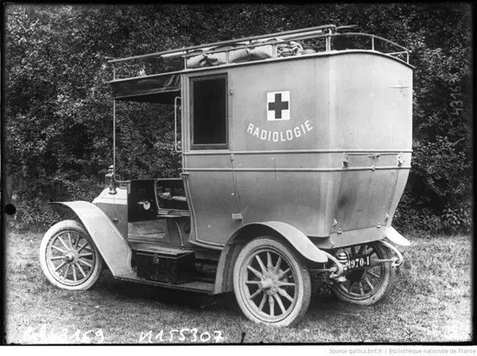
Impact of this creator nowadays
At the start of the war, X-ray machines were still found only in city hospitals, far from the battlefields where wounded troops were being treated. Curie’s solution was to invent the first “radiological car” – a vehicle containing an X-ray machine and photographic darkroom equipment – which could be driven right up to the battlefield where army surgeons could use X-rays to guide their surgeries.
One major obstacle was the need for electrical power to produce the X-rays. Curie solved that problem by incorporating a dynamo – a type of electrical generator – into the car’s design. The petroleum-powered car engine could thus provide the required electricity.

Slide 5
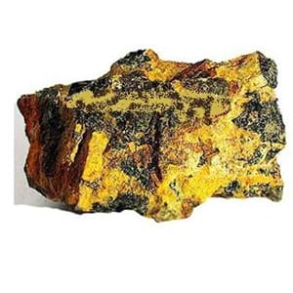
after
Marie’s pioneering work of the effects of radium on living organisms showed it could damage tissue, and this discovery was put to use against cancer and other diseases. She successful to warn the cancers and others.

Slide 6
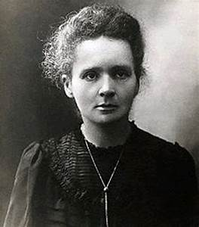
She is a Polish physicist and chemist, naturalized French.
she died July 4, 1934 Sancellemoz sanatorium located in Passy (Haute-Savoie, France)

