Slide 1
BD
Fait par: Noémie Fortier

Slide 2
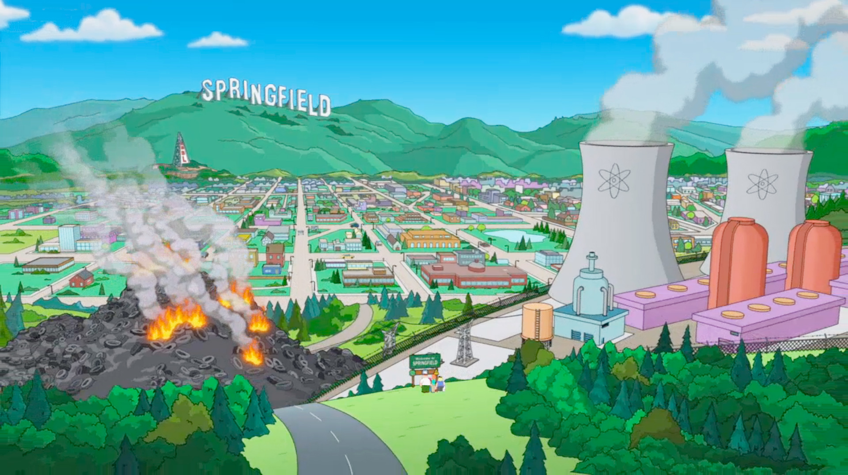
Well East coast girls are hip

Slide 3
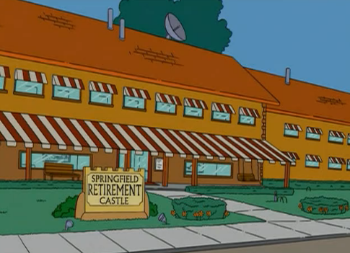
I really dig those styles they wear

Slide 4
The Mid-West farmer's daughters really make you feel alright

Slide 5
And the Northern girls with the way they kiss

Slide 6
I wish they all could be California

Slide 7
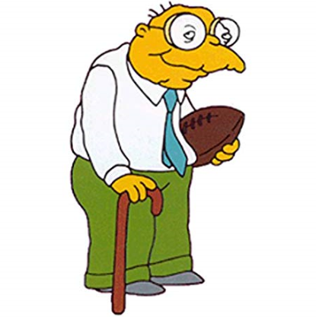
The West coast has the sunshine

Slide 8
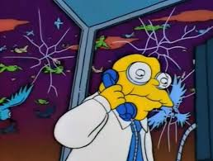
And the girls all get so tanned

Slide 9
I been all around this great big world And I seen all kinds of girls

Slide 10
I wish they all could be California

Slide 11
I wish they all could be California (Girls, girls, girls yeah I dig the)

