Slide 1
BD
fait par: Rémi Côté

Slide 2
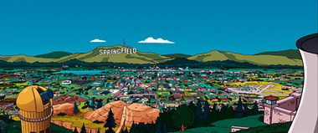
You run, run...run away

Slide 3
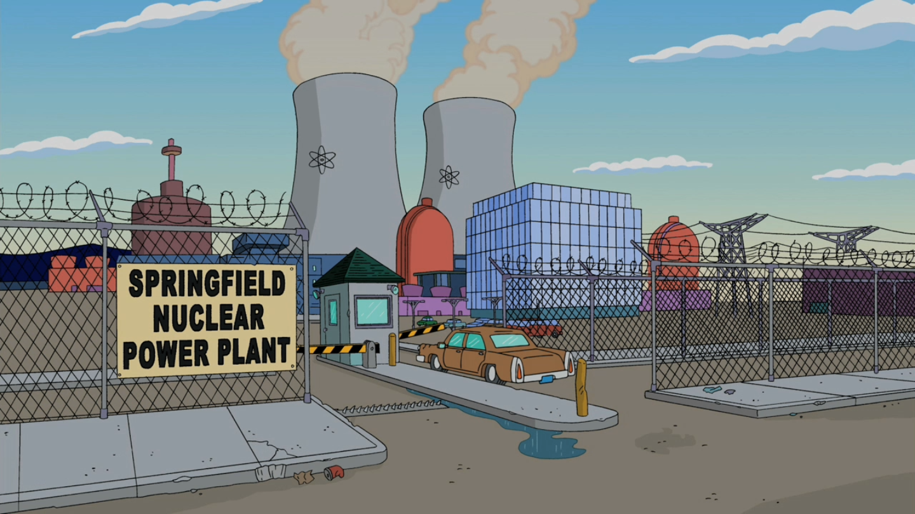
And follow me, stereo jungle child

Slide 4
Shootin' at the walls of heartache, bang, bang, I am the warrior

Slide 5
Well I am the warrior, and heart to heart you'll win..if you survive

Slide 6
Your eyes touch me physically

Slide 7
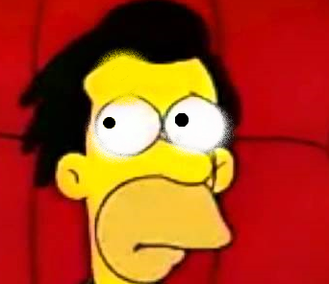
you won't be caged...in the call of the wild....

Slide 8
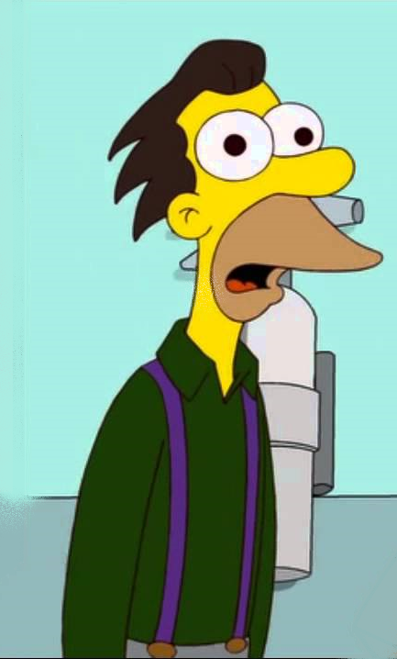
The warrior...the warrior

Slide 9
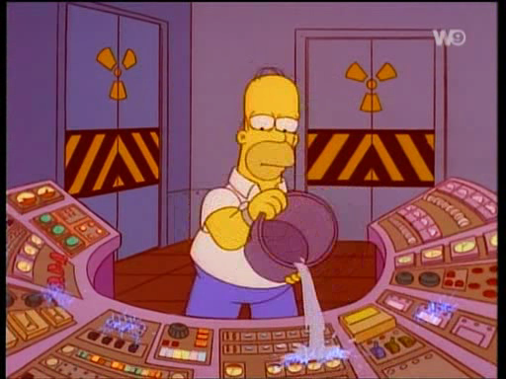
I feel the beat...call your name

Slide 10
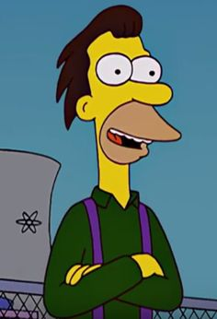
Who's the hunter...who's the game?

Slide 11
As passion takes another bite

