Slide 1
Bd
FAIT PAR WILLIAM LATULIPPE

Slide 2
It's my life

Slide 3
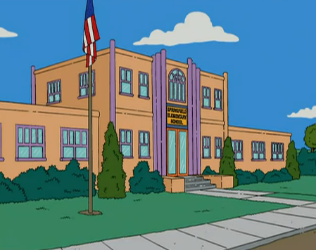
Don't bend, don't break, hell, don't back down

Slide 4
I did it my way I just wanna live while I'm alive

Slide 5
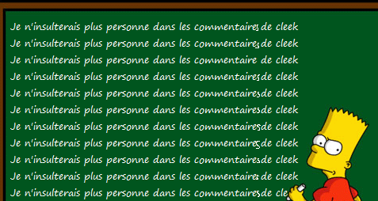
This is for the ones who stood their ground

Slide 6
This ain't a song for the broken-hearted

Slide 7
I did it my way

Slide 8
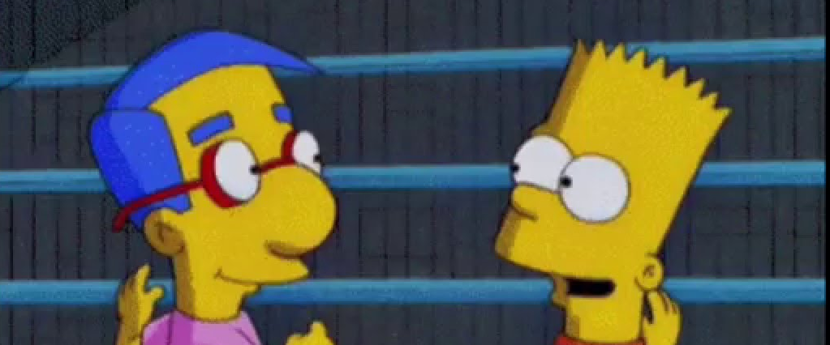
I just want to live while I'm alive

Slide 9
For a smile they can share the night

Slide 10
It goes on and on and on and on

Slide 11
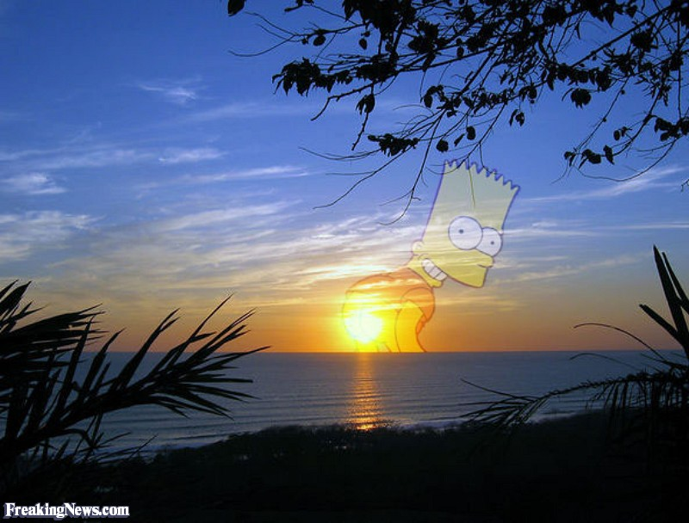
Hiding, somewhere in the night

