Slide 1
Projet G fait par Denis Proulx

Slide 2
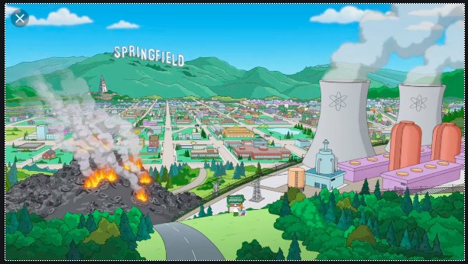
Every breath you take

Slide 3
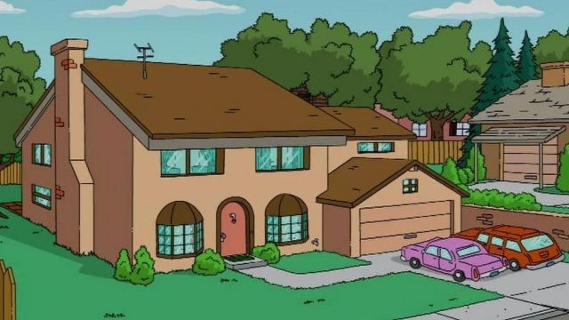
Every move you make

Slide 4
Every bond you break

Slide 5
I’ll be watching you

Slide 6
Every single day

Slide 7
Every word you say

Slide 8
Every game you play

Slide 9
Every night you stay

Slide 10
I’ll be watching you

Slide 11
O you can’t see me

Slide 12
You belong to me

