Slide 1
Projet G
Science
Présenté à :
Daniel Blais
Par : Anthony Cloutier
MSI 2
ESV
13 Novembre 2020

Slide 2
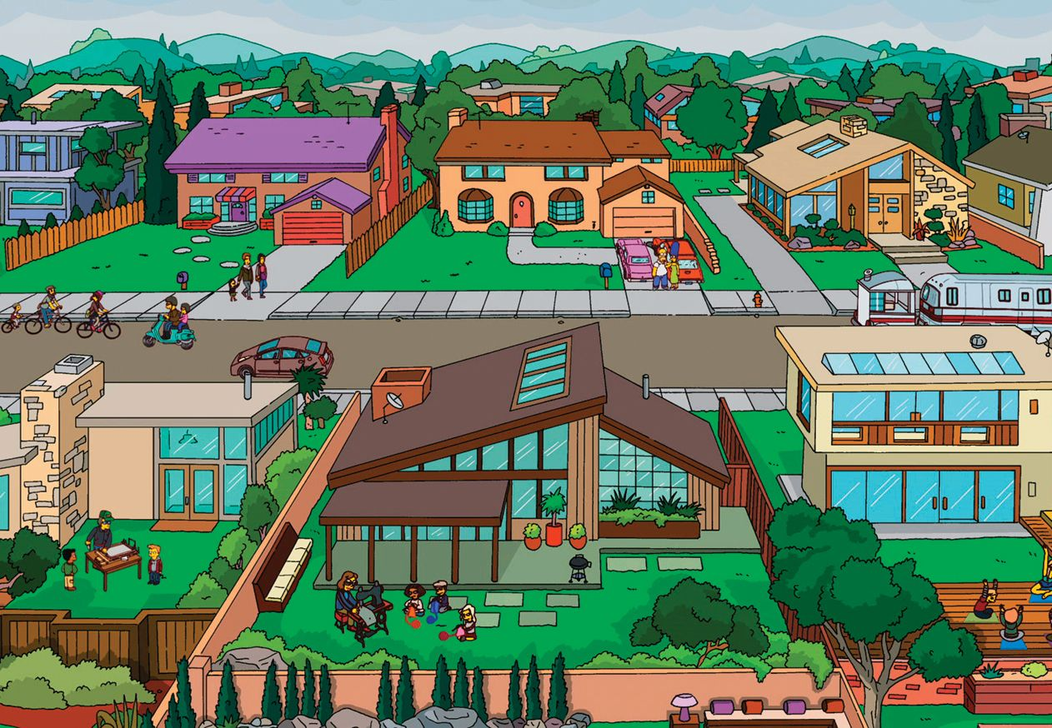
Just a small town girl, living in a lonely world

Slide 3
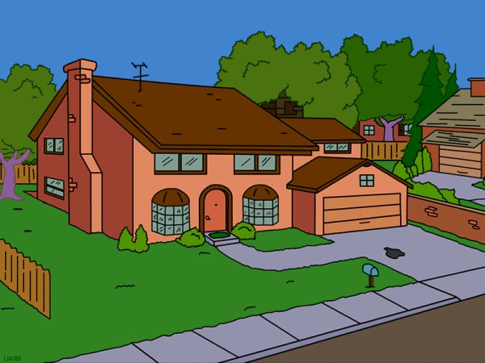
Strangers waiting, up and down the boulevard

Slide 4
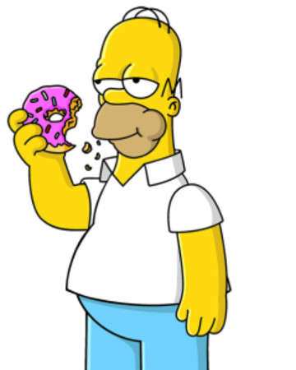
Just a city boy, born and raised in south detroit

Slide 5
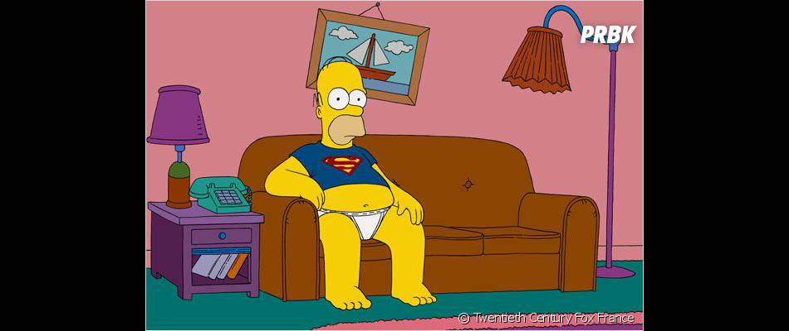
Some will win, some will lose

Slide 6
Hold on to the feeling

Slide 7
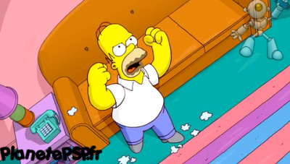
Oh, the movie never end

Slide 8
Hold on to the feelin

Slide 9
Hiding, somewhere in the night

Slide 10
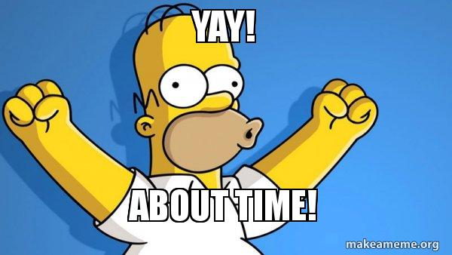
Working hard to get my fill

Slide 11
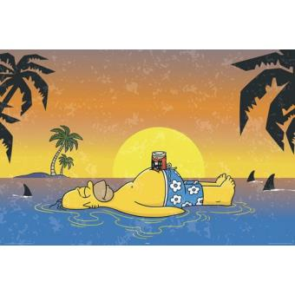
Don’t stop believen

