Slide 1
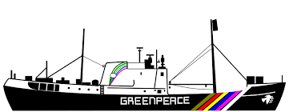
3.Were a fighter for peace-without a weapon in your hand 4.white lion 5.rainbow warrior 6.explosion du bateau 7.service secret 8.la France 9. la mort d’un photographe 10.nouvelle Zélande 11.francois Mitterrand

