Slide 1
StoryBoard
Science
Présenté à:
Daniel Blais
Fait Par: Dylan Turcotte
MSI 2
Esv
13 Novembre 2020

Slide 2
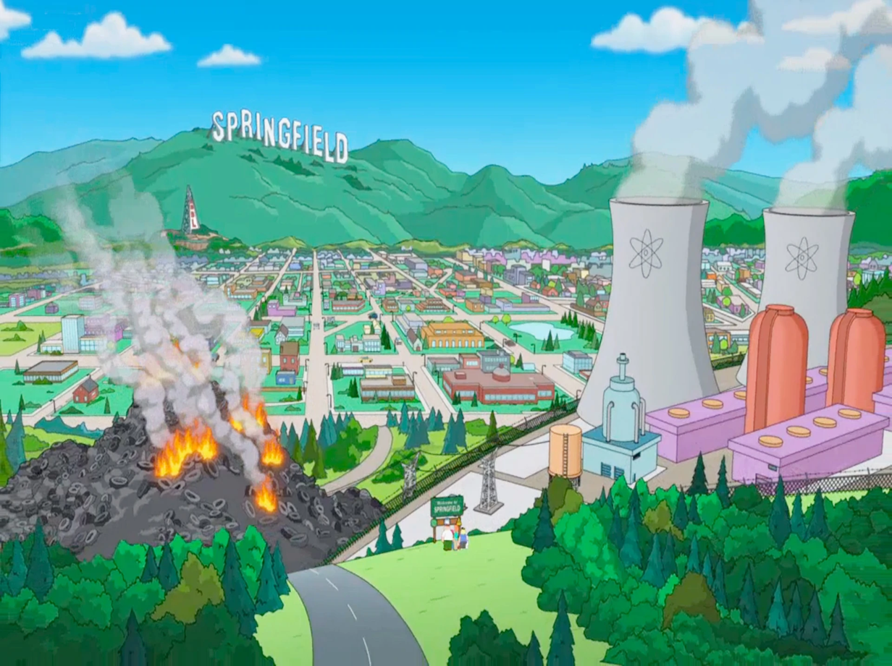
Just a small town girl, livin in a lonely world

Slide 3
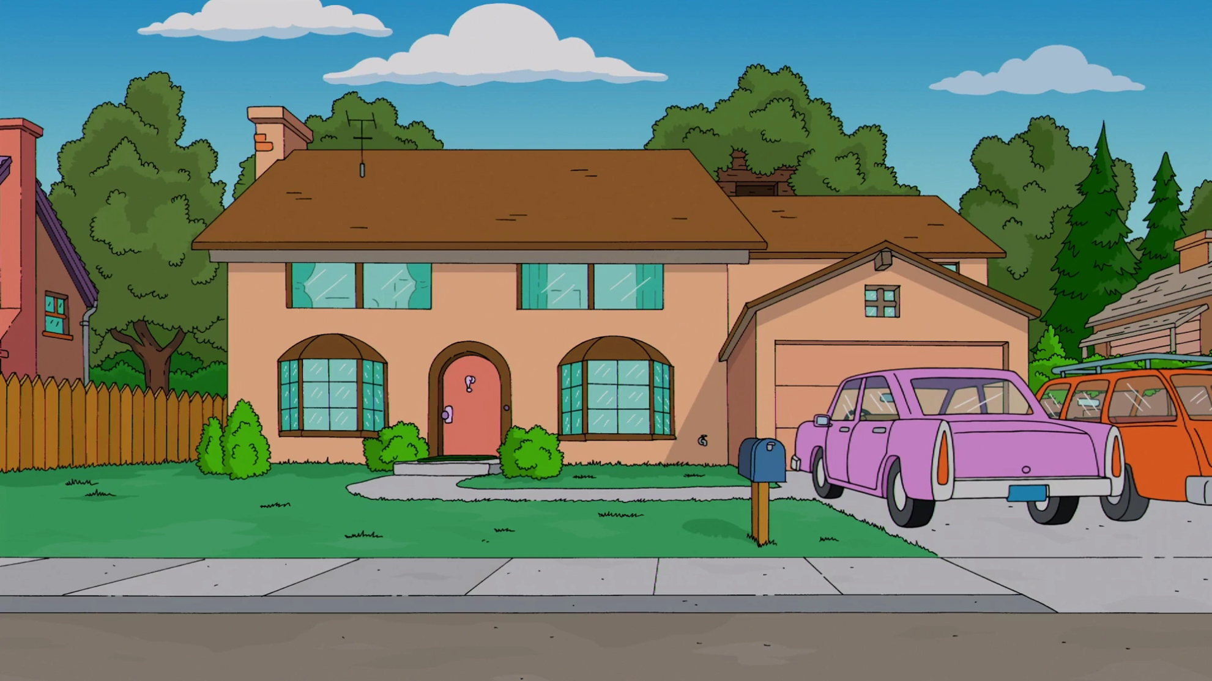
Strangers waiting, up and down the boulevard

Slide 4
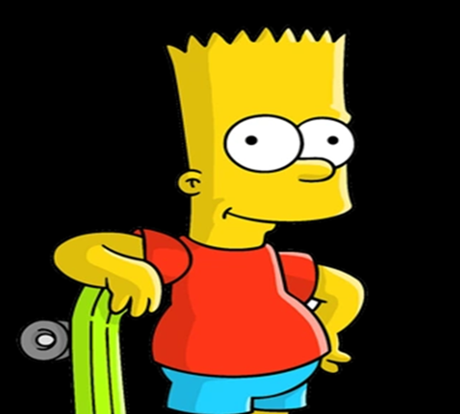
Just a city boy

Slide 5
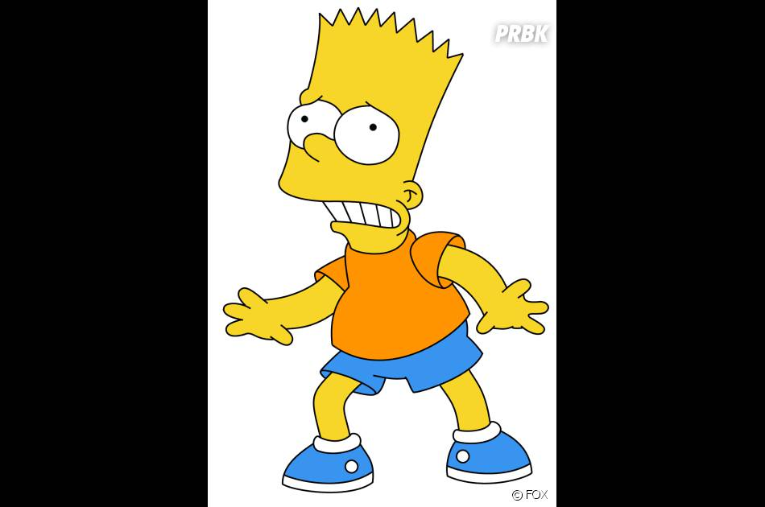
Some will win, some will lose

Slide 6
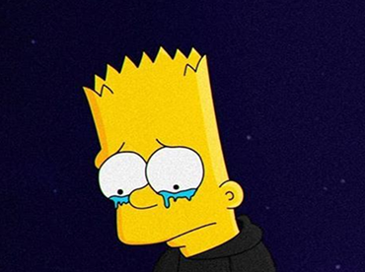
Hold on to the feelin

Slide 7
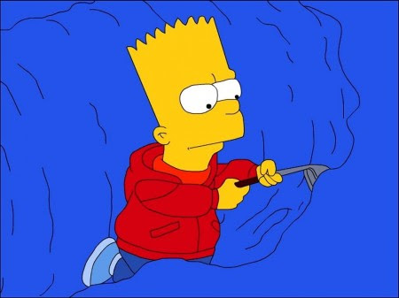
Working hard to get my fill,

Slide 8
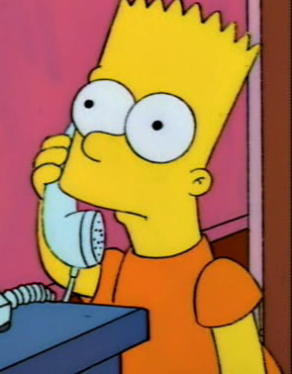
Hiding, somewhere in the night

Slide 9
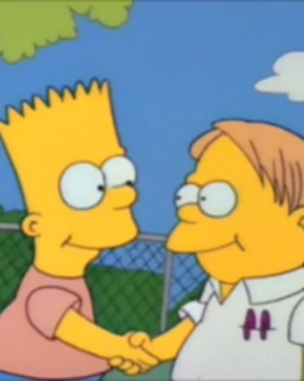
Hold on to the feelin

Slide 10
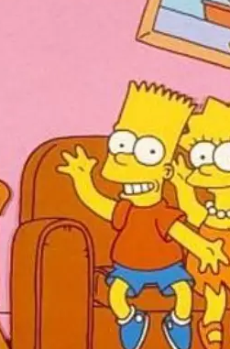
For a smile they can share the night

Slide 11
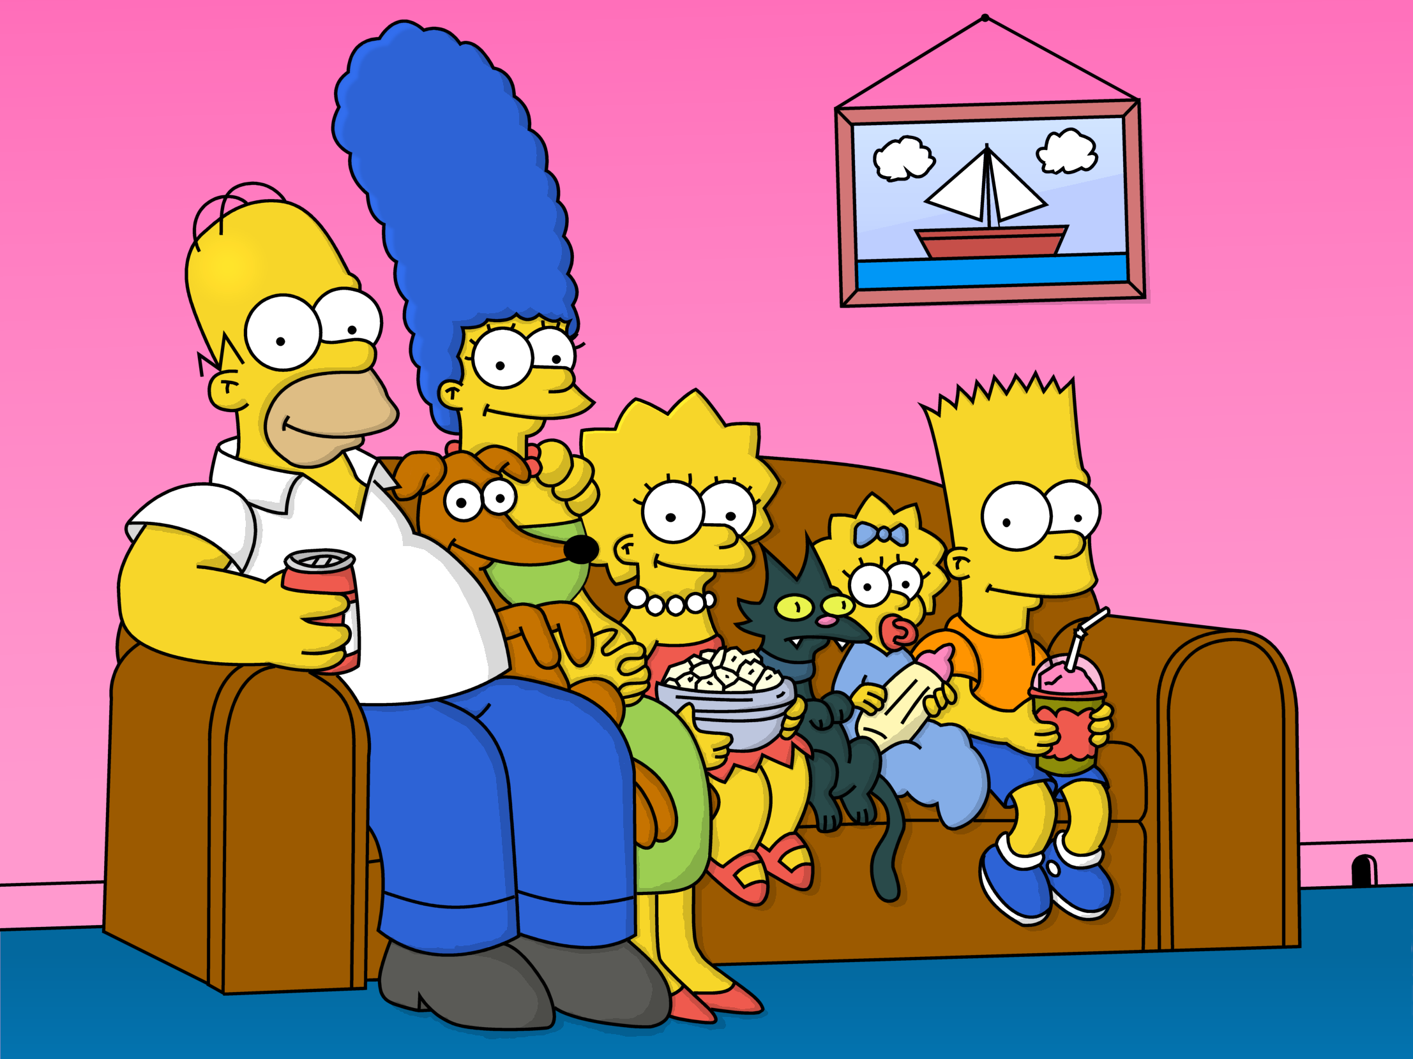
For a smile they can share the night

