Slide 1
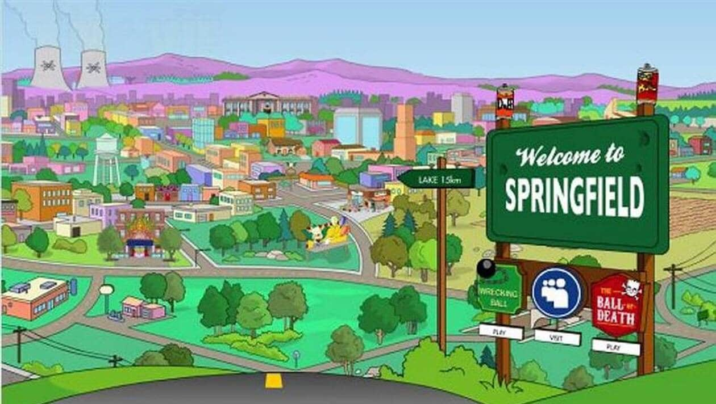
Just a small town girl, livin in a lonely world

Slide 2
She took the midnight train goin anywhere

Slide 3
Just a city boy, born and raised in south detroit

Slide 4
He took the midnight train goin anywhere

Slide 5
A singer in a smokey room A smell of wine and cheap perfume

Slide 6
For a smile they can share the night It goes on and on and on and on

Slide 7
Strangers waiting, up and down the boulevard Their shadows searching in the night

Slide 8
Streetlight people, living just to find emotion Hiding, somewhere in the night

Slide 9
Working hard to get my fill, Everybody wants a thrill Payin anything to roll the dic

