Slide 1
Projet C
Jayke beauchemin
Litle fighter

Slide 2
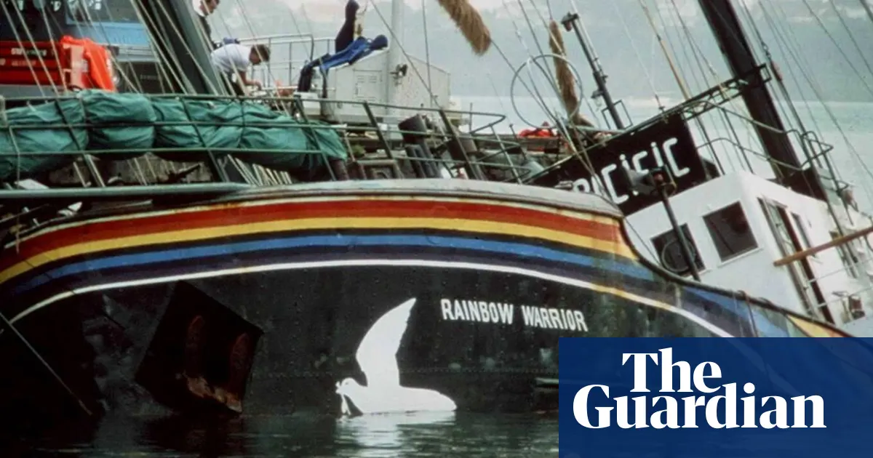
1: ALWAYS ALONE OUT ON THE SEA
2:FIGHTER FOR PEACE, HOUT A WEAPON IN YOUR HAND
3: White lion
4:Raimbow Warior
5: Green Peace
6:Explosion du bateau
7: Service Secret
8: France
9: Fernando
10:Nouvelle-Élande
11:Franciot Mitérant

