Slide 1
Storyboard Projet
Julien Perreault

Slide 2
Time after time -

Slide 3
I've done my sentence

Slide 4
But committed no crime

Slide 5
And we'll keep on fighting

Slide 9
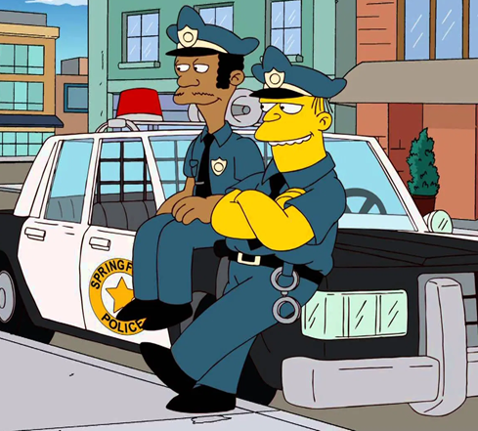
I thank you all

Slide 10
We are the champions

Slide 11
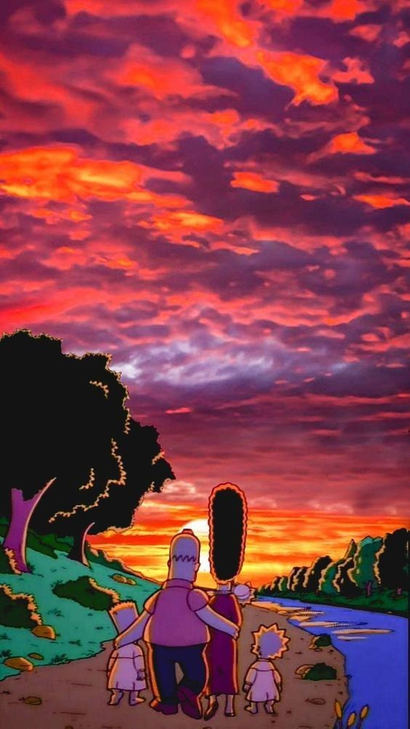
till the end

