Slide 1
Projet G storyboard
Fait par Kayla Maheu
2020-11-13

Slide 2
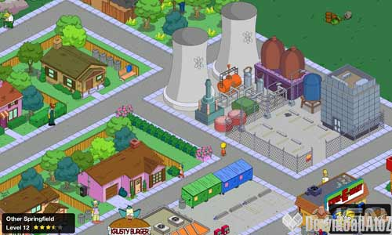
i love rock n roll

Slide 3
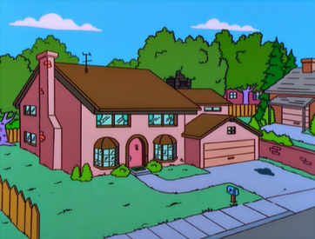
I saw him dancin there by the record machine

Slide 4
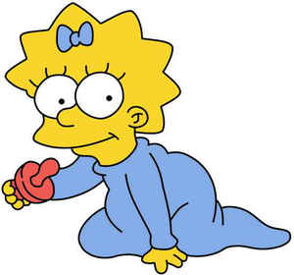
I knew he must a been about seventeen

Slide 5
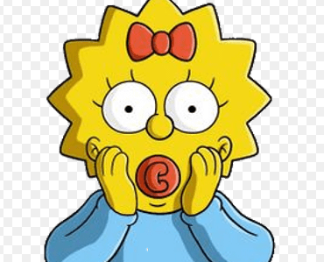
The beat was goin strong

Slide 6
Playin my favorite song

Slide 7
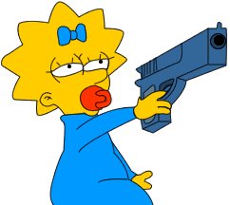
An I could tell it wouldnt be long

Slide 8
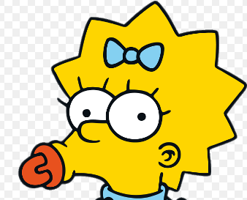
Till he was with me, yeah me, singin

Slide 9
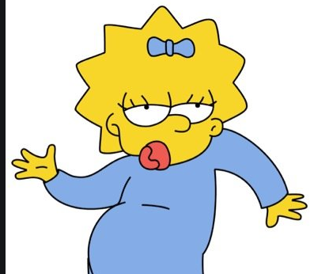
I love rock n roll

Slide 10
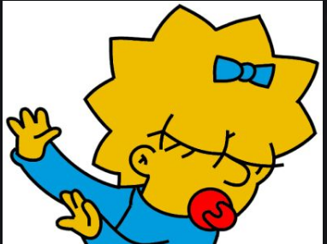
So put another dime in the jukebox, baby

Slide 11
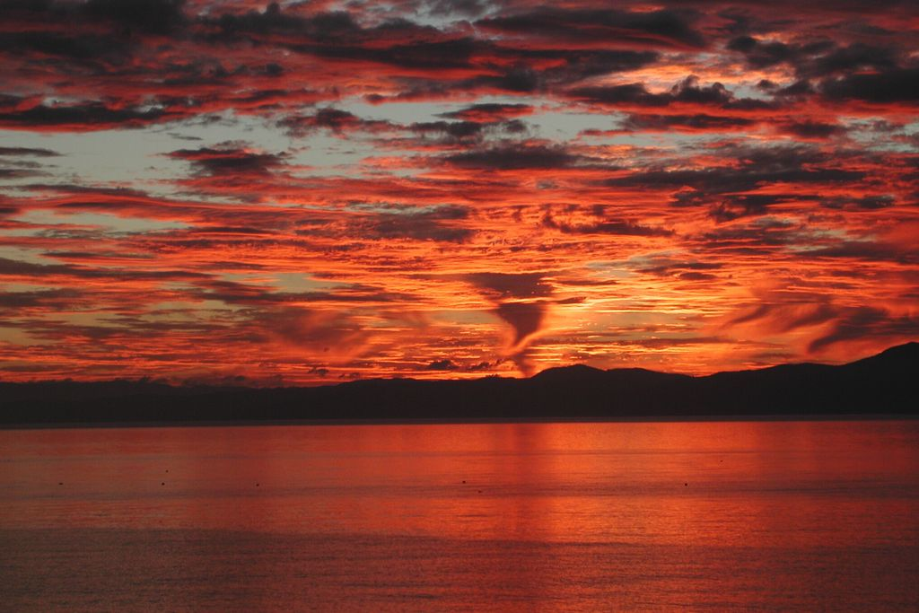
So come an take your time an dance with me

