Slide 1
A Dynamic and epic war game

Slide 2
A new era of destruction and plunder
Borderlands 2

Slide 3
The mission is to save pandora and kill the evil tyrant handsome jack
pandora
The handsome jack

Slide 4
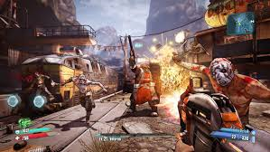
How it’s work ?
There are 3 game modes
One call (normal modes) the main story boss level is 32
the level of the enemies remains in this interval depending on the level of the player
if the player enters an area where the level is predetermined enemies is so much higher than his, the game will be more difficult
The second game mode is call (ultimate hunter) very difficult
And the third game mode is call (ultimate hunter 2) very very difficult

Slide 5
The strategies to succeed ??
Win experience to level up
How we do that??
You need to kill creature or do missions
When you kill creatures you gan exp depending if its a boss or simple monster finishing mission gave exp ans loot
Further you get harder it will be
That the skill screen

Slide 6
Character
He have 5 character
Zero is can be invisible for 5sec
Maya she made a portail
Axton he
Salvador he have a upgrade for is gun

Slide 7
Fin

