Slide 1
Storyboard
Fait par Lucas

Slide 2
I've paid my dues -
Time after time -

Slide 3
I've done my sentence But committed no crime

Slide 4
And bad mistakes I've made a few

Slide 5
I've had my share of sand kicked in my face But I've come through

Slide 6
We are the champions - my friends And we'll keep on fighting - till the end - We are the champions -

Slide 7
We are the champions No time for losers 'Cause we are the champions - of the world

Slide 8
I've taken my bows And my curtain calls

Slide 9
You brought me fame and fortuen and everything that goes with it - I thank you all -

Slide 10
But it's been no bed of roses No pleasure cruise

Slide 11
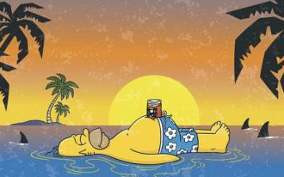
I consider it a challenge before the whole human race - And I ain't gonna lose - We are the champions - my friends And we'll keep on fighting - till the end - We are the champions - We are the champions No time for losers 'Cause we are the champions - of the world

