Slide 1
Projet g storyboard
Fait par Nathan Groleau

Slide 2
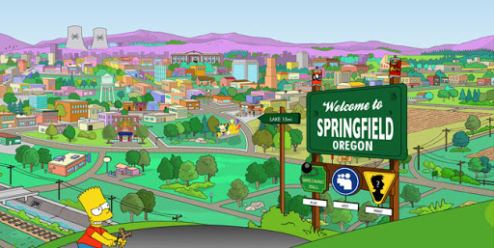
I've paid my dues -

Slide 3
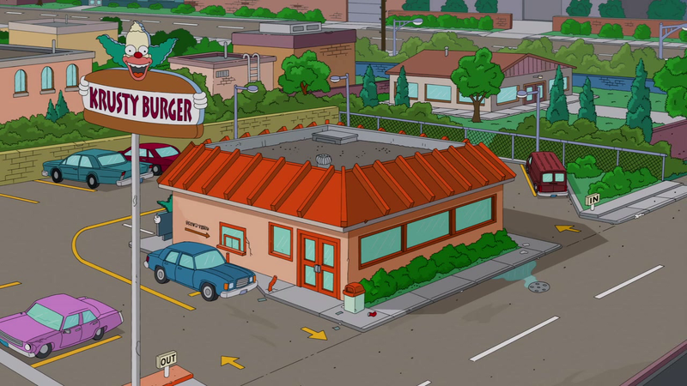
Time after time -

Slide 4
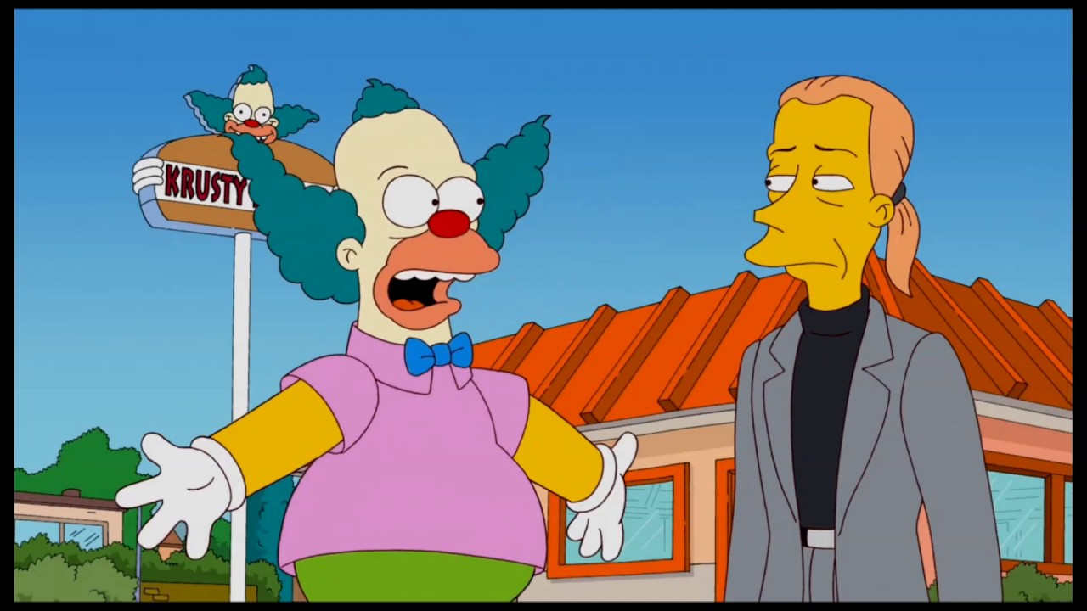
I've done my sentence

Slide 5
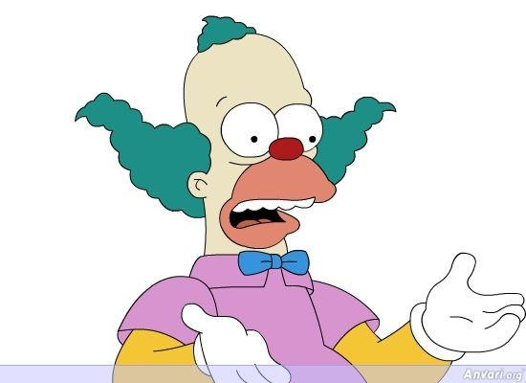
But committed no crime -

Slide 6
I've made a few

Slide 7
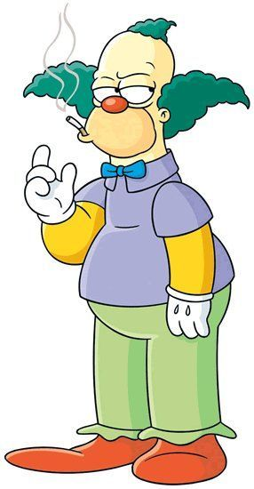
I've had my share of sand kicked in my face -

Slide 8
But I've come through

Slide 9
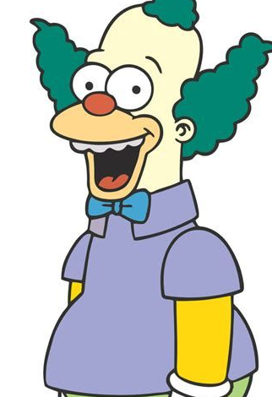
We are the champions - my friends

Slide 10
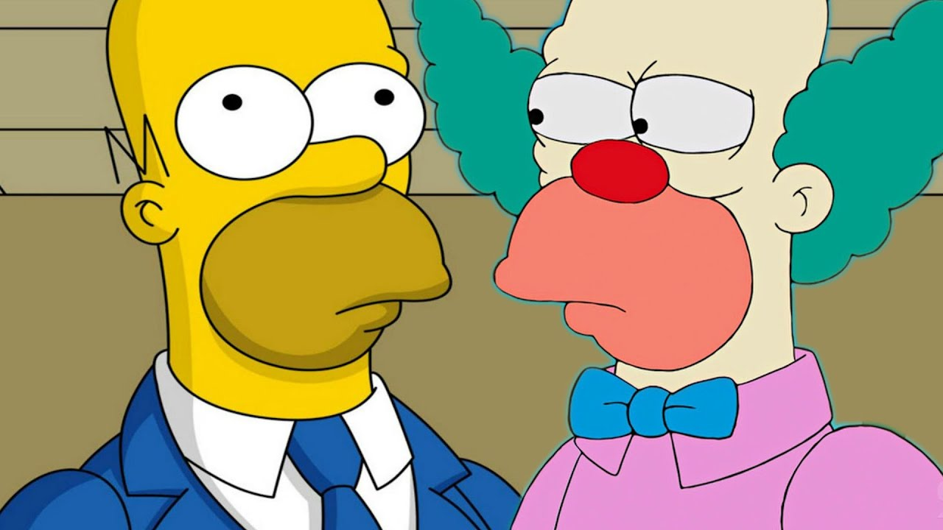
And we'll keep on fighting - till the end -

Slide 11
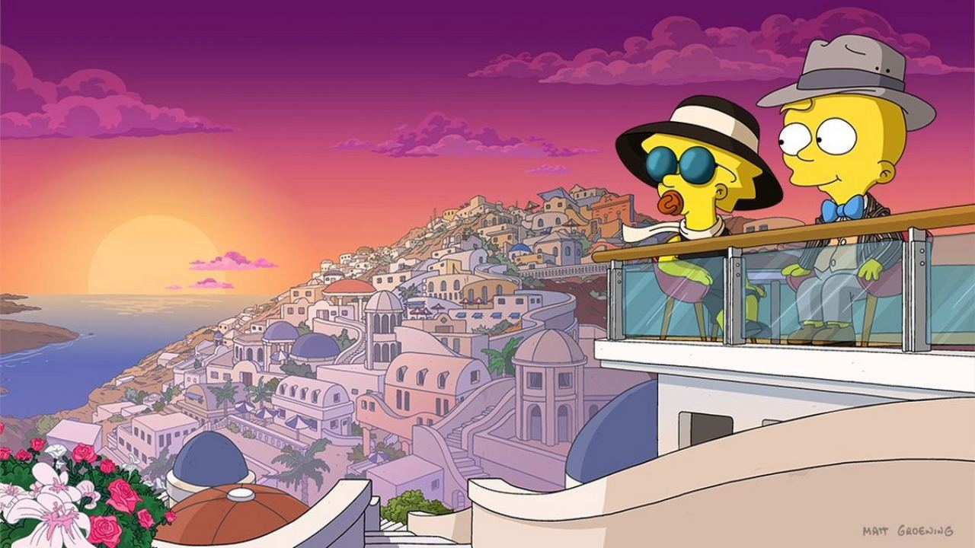
We are the champions -

