Slide 1
StoryBoard

Slide 2
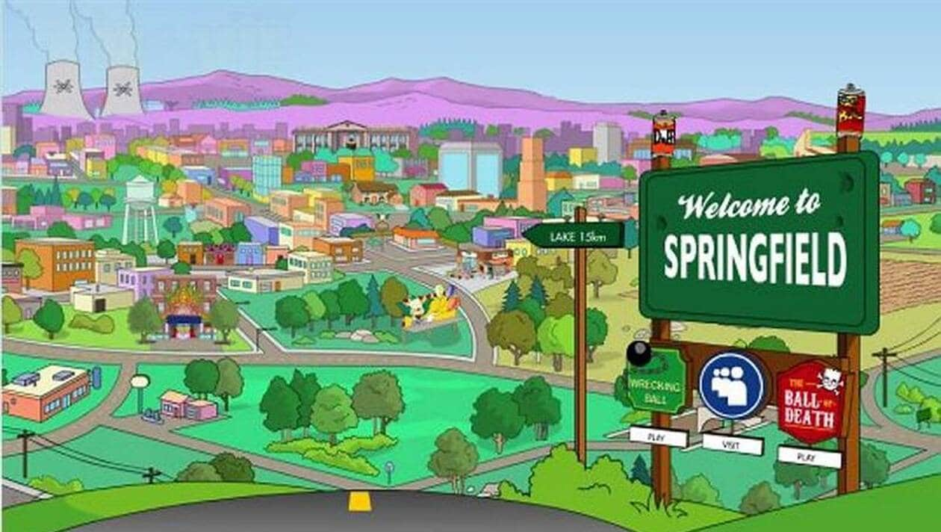
I've paid my dues - Time after time -

Slide 3
But committed no crime - And bad mistakes

Slide 4
But I've come through

Slide 5
And we'll keep on fighting

Slide 6
No time for losers

Slide 7
I thank you all -

Slide 8
And we'll keep on fighting

Slide 9
We are the champions

Slide 10
I consider it a challenge before the whole human race

Slide 11
Cause we are the champions - of the world

