Slide 1
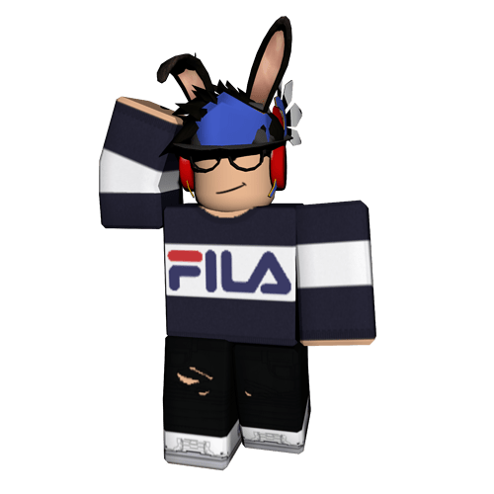
Roblox.

Slide 2
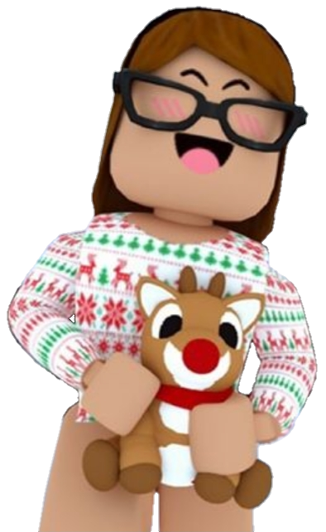
What’s roblox?
A game plateform w/ differents kinds of games.
Very peaceful place. (Enjoy your time.)

Slide 3
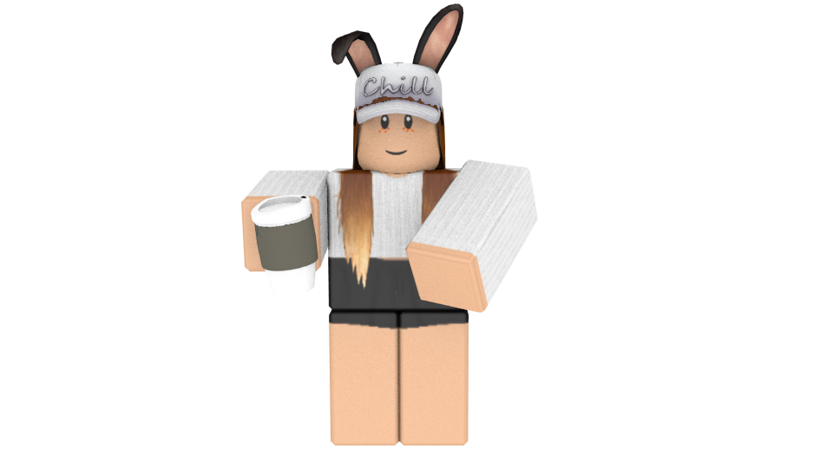
What to do on roblox?
Create your own games! (Roblox Studio.)
Play with friends!
Create your own avatar!
Buy gamepasses!
A lot more!

Slide 4
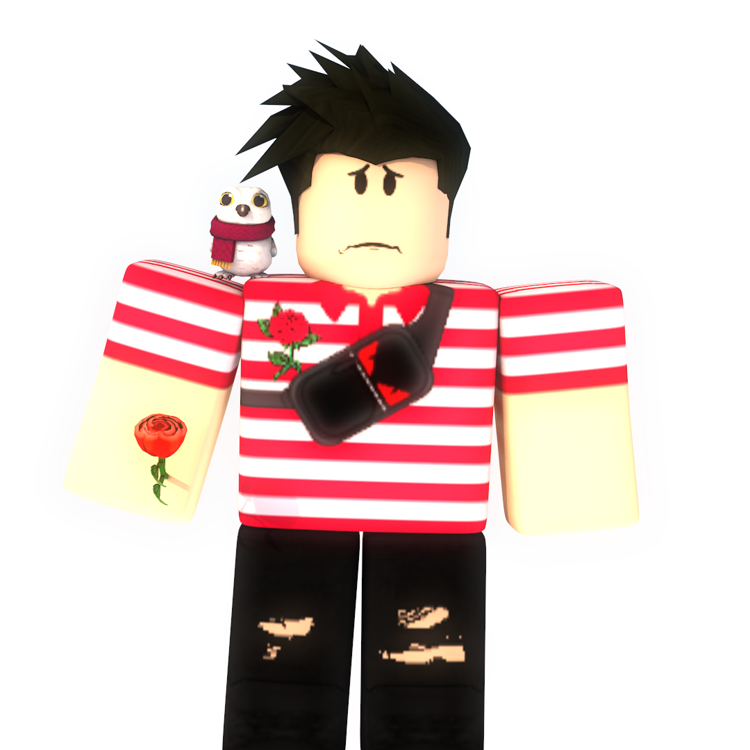
Roblox money?
Robux.
PRICES?
6,49$ = 400R$ (Premium -> 450R$/month.)
12,99$ = 800R$ (Premium -> 1000R$/month.)
25,99$ = 1700R$ (Premium -> 2200R$/month.)
Giftcard! (Give friends.)

