Slide 1
Hey guy
Today im gonna talk about my favorite game in this month

Slide 2
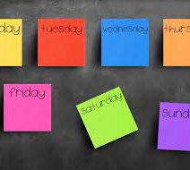
How many time I play in a week
I play MX 2,3,5 times a week so every tme a play I game for like 1 or 2 hours

Slide 3
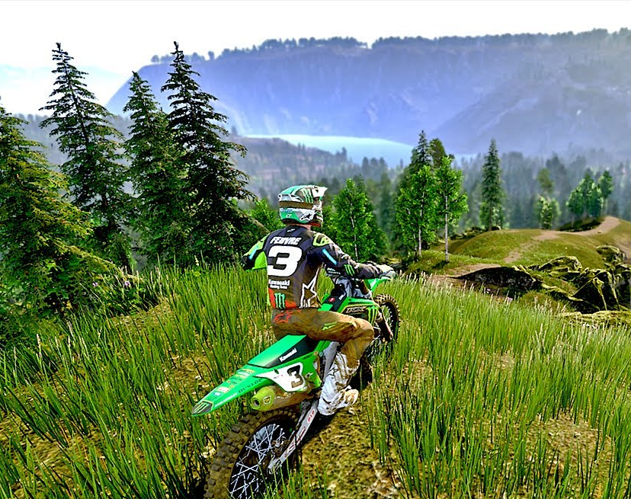
All the things im going to tell you about the game
How to whip like a boss
The best way to earn money
And the first sponsor I choose in the game
the bad point and the good points

Slide 4
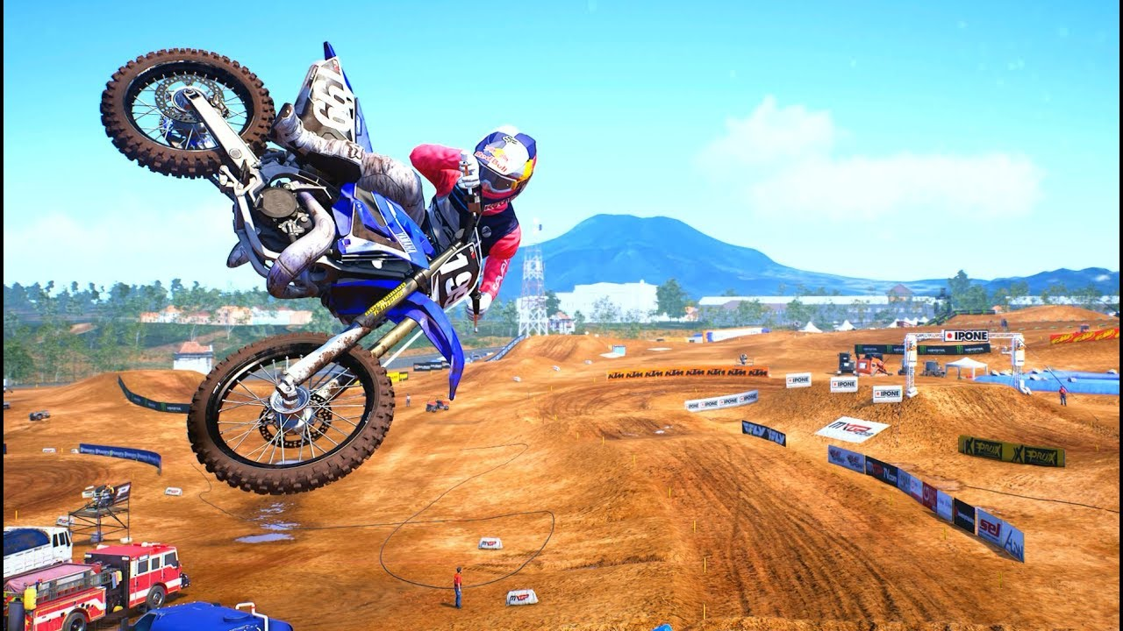
How to whip like a boss
My tips to whip perfectly are to turn your left stick to the right
And the right stick downside

Slide 5
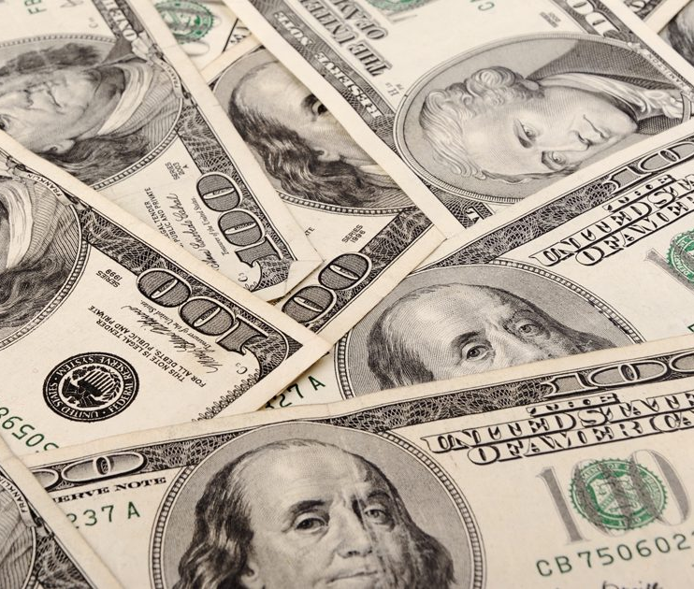
The best way you can make money in MX
If you want your nike and don’t have enough money here I teach you how to make big amount of money rapidly
So you can buy any bikes you want
The tips is to go in fast mode – race against time – click on the cloud and scroll untill you see fast credit

Slide 6
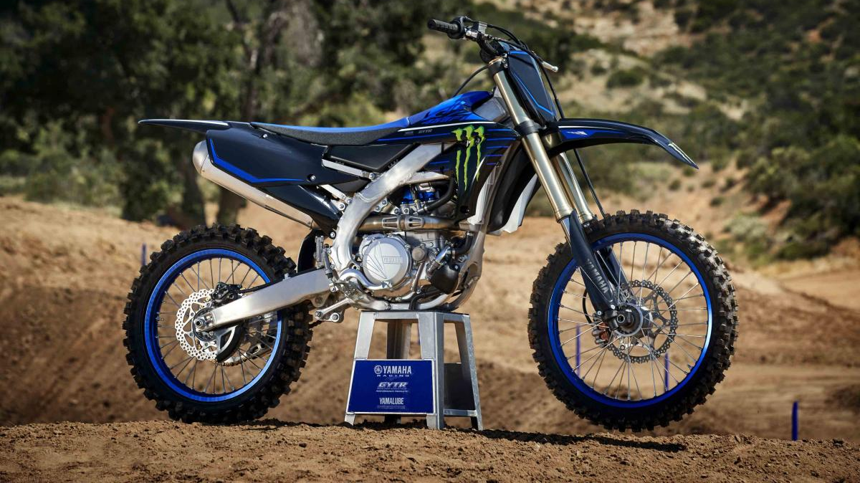
sponsor
I would recommend you for your first race the monster energy yamaha 250 f

Slide 7
The bad point
The bad point is that the game is a little hard and the race are too long

Slide 8
The good points
The game as hight quality physic
And it as many bikes and they all exist in real life

