Slide 1
Storyboard fait par Benjamin

Slide 2
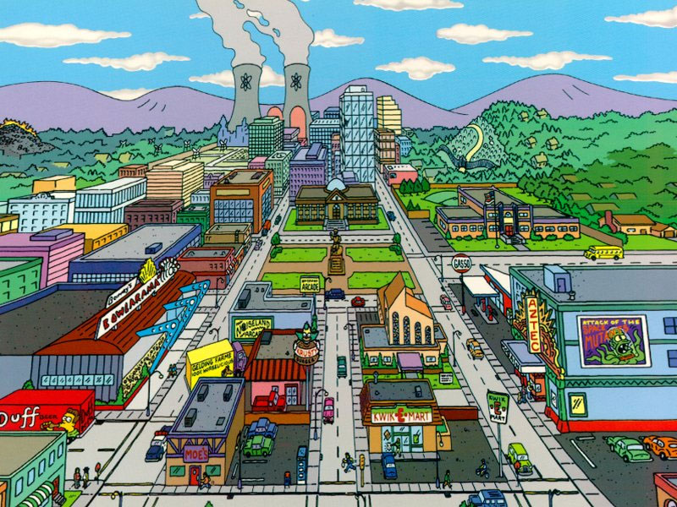
If I Could Turn Back Time

Slide 3
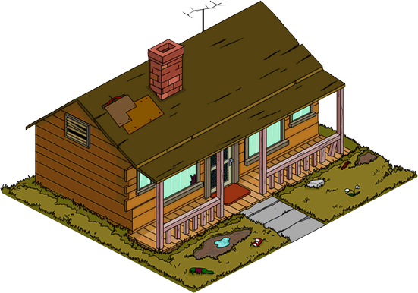
If I could find a way I'd take back those words that hurt you and you'd stay

Slide 4
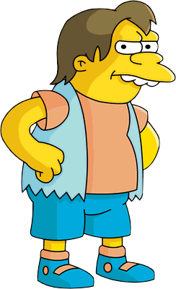
I didn't really mean to hurt you I didn't wanna see you go I know I made you cry, but baby

Slide 5
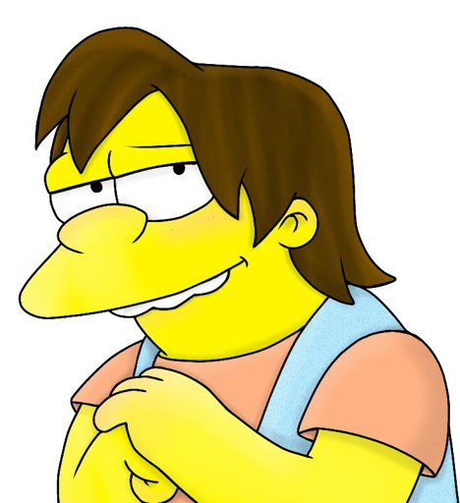
I'd take back those words that hurt you

Slide 6
Then you'd love me, love me

Slide 7
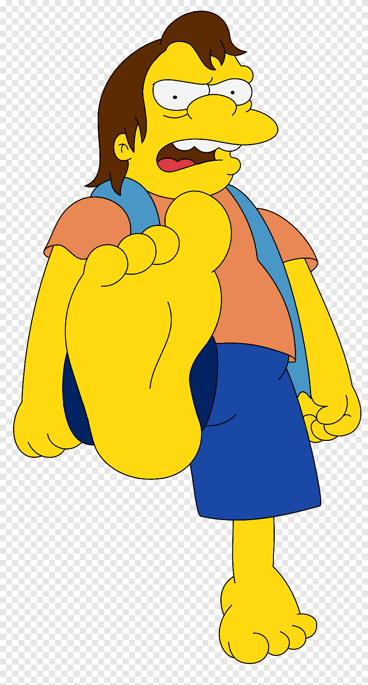
My world was shattered I was torn apart

Slide 8
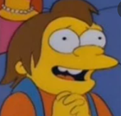
You walked out that door I swore that I didn't care

Slide 9
Too strong to tell you I was sorry

Slide 10
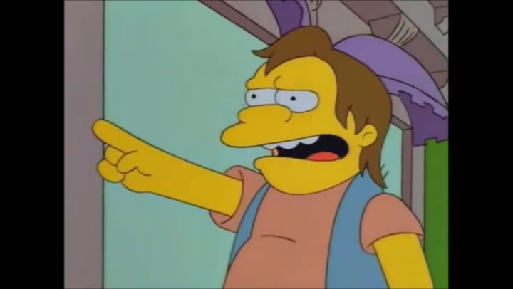
I know that I was blind, and ooh...

Slide 11
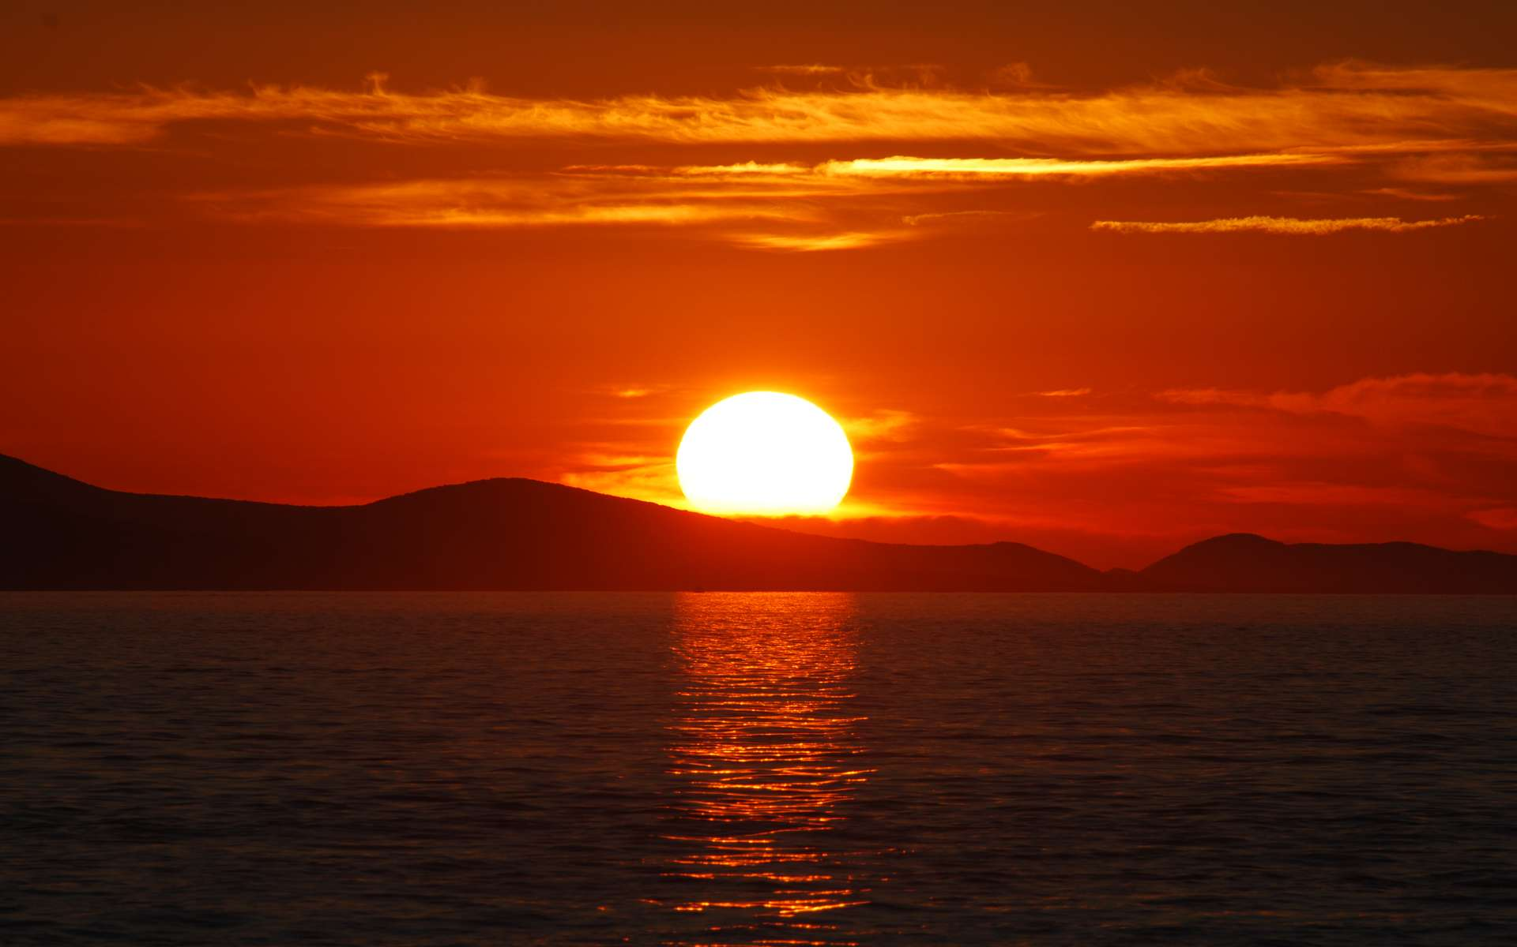
If I could reach the stars

