Slide 1
Storyboard
Fait par Charles-Antoine Bilodeau

Slide 2
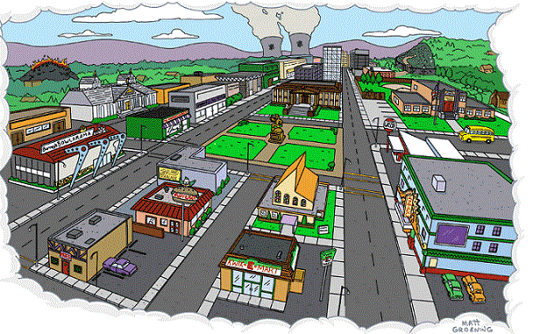
The flame

Slide 3
Another night slowly closes in, And I feel so lonely.

Slide 4
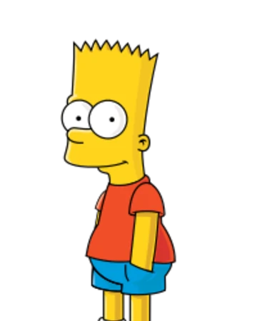
Touching heat freezing on my skin, I pretend you still hold me.

Slide 5
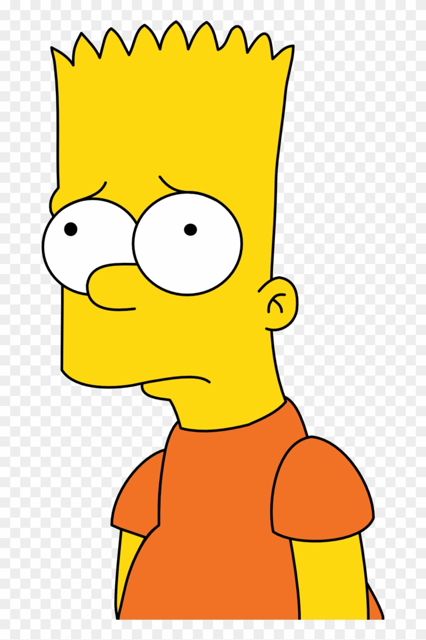
Im going crazy, Im losing sleep.

Slide 6
Im in too far, Im in way too deep over you.

Slide 7
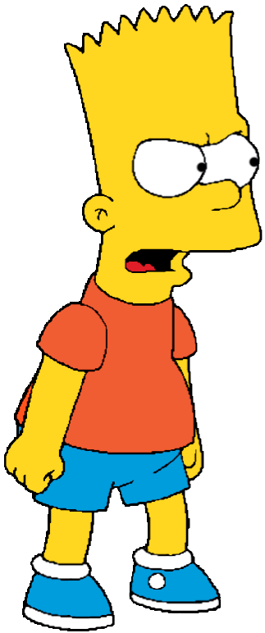
I cant believe youre gone.

Slide 8
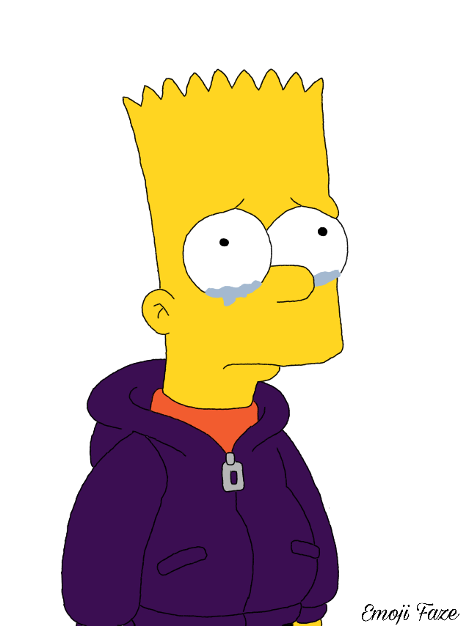
You were the first, youll be the last.

Slide 9
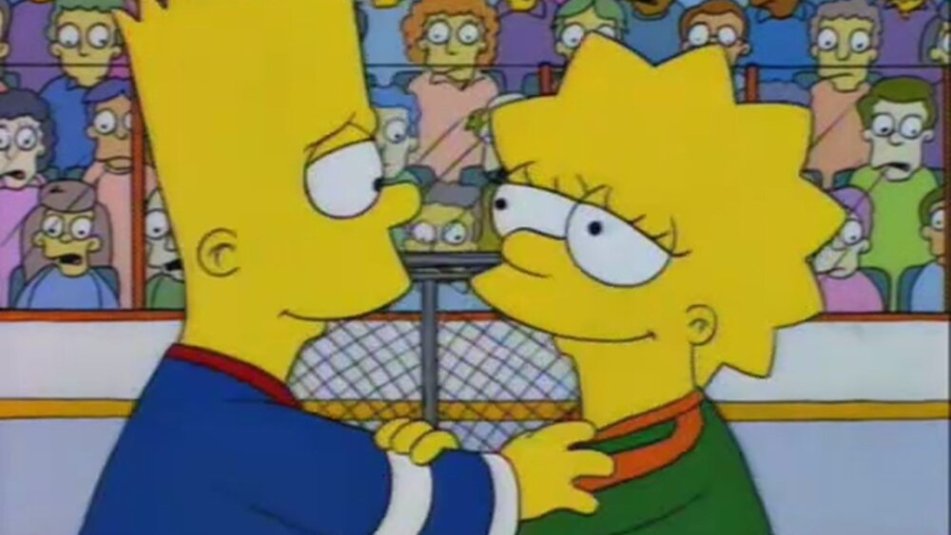
Wherever you go, Ill be with you.

Slide 10
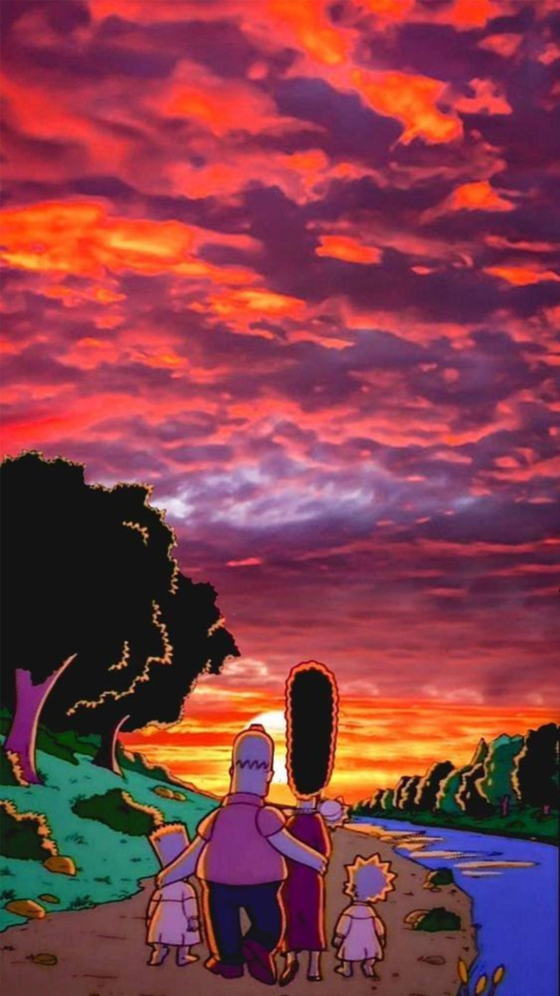
Whatever you want, Ill give it to you.

