Slide 1
Story board fait par Émile Leblanc

Slide 2
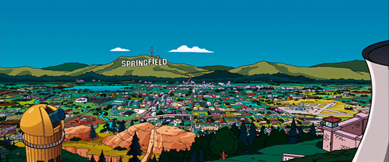
We are the Champions (Queen)

Slide 3
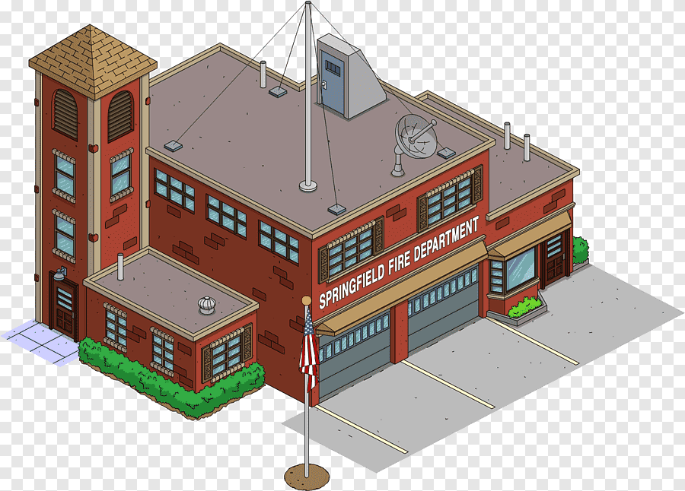
But it's been no bed of roses

Slide 4
I’ve taken my bows

Slide 5
We are the champions - my friends

Slide 6
No time for losers

Slide 7
I consider it a challenge before the whole human race

Slide 8
Cause we are the champions - of the world

Slide 9
But I've come through

Slide 10
You brought me fame and fortuen and everything that goes with it

