Slide 1
Forza Horizon 4

Slide 2
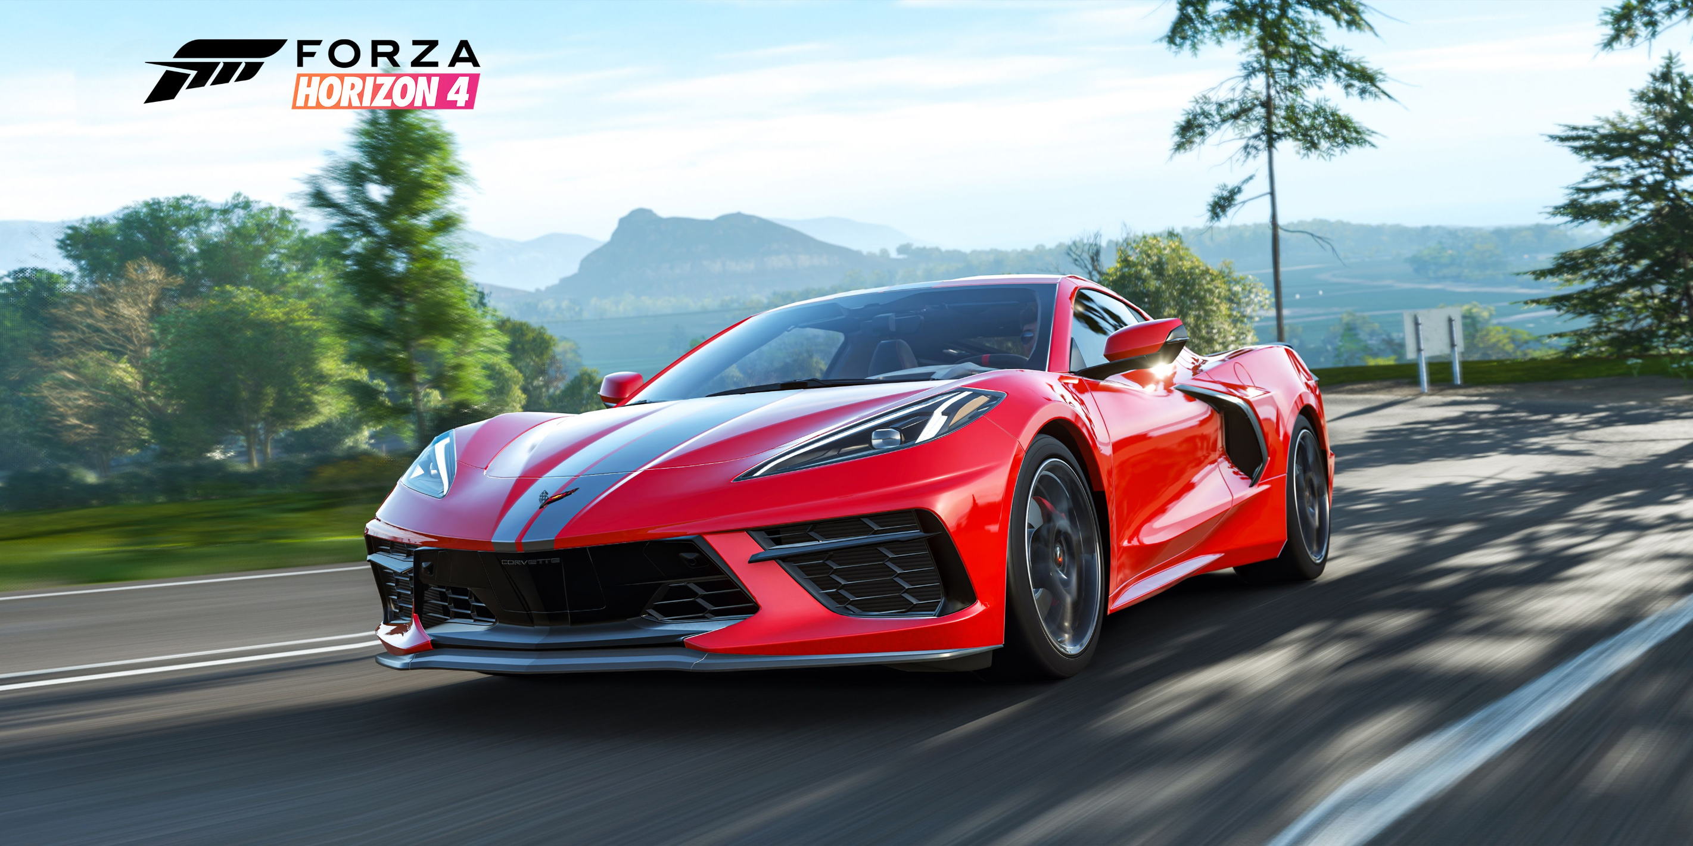
All the subject I will present you today
The goals of the game
What you need to play forza
The strategies to succeed
The traps
Some common error
Why you should play forza

Slide 3
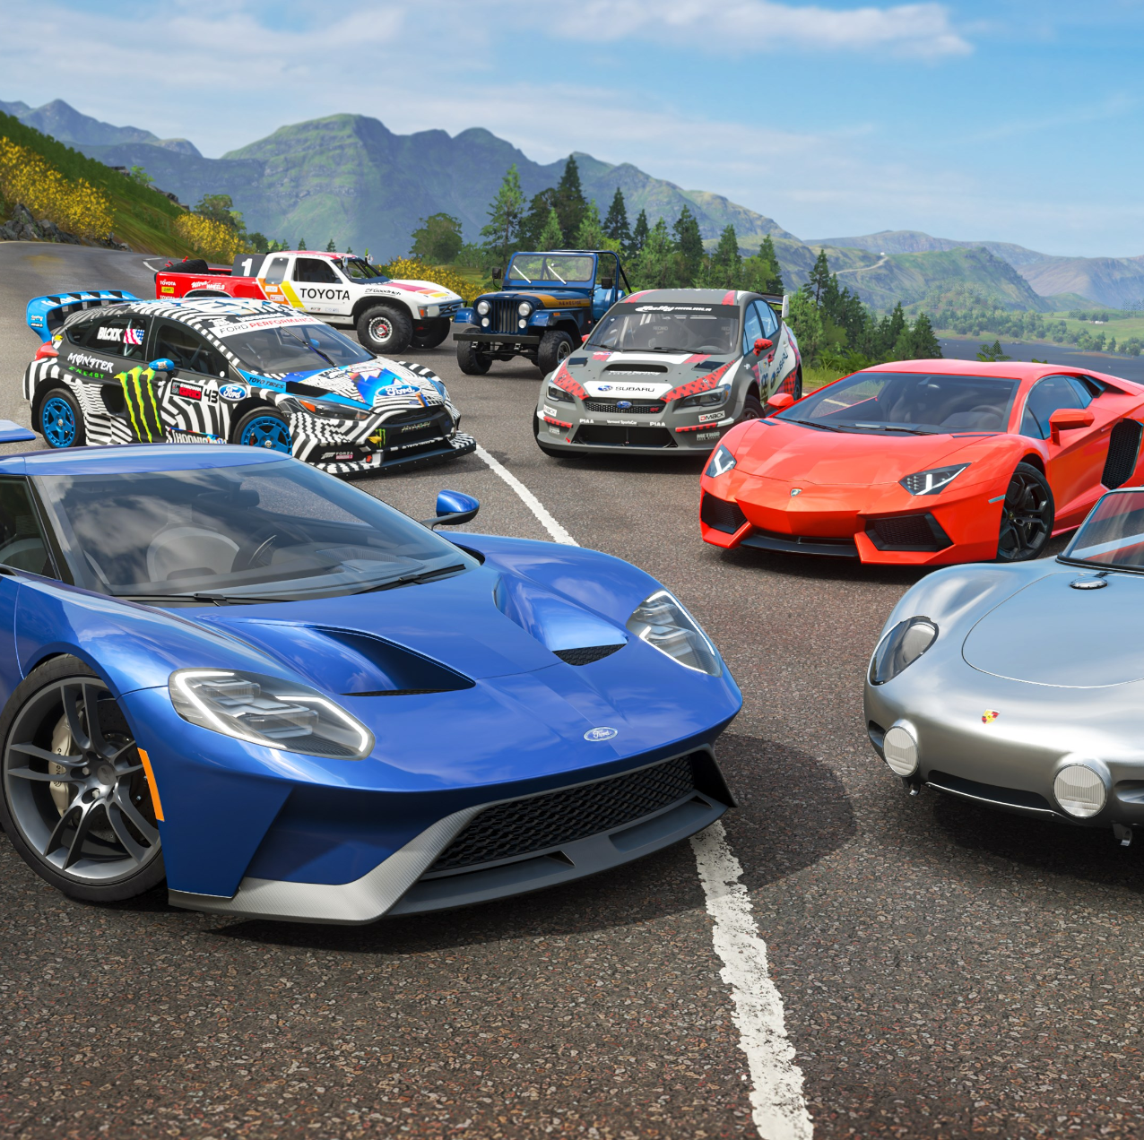
Goal of the game
:have the most cash
:win every race
:do all the secondary activity
:have all the cars in the game

Slide 4
What do you need to play forza
:you need a contoler or a steering wheel
:a computer or a xbox because this is made by microsft
:a good wifi
a xbox gold card but just for xbox not pc

Slide 5
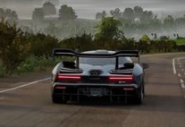
The strategies to succeed
For me, the best strategies is to do some auction because you can find some good deal
Do your daily challenge they can give you cars sometime

Slide 6
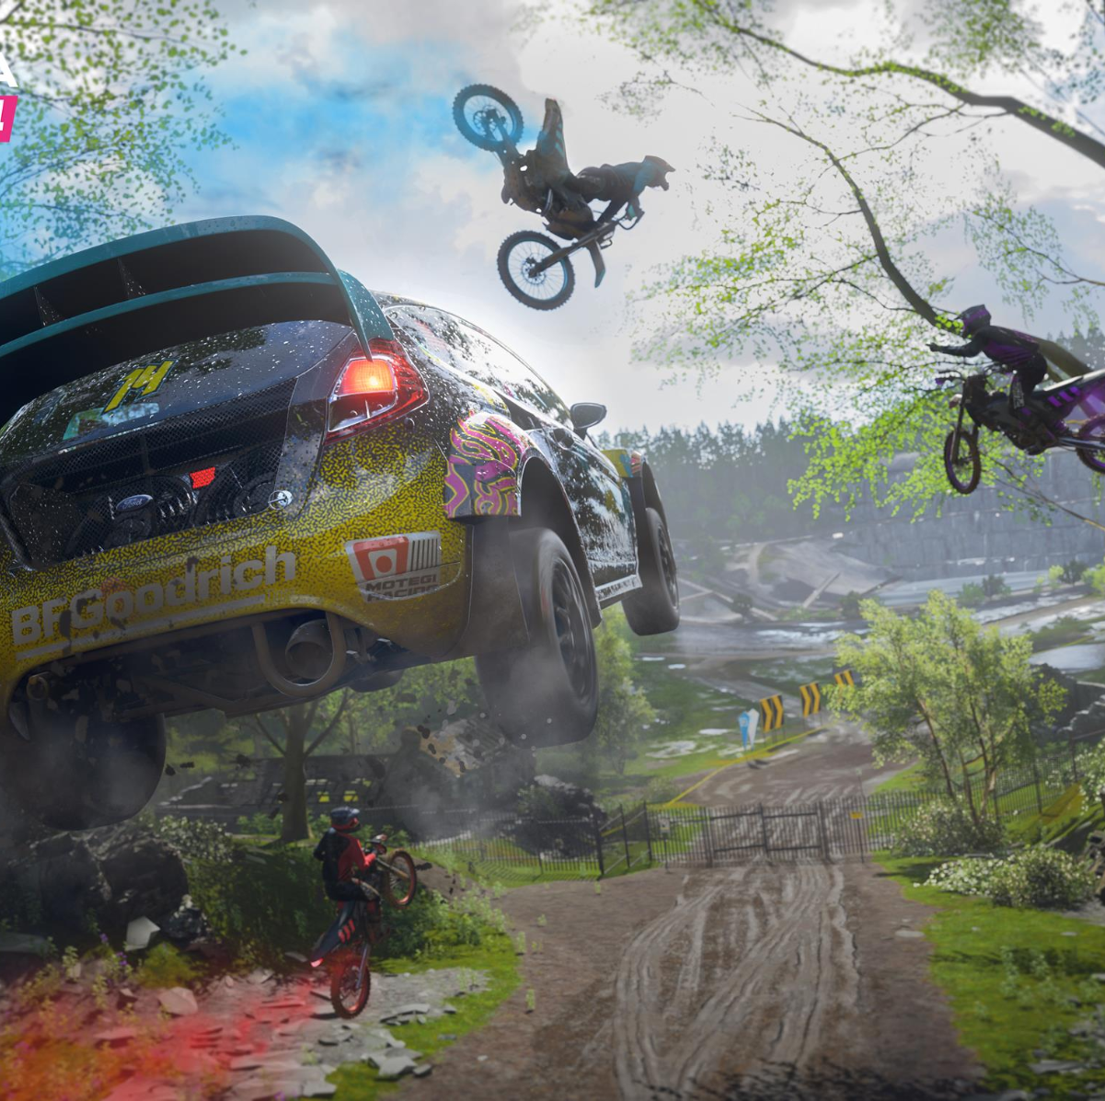
The traps
Even if you find some good deal you can find some really bad so we nned to be carefull with that
Do some race to earn money. Race are fun but the doesn't make much money has other thing you can do

Slide 7
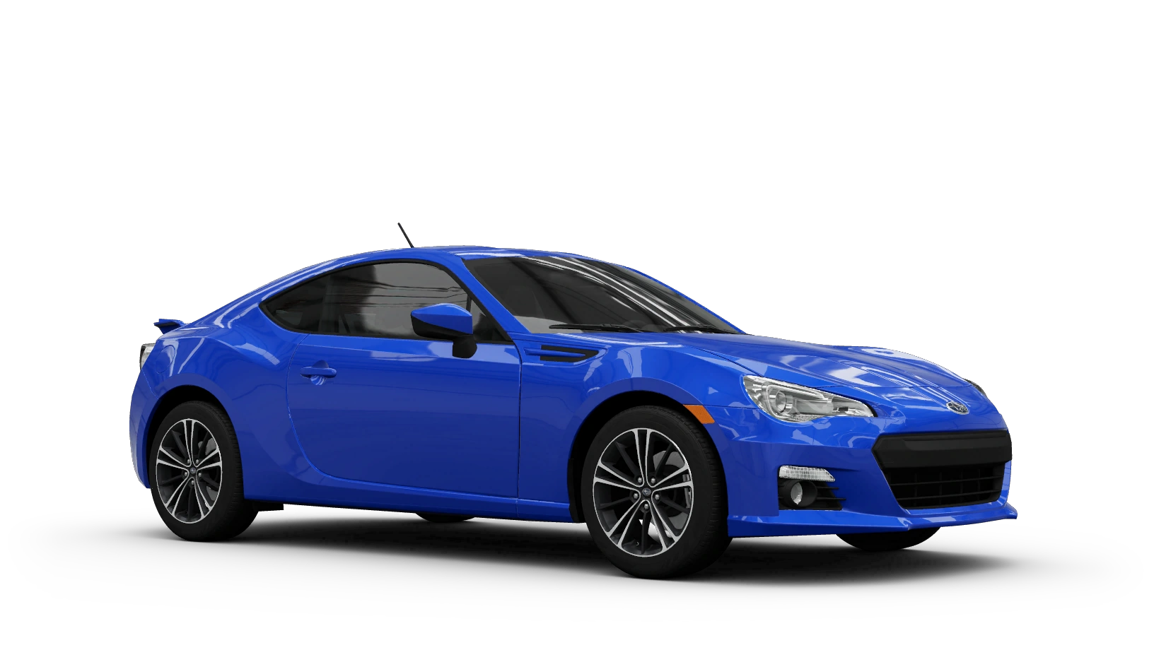
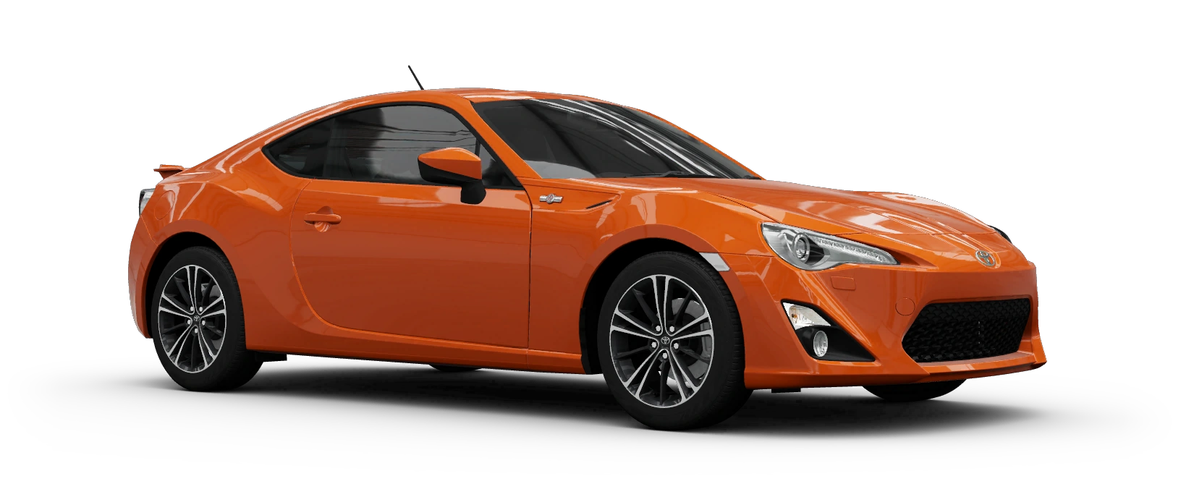
Some common error
You can find a subaru brz for like 20 000 in auction
And you can find a toyota gt 86 for at least 10 000 000 in auction and it’s the same cars but not the same brand

Slide 8
Why you should play forza
You should play this game because he is a multiplayer game and can't get bored playing this game
Every 2-week forza changes the season in the game and they put some new race
They are making a new forza and it will be released on November 5
And one of the cool thing is that the released a Lego mode
This is a game that kids can play because there's no violence in this game

Slide 9
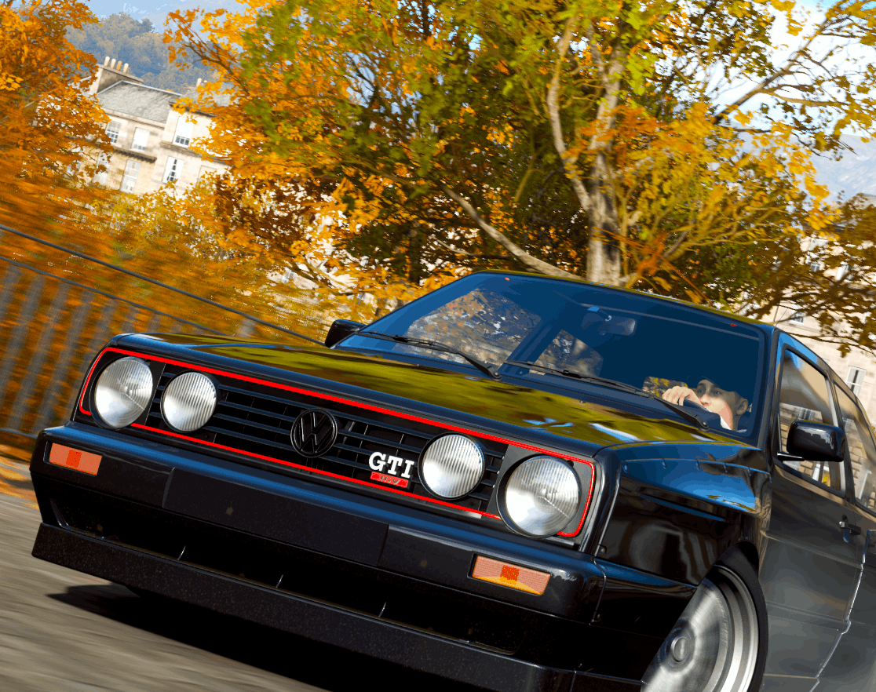
Thank you for listening!!!

