Slide 1
Hayden
Storyboard
Whitesnake: here I go again

Slide 2
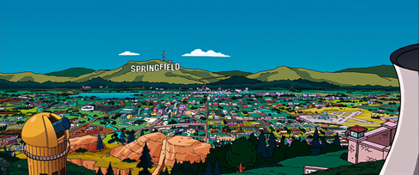
Here I go again

Slide 3
Here I go again on my own goin' down the only road I've ever known

Slide 4
I don't know where I'm goin but I sure know where I've been hanging on the promises in songs of yesterday

Slide 5
An' I've made up my mind, I ain't wasting no more time but here I go again, here I go again.

Slide 6
Tho' I keep searching for an answer I never seem to find what I'm looking for.

Slide 7
Oh Lord, I pray you give me strength to carry on 'cos I know what it means to walk along the lonely street of dreams.

Slide 8
Here I go again on my own goin' down the only road I've ever known.

Slide 9
Like a drifter I was born to walk alone. An' I've made up my mind, I ain't wasting no more time.

Slide 10
Just another heart in need of rescue waiting on love's sweet charity an' I'm gonna hold on for the rest of my days 'cos I know what it means to walk along the lonely street of dreams.

Slide 11
Here I go again on my own goin' down the only road I've ever known

