Slide 1
Storyboard fait par Jordan Drouin

Slide 2
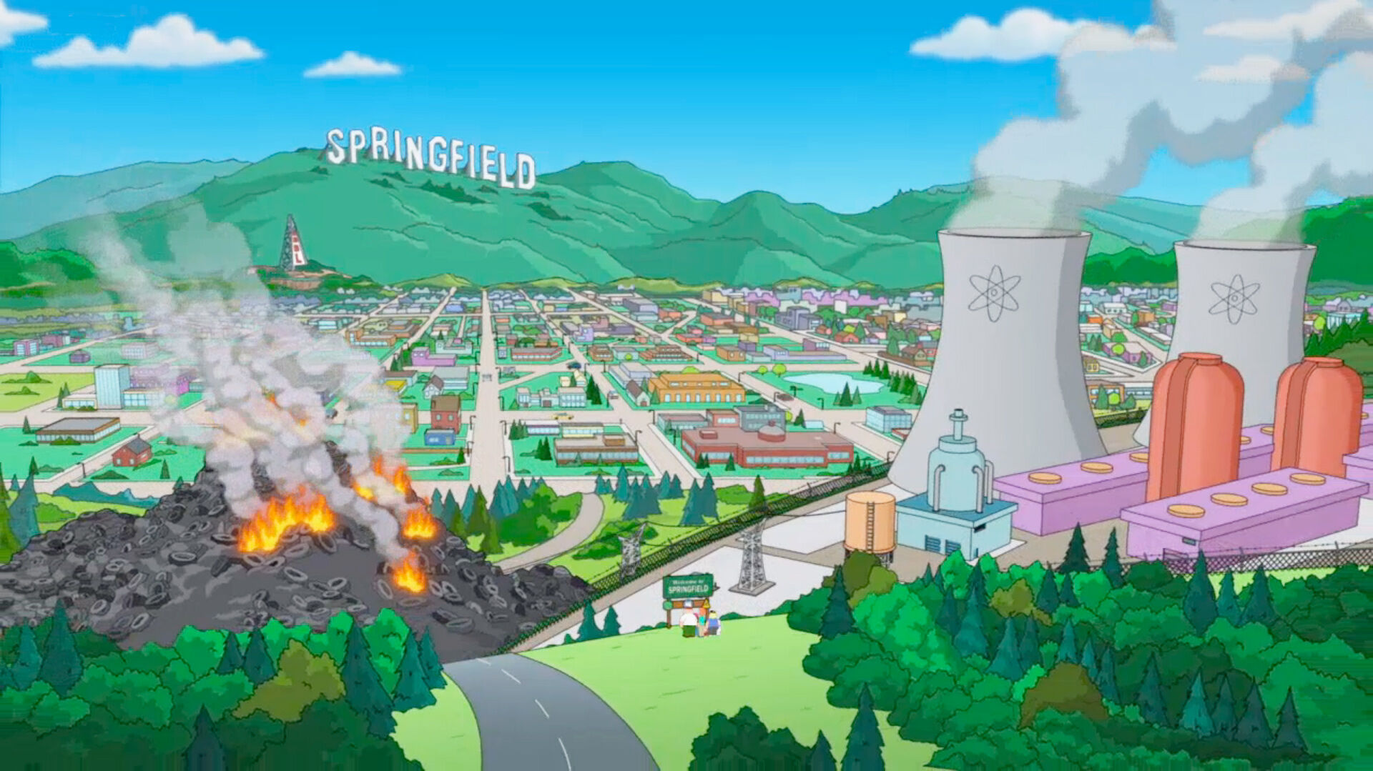
If I Could Turn Back Time

Slide 3
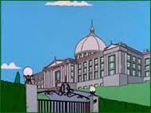
I don't know why I did the things I did I don't know why I said the things I said

Slide 4
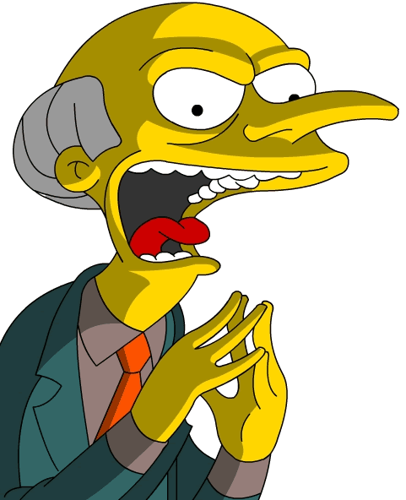
Pride's like a knife it can cut deep inside

Slide 5
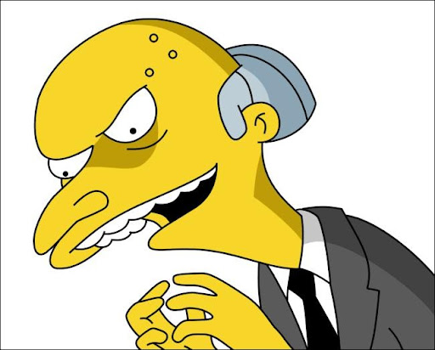
Words are like weapons they wound sometimes.

Slide 6
I didn't really mean to hurt you I didn't wanna see you go I know I made you cry, but baby [Chorus:]

Slide 7
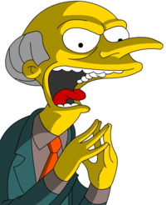
If I could turn back time If I could find a way

Slide 8
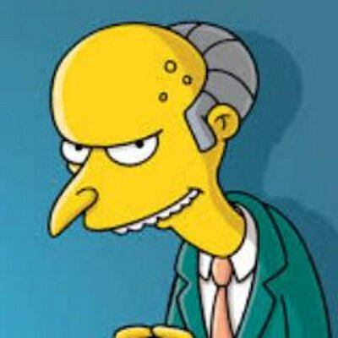
My world was shattered I was torn apart Like someone took a knife and drove it deep in my heart

Slide 9
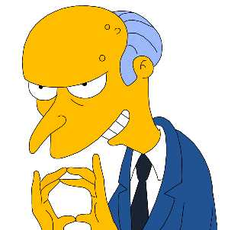
You walked out that door I swore that I didn't care But I lost everything darling then and there

Slide 10
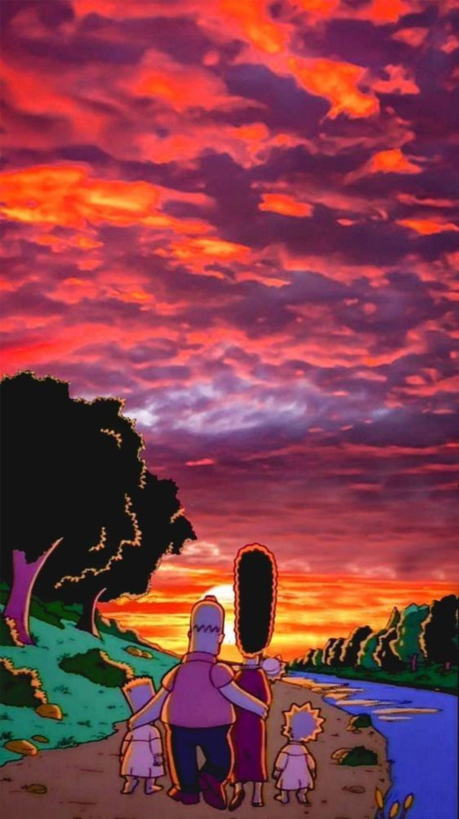
Too strong to tell you I was sorry Too proud to tell you I was wrong I know that I was blind, and ooh...

