Slide 1
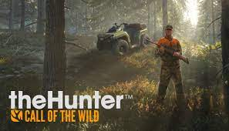
Hi gase the game I am going to present to you is the hunter call of the wild in these games the goal is to kill the most species of animals in order to colecte the money end kiling them to buy weapons ammunition,tools and even more my own which is the most fun in my opinion its to be able to stuff them I like the go hunting in this game because it has all kinds of map my opinion is that the best map is the yukon I think the most fun animal has hunted its moose because its is big and easier to see than what surprised me its that animals run fast and make your shote him to the heart so that he dies.And thats's wath's the coolest thing is that you can drive quad bicks and the more you discover the map the more you discover hunting spots and buildings and get close to hunting tents

