Slide 1
Storyboard
Fait par Amélie Cliche

Slide 2
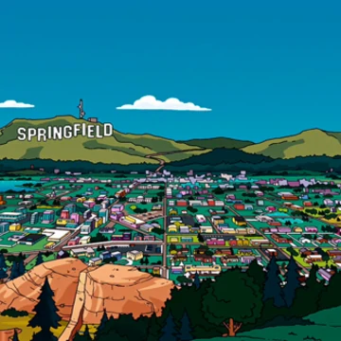
California Girls

Slide 3
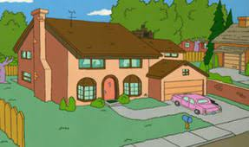
Well East coast girls are hip

Slide 4
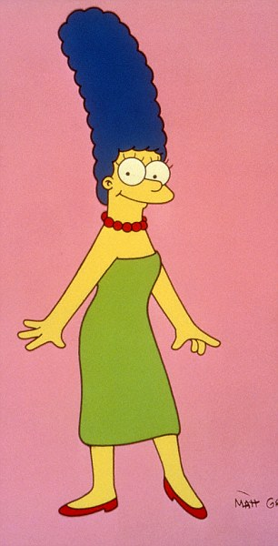
I really dig those styles they wear

Slide 5
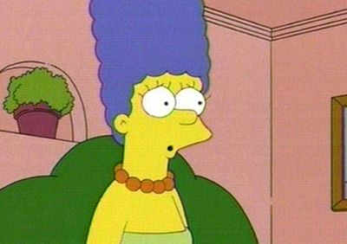
And the Southern girls with the way they talk

Slide 6
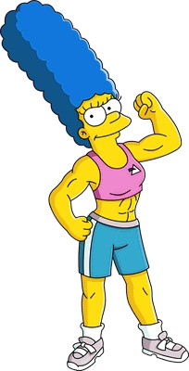
They knock me out when I'm down there

Slide 7
The Mid-West farmer's daughters really make you feel alright

Slide 8
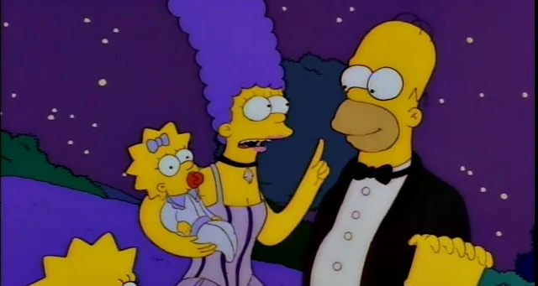
And the Northern girls with the way they kiss

Slide 9
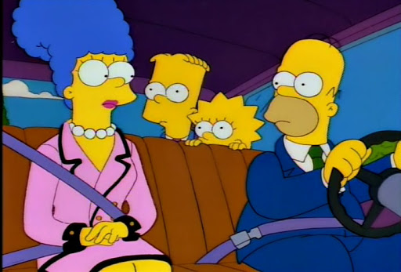
I wish they all could be California

Slide 10
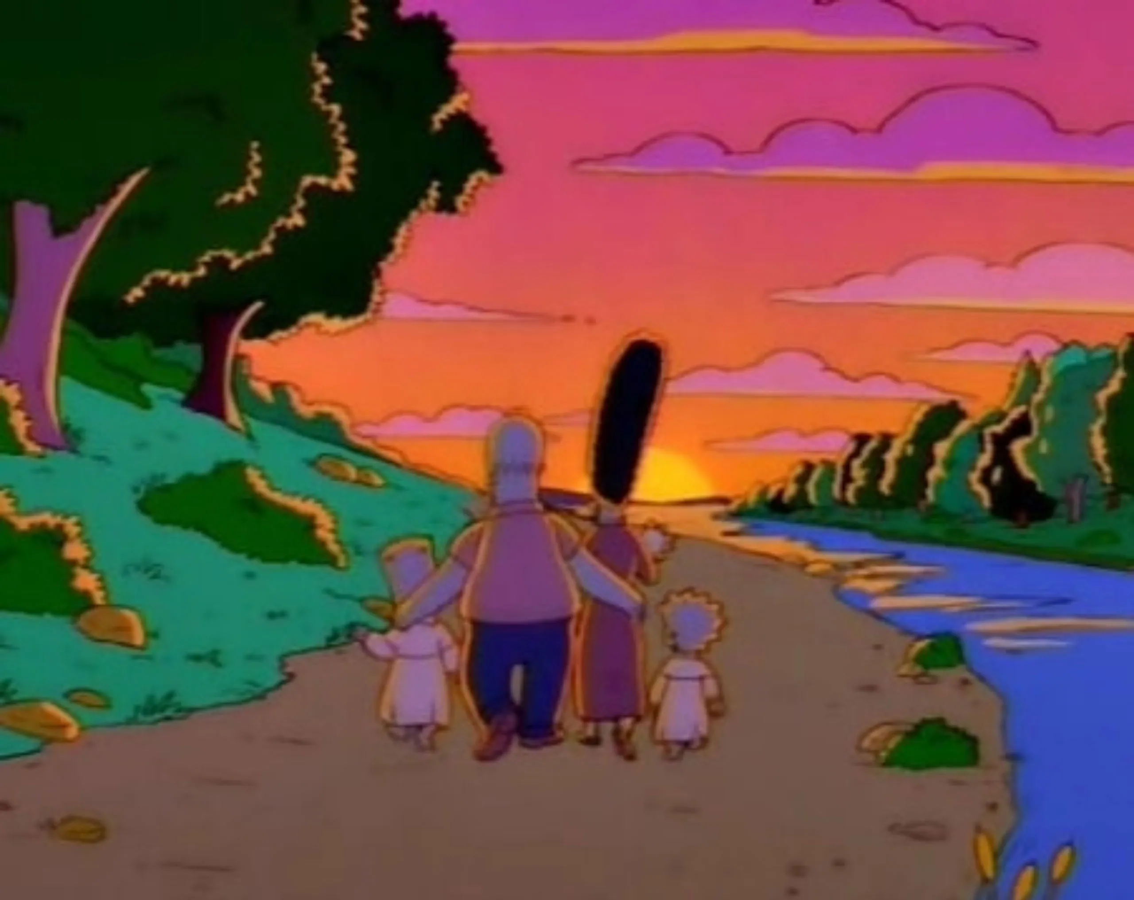
They keep their boyfriends warm at night

