Slide 1
StoryBoard
Fait par:
Xavier Gérin

Slide 2
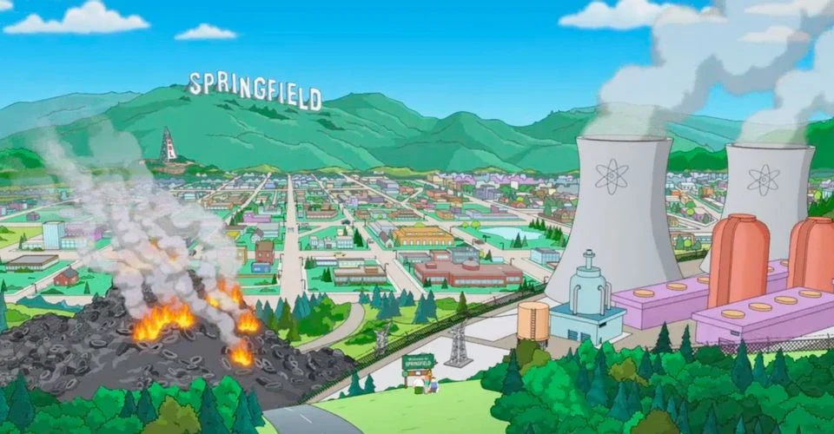
It’s my life

Slide 3
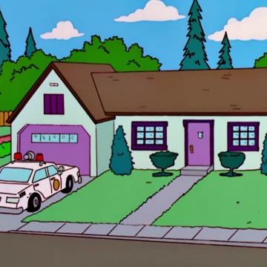
It's my life

Slide 4
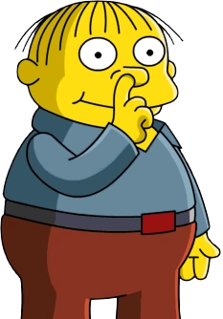
It's now or never

Slide 5
I ain't gonna live forever

Slide 6
I just want to live while I'm alive

Slide 7
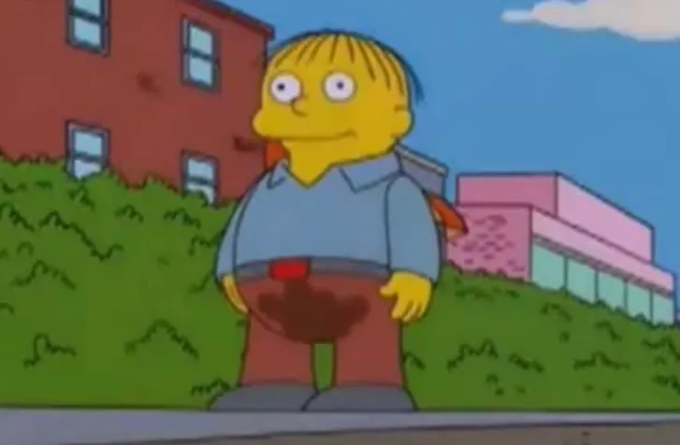
My heart is like an open highway

Slide 8
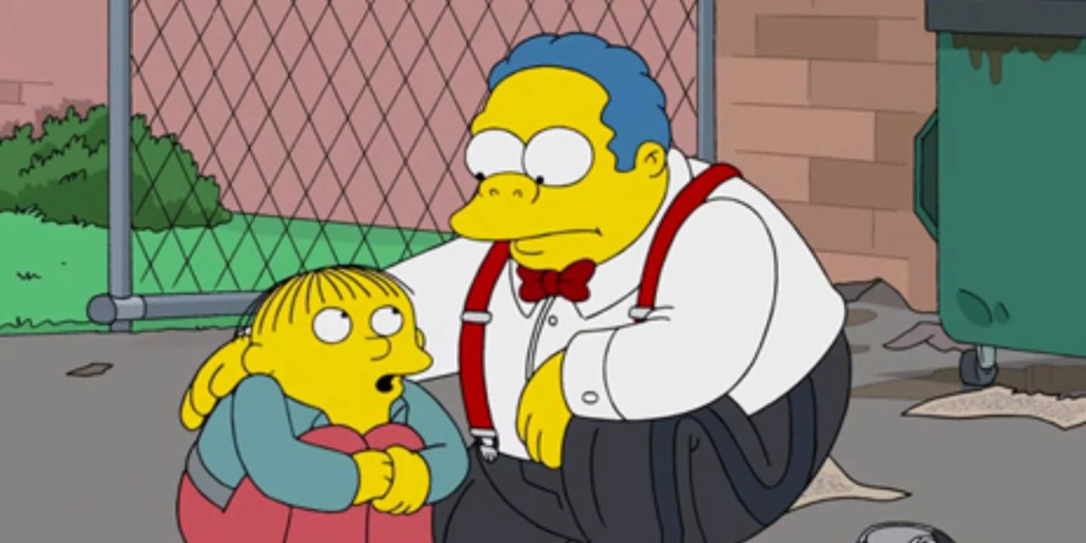
Like Frankie said

Slide 9
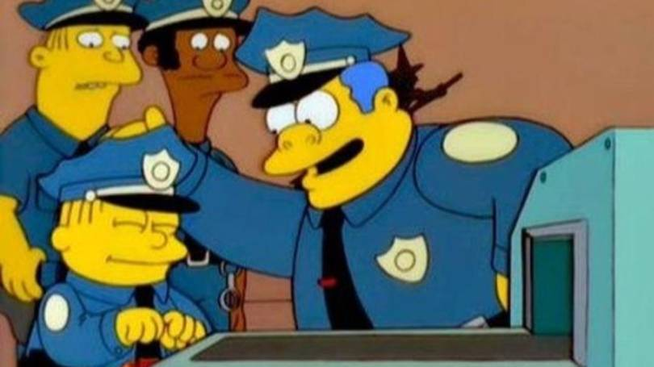
I did it my way

Slide 10
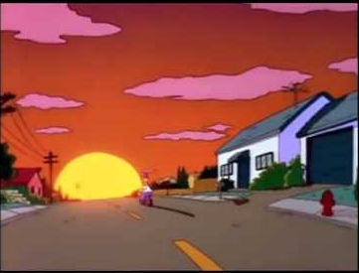
I just wanna live while I'm alive

