Slide 1
League of Legend

Slide 2
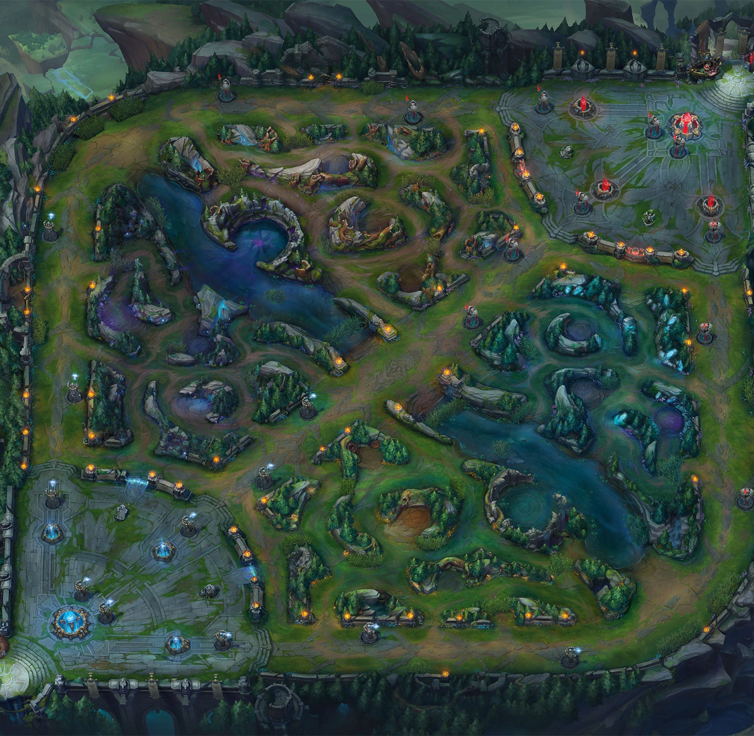
hi everyone today i will introduce you to League of Legend.
Lol is a competitive 5v5 arena game.

Slide 3
there are hundreds of characters you can play and each character has 3 different attacks and one ultimate.

Slide 4
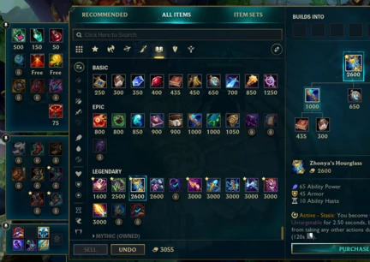
In games you can buy items in the shop with the gold that you earn during the game.

Slide 5
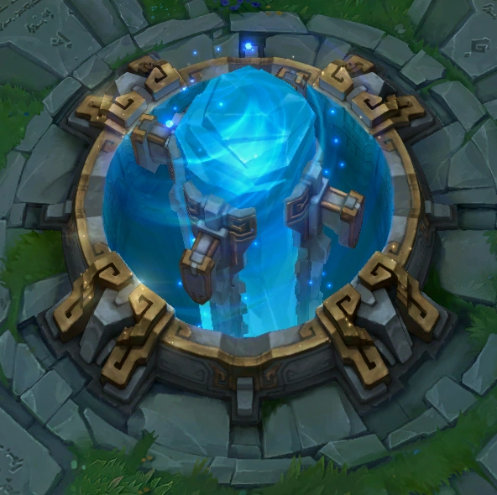
to win you have to destroy the opposing nexux (base). And to destroy it you must first destroy the towers that are on the way to the nexux.

Slide 6
the more you win the more you will rise in ranks

Slide 7
I hope to make you want to play League Of Legend

