Slide 1
StoryBoard fait par yohan

Slide 2
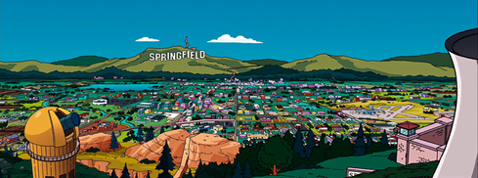
Mystery

Slide 3
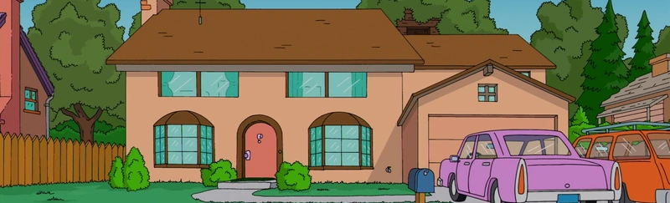
Can you hear me

Slide 4
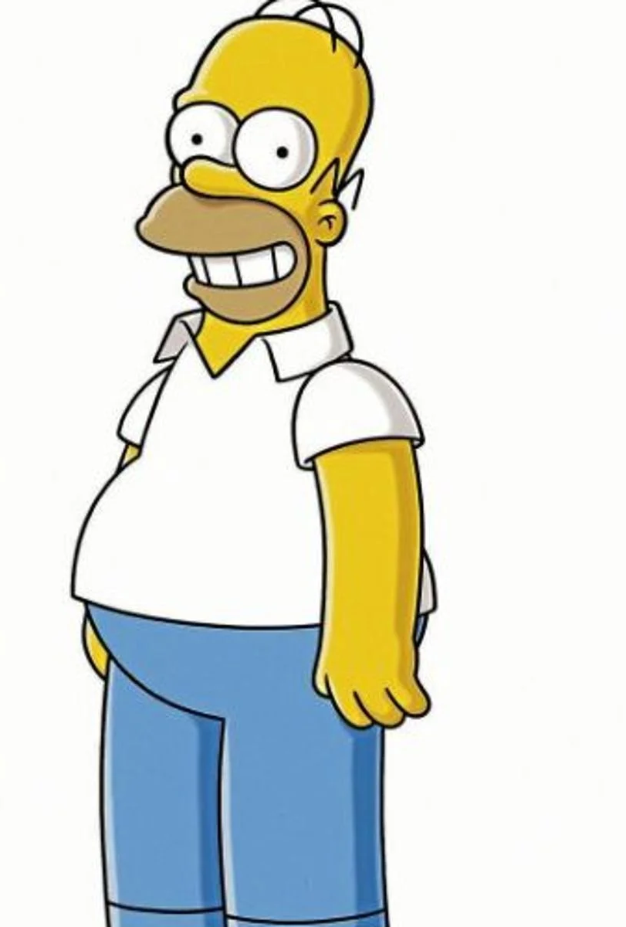
Can you see

Slide 5
There's a storm on the edge of the sky

Slide 6
Does it matter

Slide 7
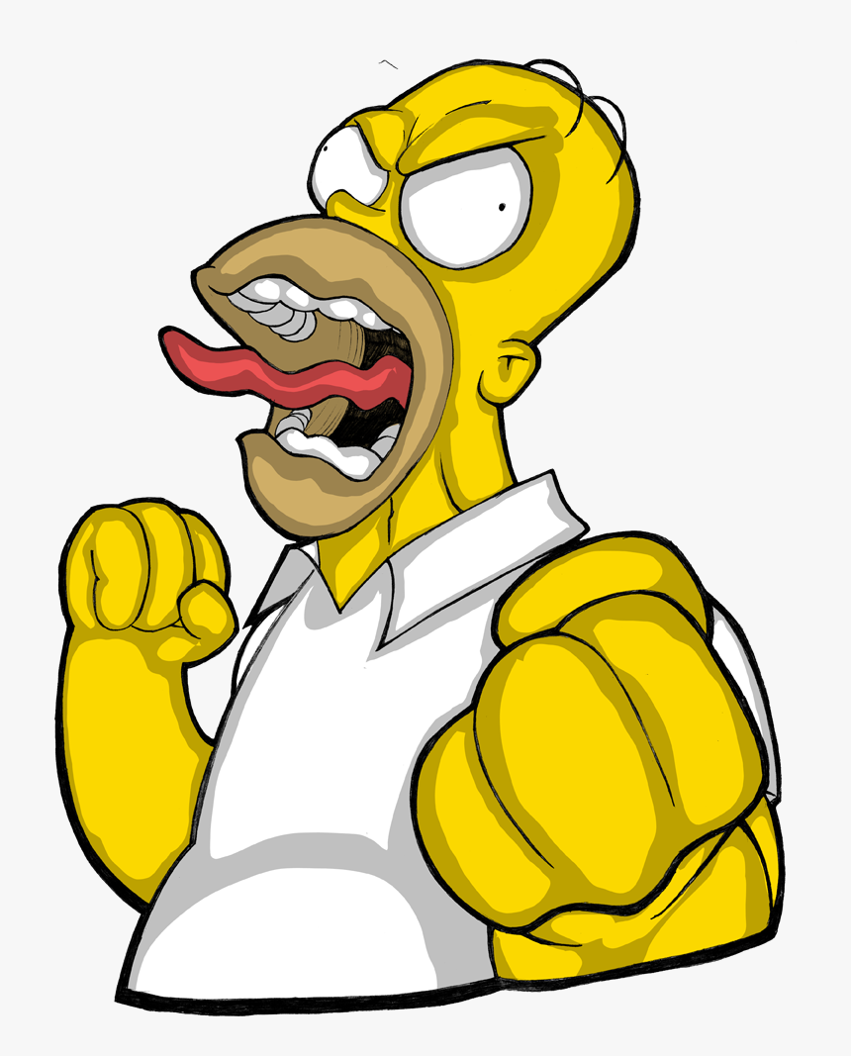
it does to me, I can tell you why

Slide 8
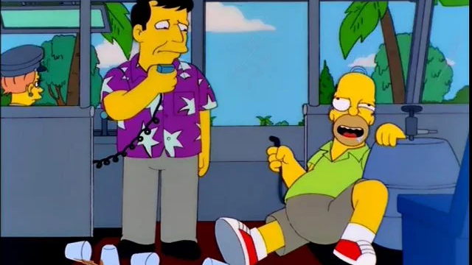
When there's thunder, there should be rain

Slide 9
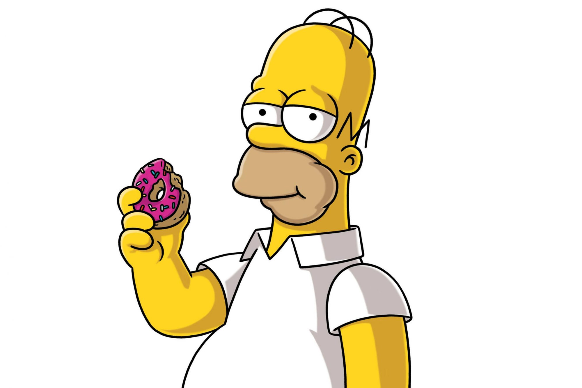
But it don't always follow the rule

Slide 10
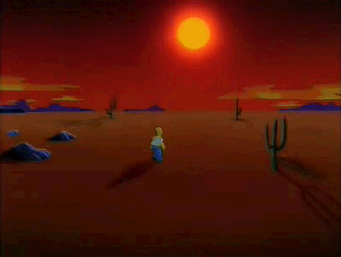
nd is the wise man always right? No he can play the fool

