Slide 1
Storyboard
Fait par Zachary Bilodeau

Slide 2
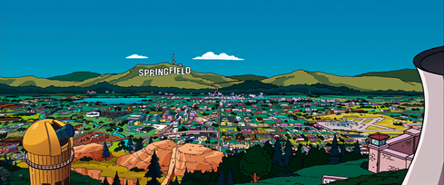
It’s my life

Slide 3
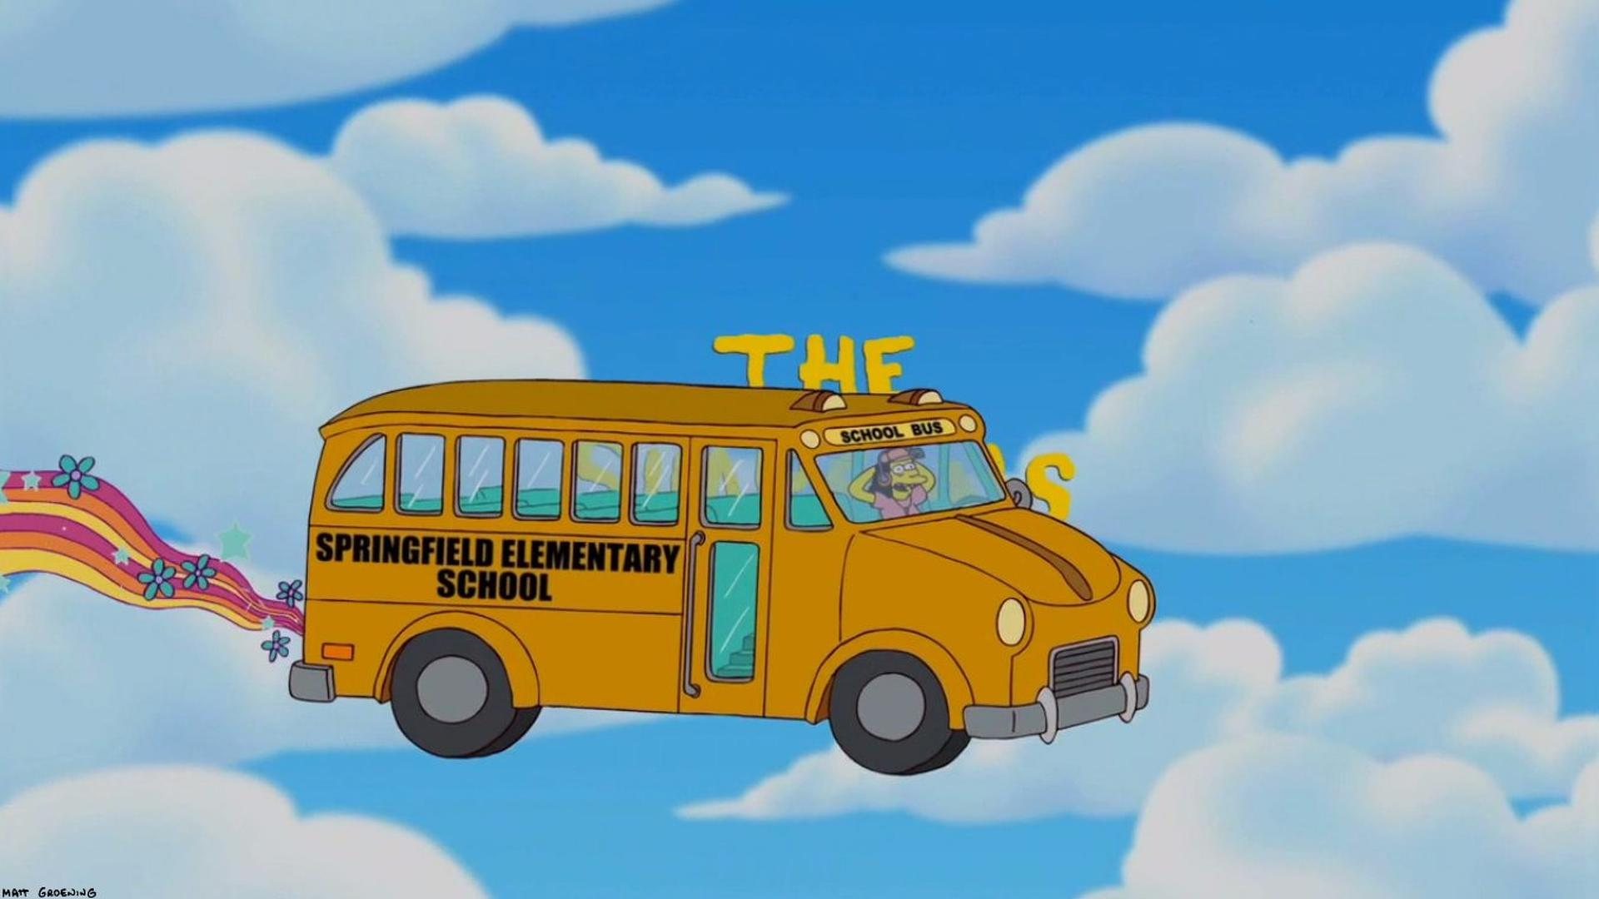
This ain't a song for the broken-hearted

Slide 4
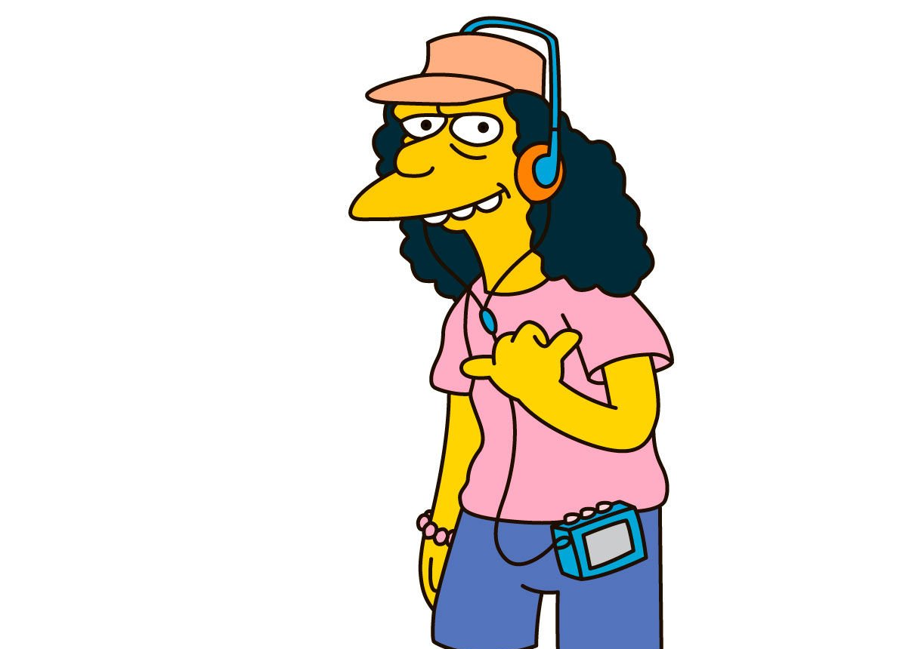
It's my life And it’s now or never

Slide 5
I ain't gonna live forever

Slide 6
I just want to live while I'm alive (It's my life)

Slide 7
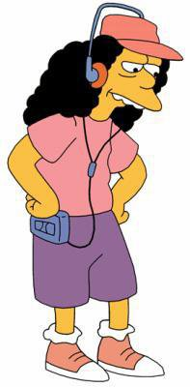
My heart is like an open highway

Slide 8
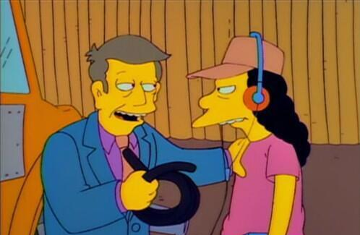
Better stand tall when they're calling you out

Slide 9
Don't bend, don't break, hell, don't back down

Slide 10
It's my life And it's now or never

