Slide 1
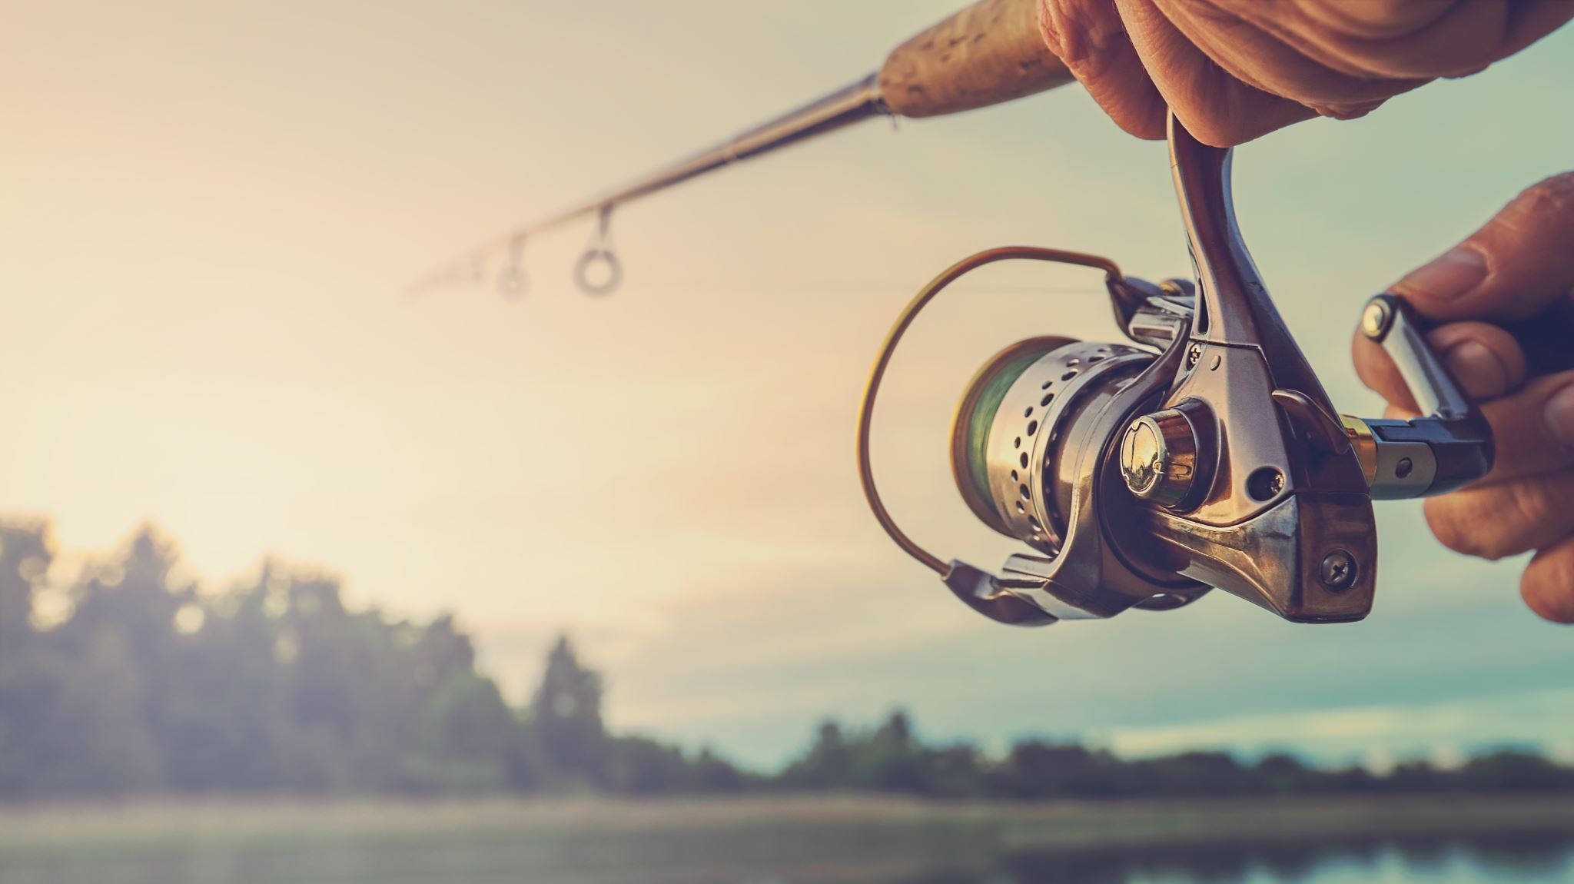
Hello today I will present you my hobbie

Slide 2
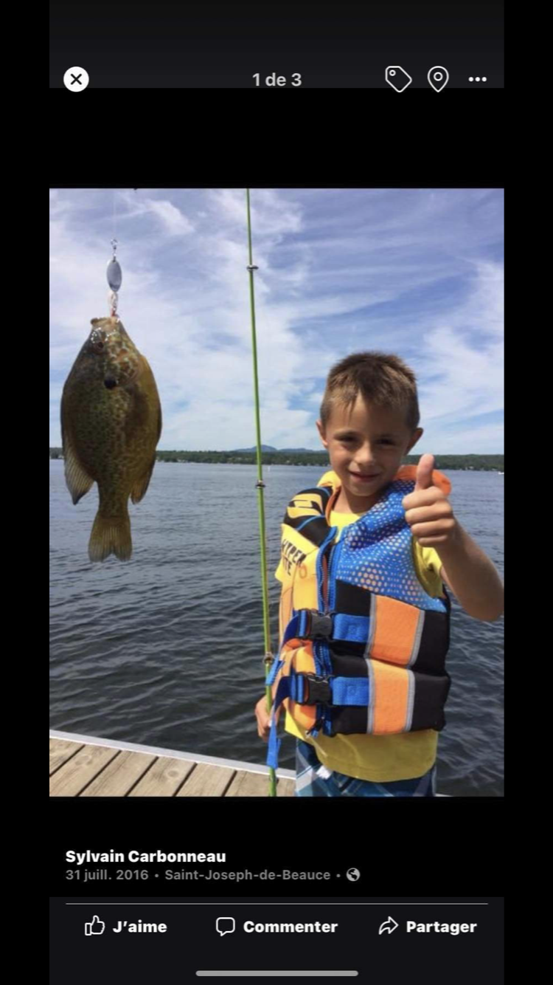
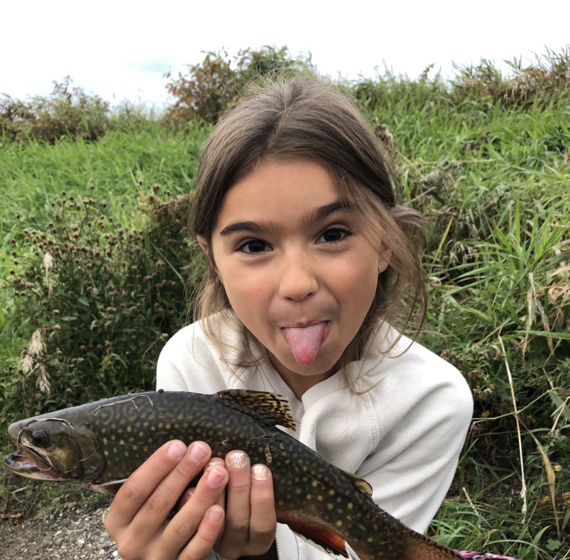
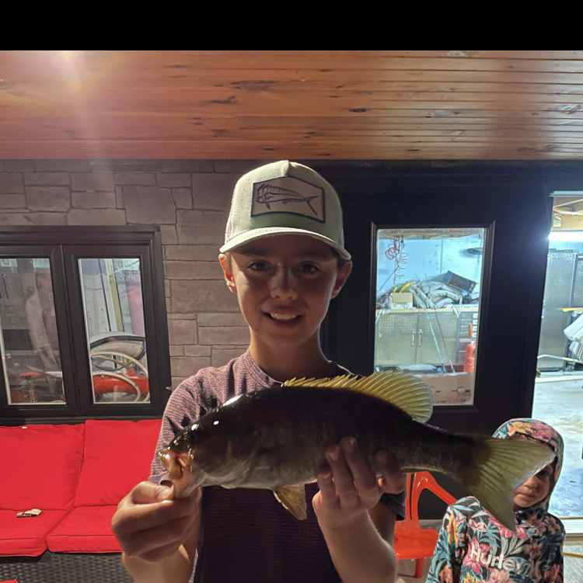
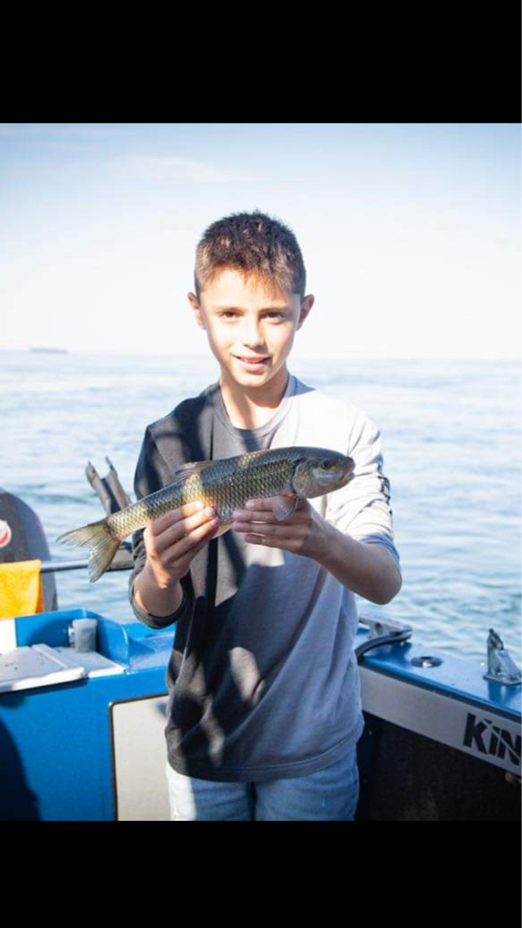
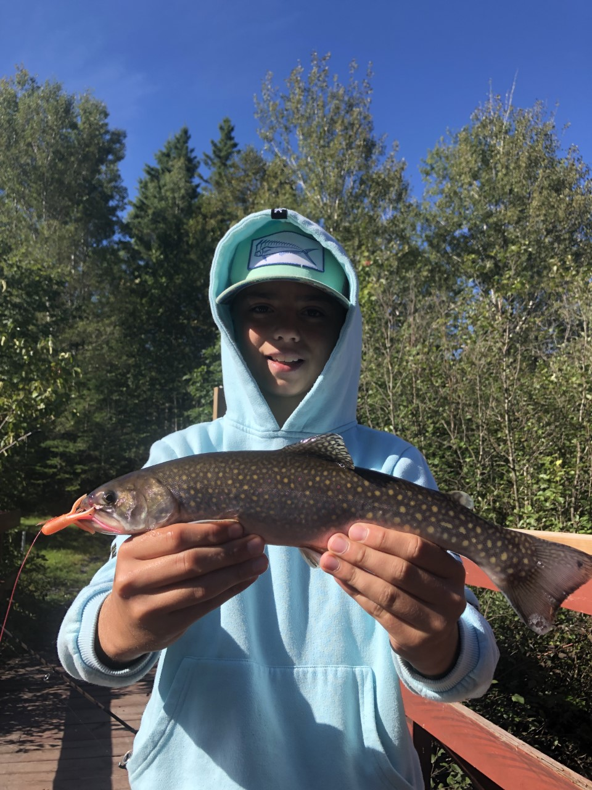
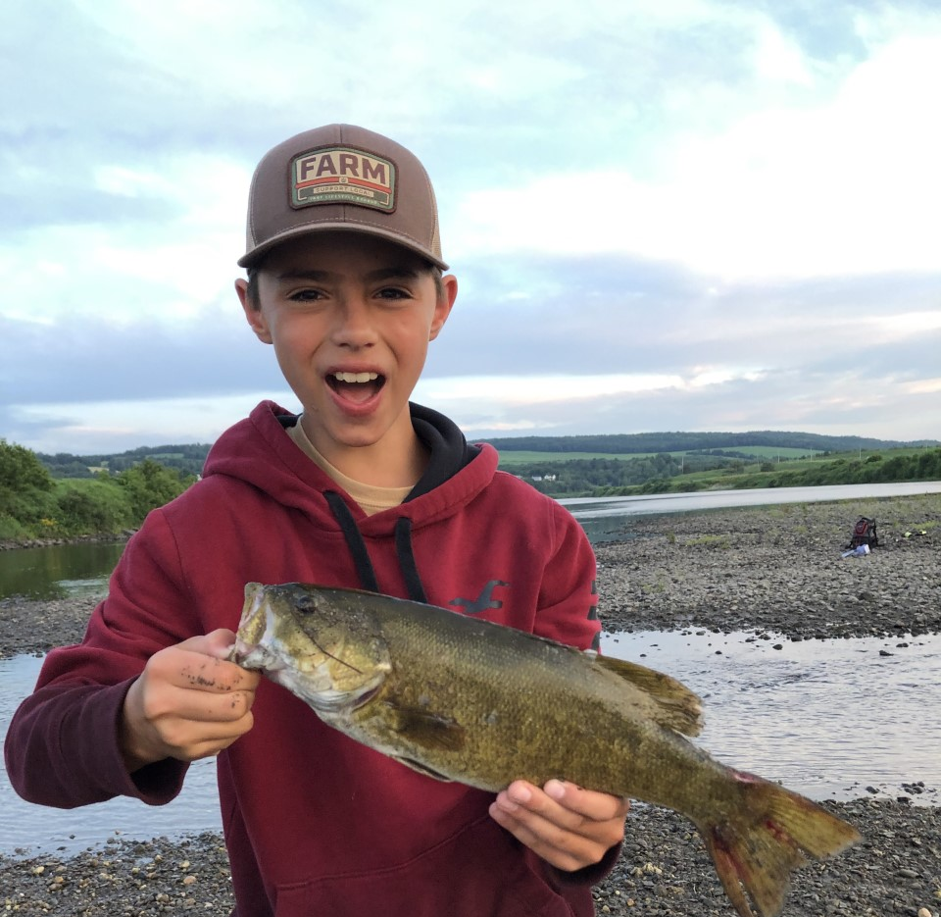
My Hobbie is fishing

Slide 3
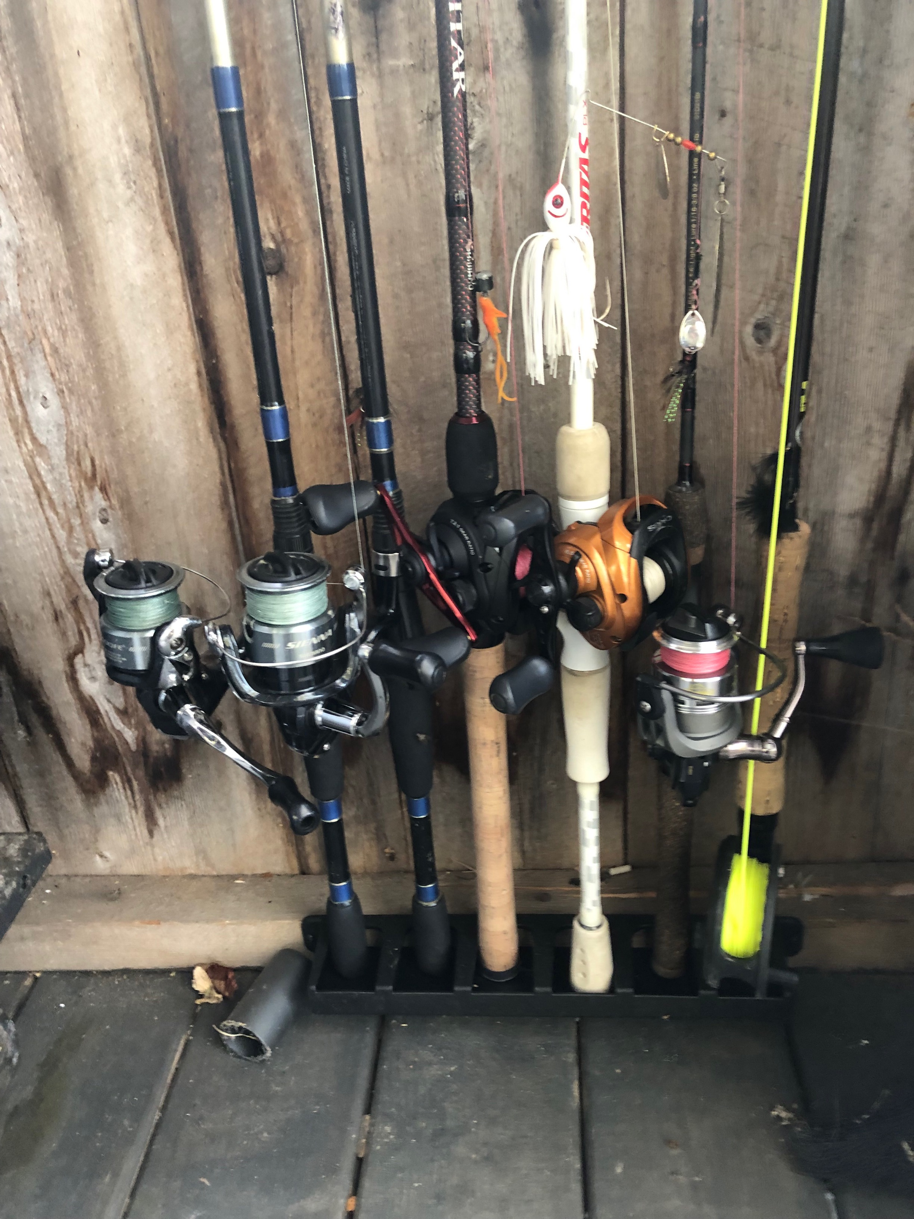
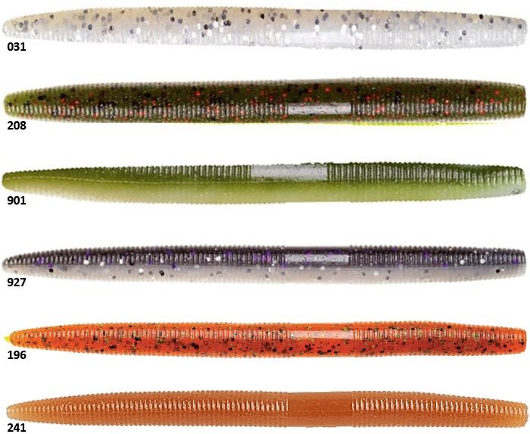
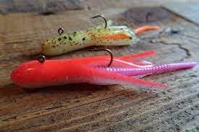
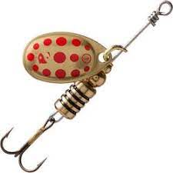
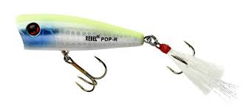
will show you my favorite lure and rode to choose
https://csbe5-my.sharepoint.com/:v:/r/personal/nancy_h_drouin_csbe_qc_ca/Documents/Microsoft%20Teams%20Chat%20Files/vid%C3%A9o%20-20221005-002135-55e28b68.mov?csf=1&web=1&e=quKhGs
https://csbe5-my.sharepoint.com/:v:/r/personal/nancy_h_drouin_csbe_qc_ca/Documents/Microsoft%20Teams%20Chat%20Files/vid%C3%A9o%20-20221005-002212-7ded48bc.mov?csf=1&web=1&e=Jb1Afg
https://csbe5-my.sharepoint.com/:v:/r/personal/jcarbonneau33_scol_qc_ca/Documents/Microsoft%20Teams%20Chat%20Files/original-B41A32AE-9612-4D7A-B321-D55AFB90FAFD.mp4?csf=1&web=1&e=yzcatj
https://csbe5-my.sharepoint.com/:v:/r/personal/jcarbonneau33_scol_qc_ca/Documents/Microsoft%20Teams%20Chat%20Files/original-4A62B8EE-EB60-42CB-ACBD-142BF04D4578.mp4?csf=1&web=1&e=nWazdT

Slide 4
i tink that is a very good hobby because when you may have nothing to do you could just go outside and go on a river or a lake and you should cath fish i belive that is better than the video gamme because your not sit on a sofa and gamme all the day and do nothing you may have to find a spot to fish and if the fish dont like your lure you might have to change the lure.you have to adapt your fishing rod like medium rod for medium fish.what surprised me is a rod is very difficulte to brake.i really recomend you this hobby you should juste try one time and you might like this.you shouldn't buy a very expensive fishing rod for your first time you must buy a cheapest one like 40$

Slide 5
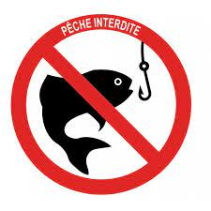
Something I don't like is when the season is over

