Slide 1
storybord
Par mathieu dodier

Slide 2
springfield

Slide 3
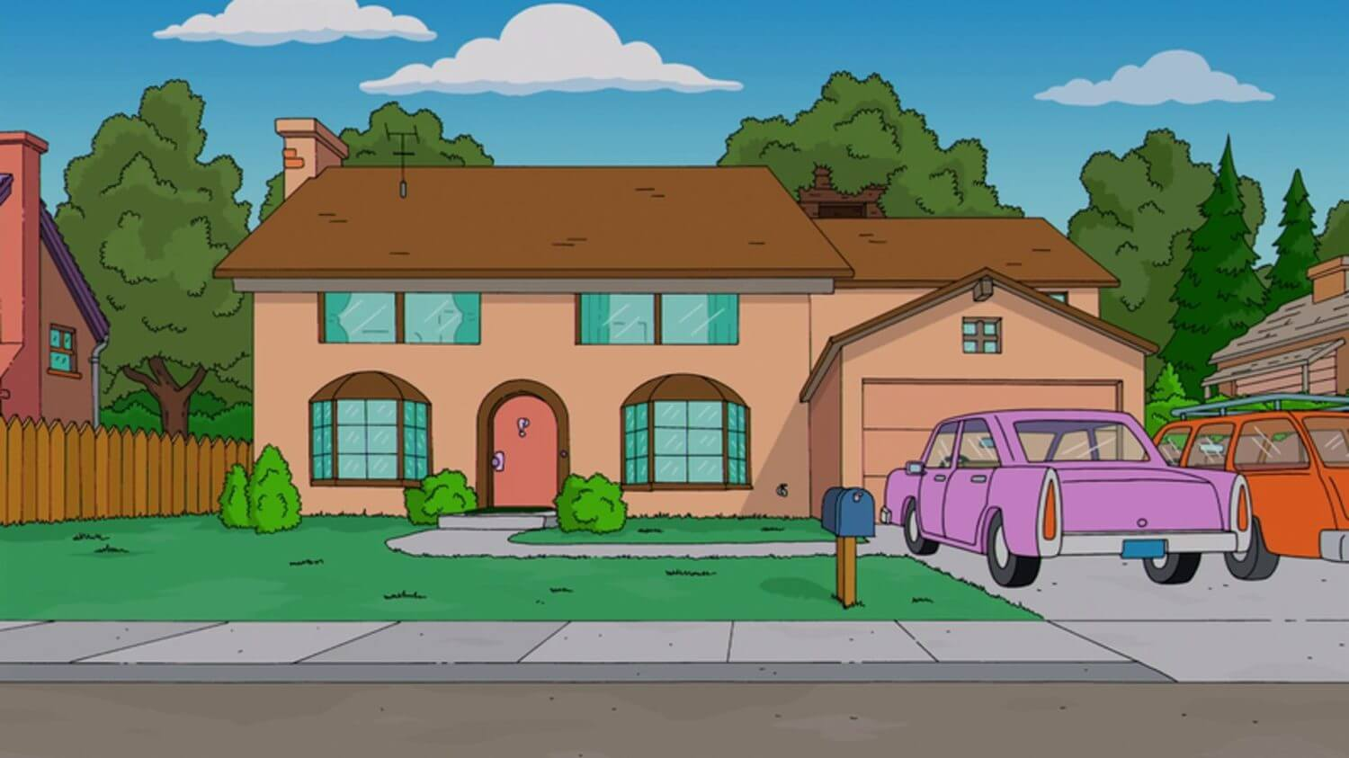
Maison Homer simpson

Slide 4
Homer simpson

Slide 5
homer

Slide 6
homer

Slide 7
homer

Slide 8
homer

Slide 9
homer

Slide 10
aide

Slide 11
homer

Slide 12
homer

