Slide 1
Storyboard
Fait par Luca Drouin

Slide 2
Kicked in my face

Slide 3
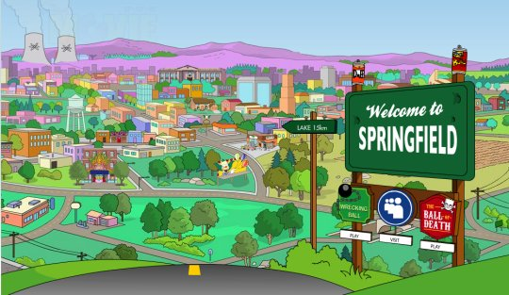
I consider it a challenge before

Slide 4
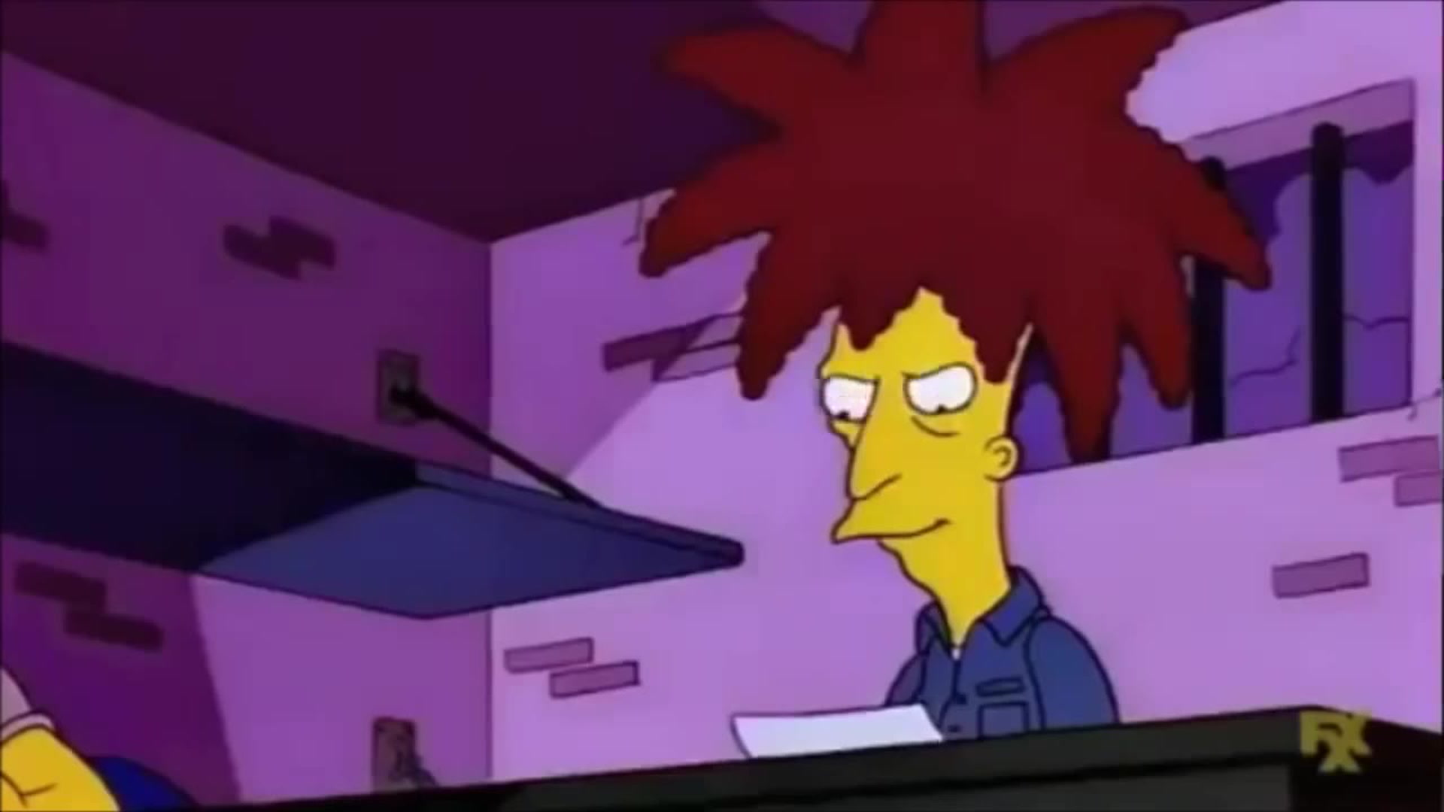
The human race

Slide 5
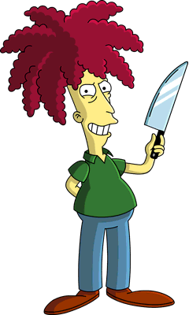
And I ain't gonna lose

Slide 6
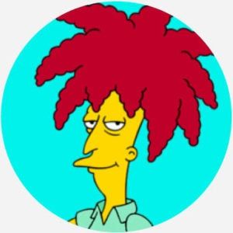
No pleasure cruise

Slide 7
No time for losers

Slide 8
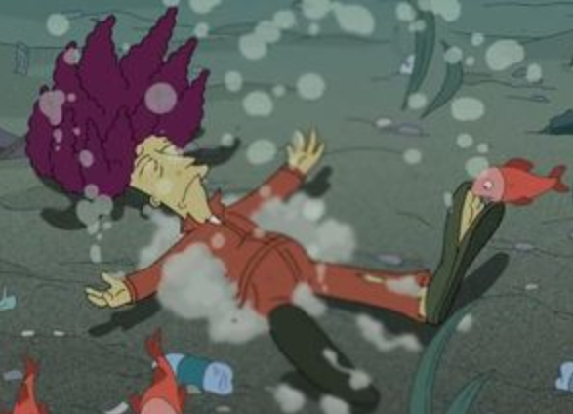
And we'll keep on fighting till the end

Slide 9
And we mean to go on and on and on and on

Slide 10
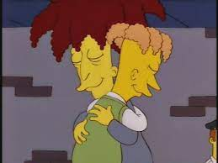
We are the champions, my friends

Slide 11
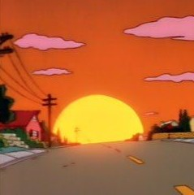
Cause we are the champions of the World

