Slide 1
Story board fait par alexis dubuc

Slide 2
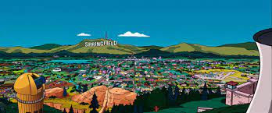
I've paid my dues
Time after time
I've done my sentence
But committed no crime
And bad mistakes
Les simpson

Slide 3
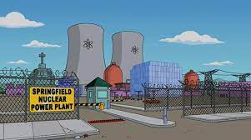
I've made a few
I've had my share of sand
Kicked in my face
But I've come through

Slide 4
And we mean to go on and on and on and on
We are the champions, my friends
And we'll keep on fighting till the end
We are the champions
We are the champions
No time for losers
'Cause we are the champions of the World

Slide 5
I've taken my bows
And my curtain calls
You brought me fame and fortune
And everything that goes with it
I thank you all

Slide 6
But it's been no bed of roses
No pleasure cruise
I consider it a challenge before
The human race
And I ain't gonna lose
And we mean to go on and on and on and on

Slide 7
We are the champions, my friends
And we'll keep on fighting till the end
We are the champions
We are the champions
No time for losers
'Cause we are the champions of the World

Slide 8
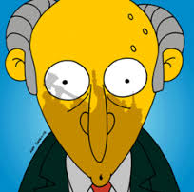
And we'll keep on fighting till the end
We are the champions
We are the champions
No time for losers
'Cause we are the champions of the World

Slide 9
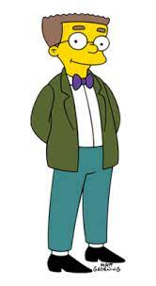
We are the champions
We are the champions
No time for losers
'Cause we are the champions of the World

Slide 10
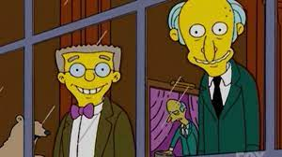
We are the champions
No time for losers
'Cause we are the champions of the World

Slide 11
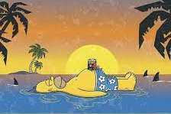
No time for losers
'Cause we are the champions of the World

