Slide 1
Storyboard
Fait par Élika Nadeau

Slide 2
Time after time

Slide 3
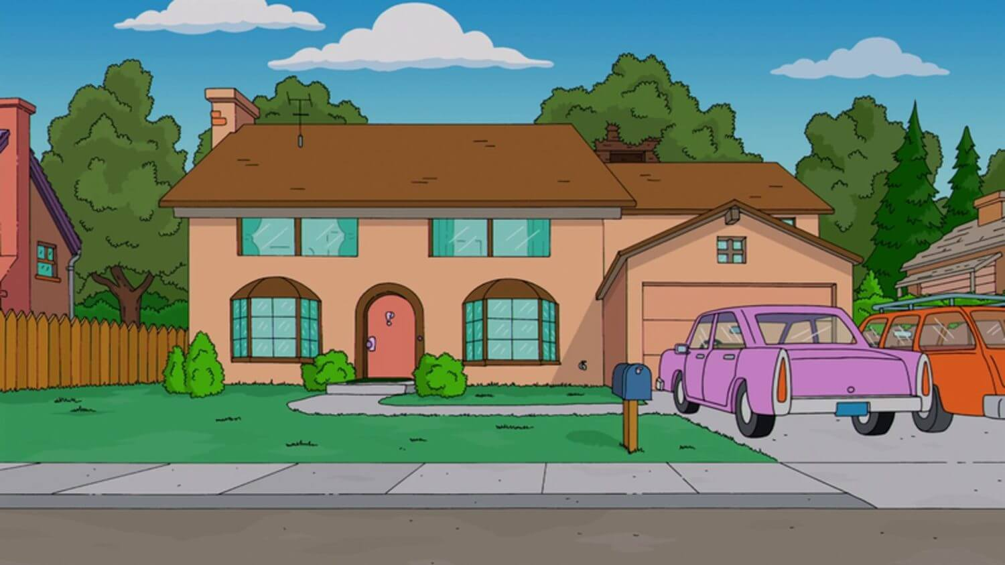
I've done my sentence

Slide 4
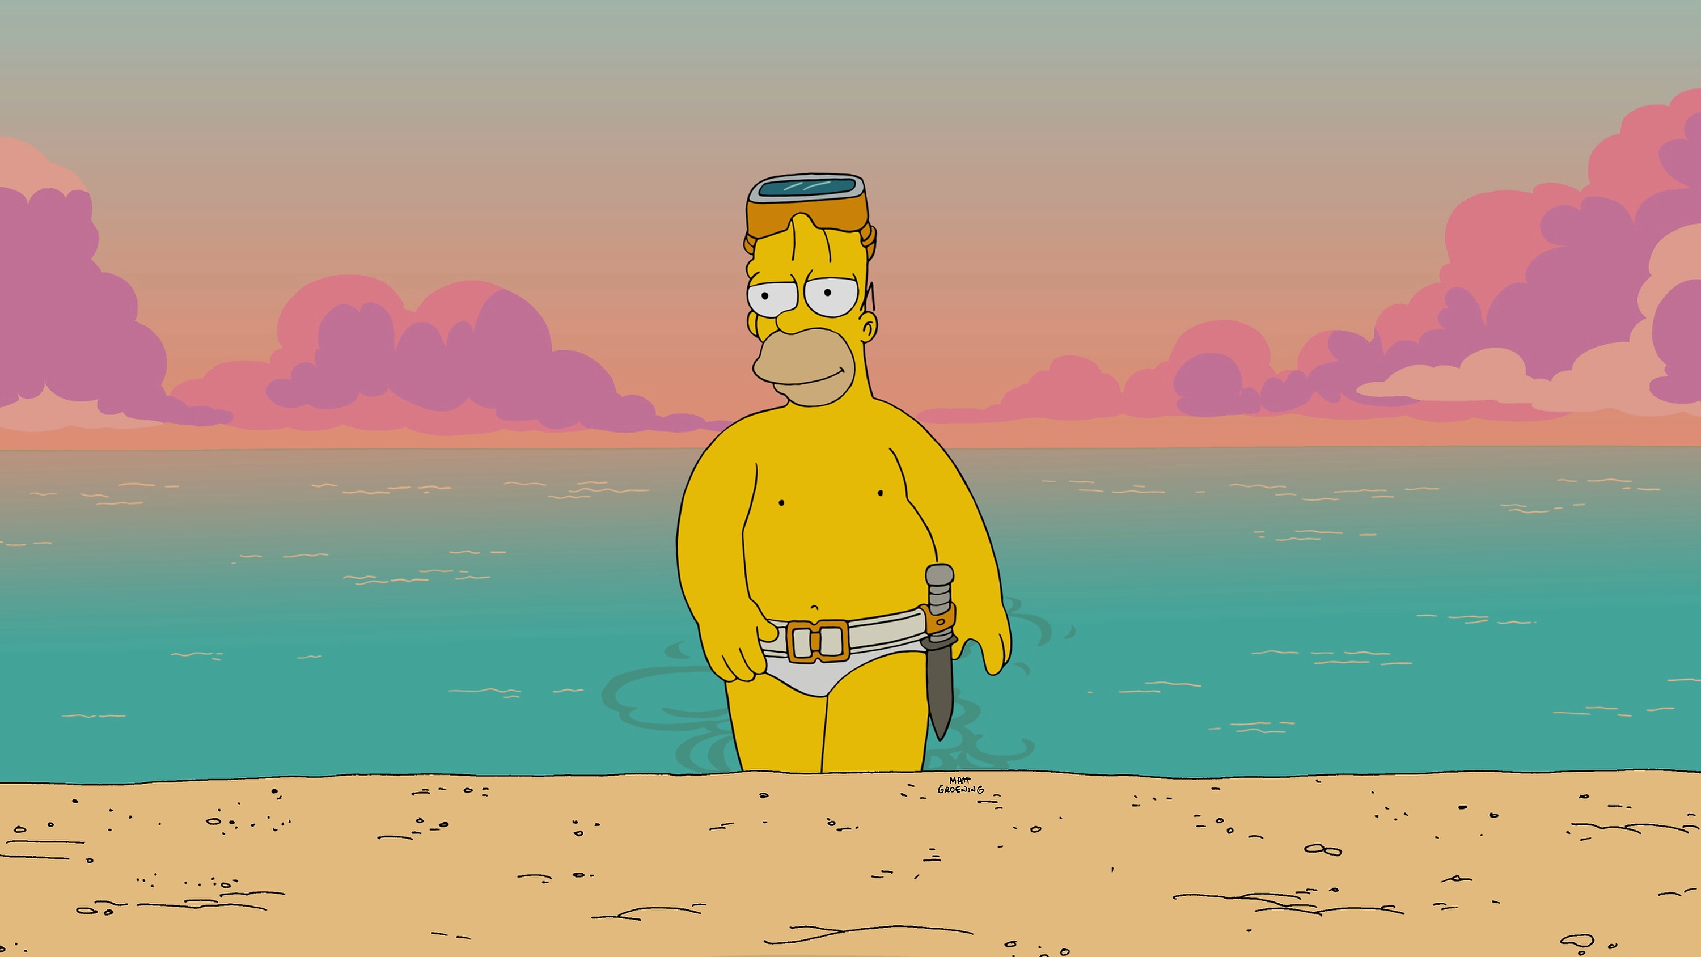
I've had my share of sand

Slide 5
But committed no crime

Slide 6
You brought me fame and fortune

Slide 7
But it's been no bed of roses

Slide 8
And we'll keep on fighting till the end

Slide 9
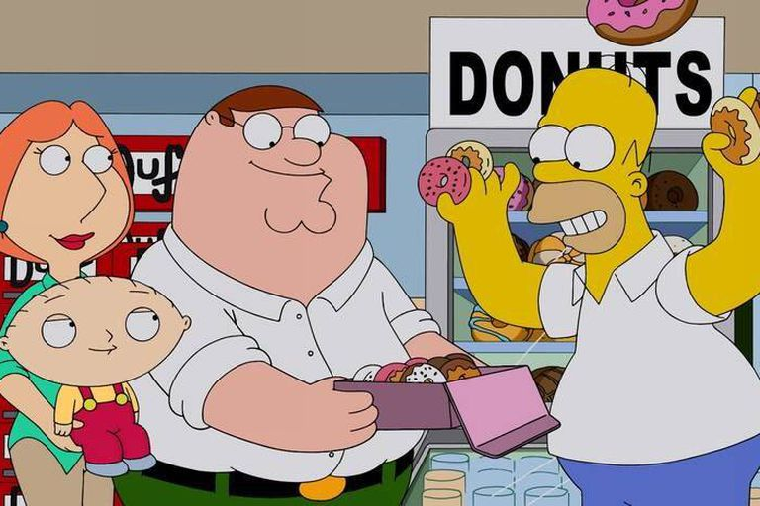
We are the champions, my friends

Slide 10
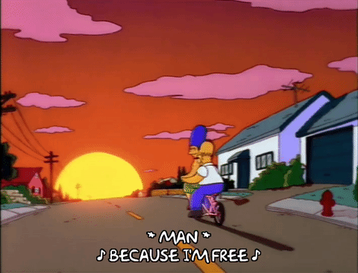
No time for losers

