Slide 1
Storyboard
Par Dominique Roy

Slide 2
I'm dreaming away

Slide 3
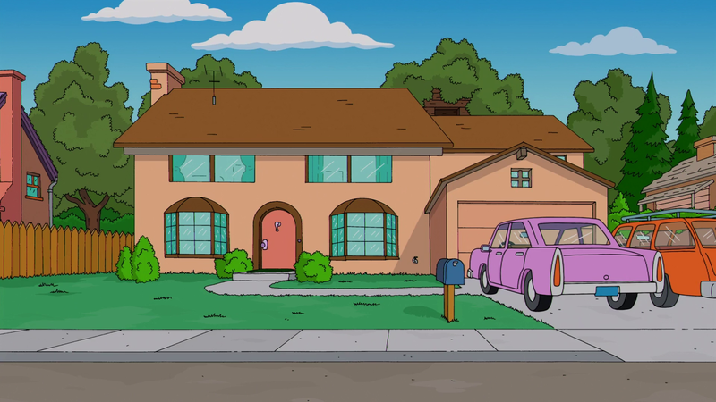
That is just so typically me

Slide 4
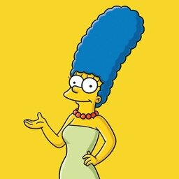
I cry, watching the days

Slide 5
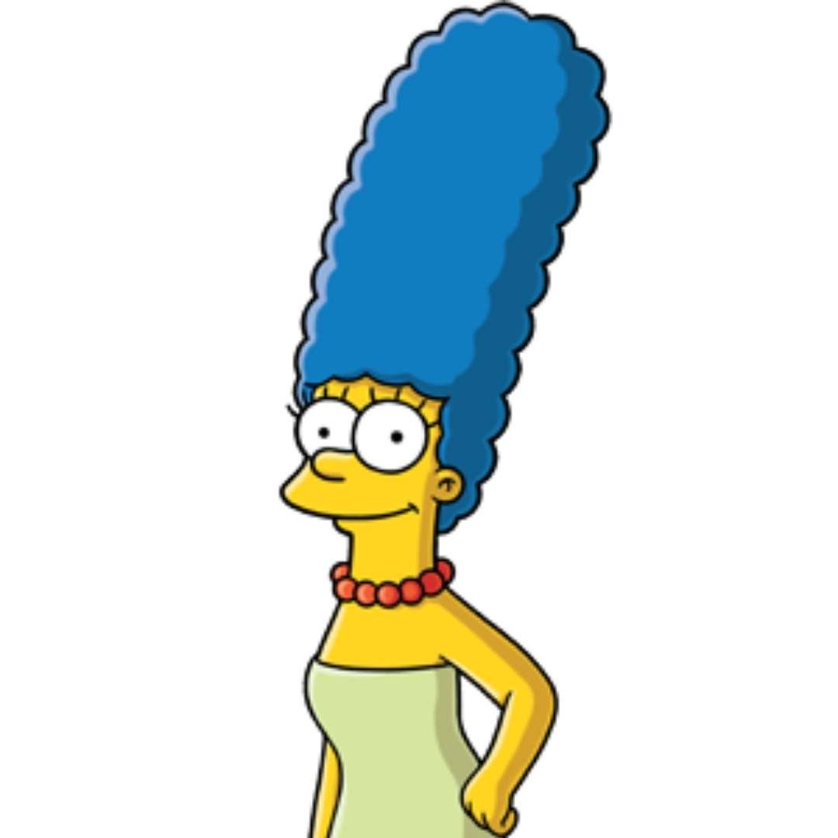
Can't you see I'm a fool in so many ways

Slide 6
I played with your heart, got lost in the game

Slide 7
I'm not that innocent

Slide 8
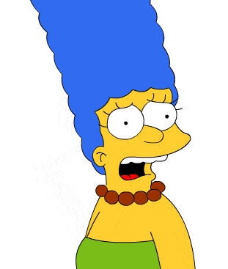
All aboard
Help !

Slide 9
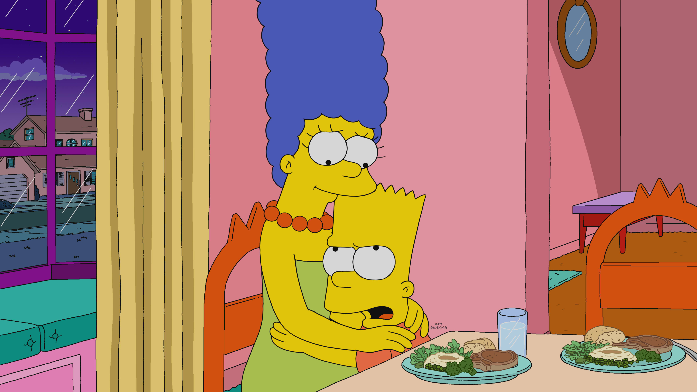
Britney, before you go, there's something I want you to have

Slide 10
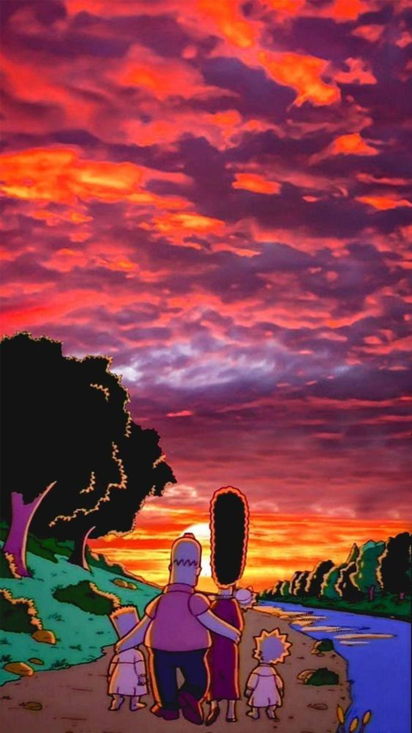
Oh, it's beautiful, but wait a minute, isn't this?

