Slide 1
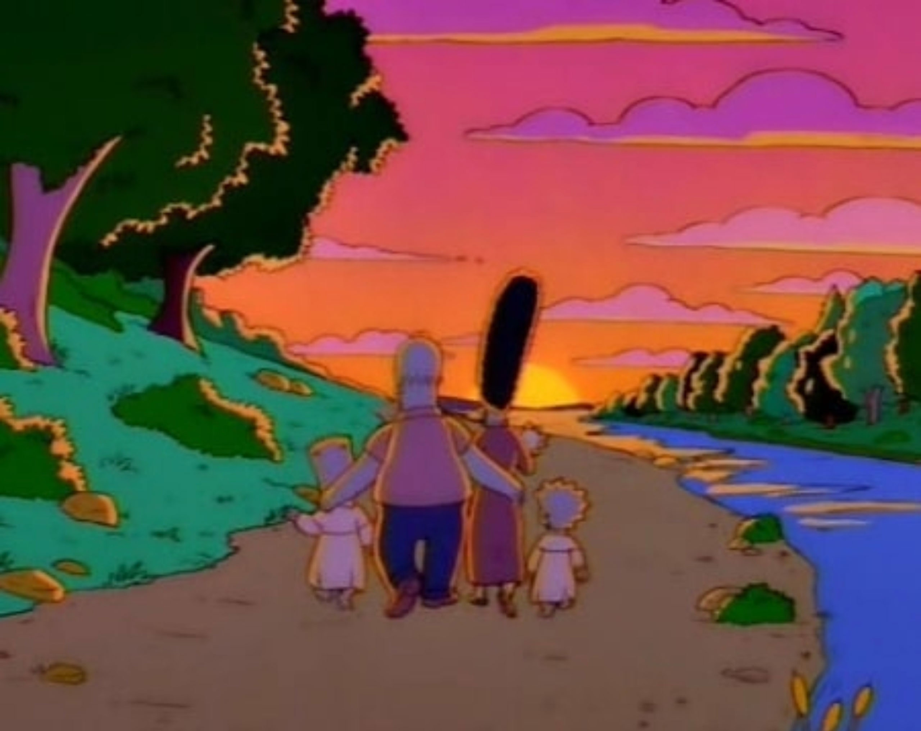
Storyboard
Par Jade Sylvain

Slide 2
A Springfield
Like Frankie said, "I did it my way"

Slide 3
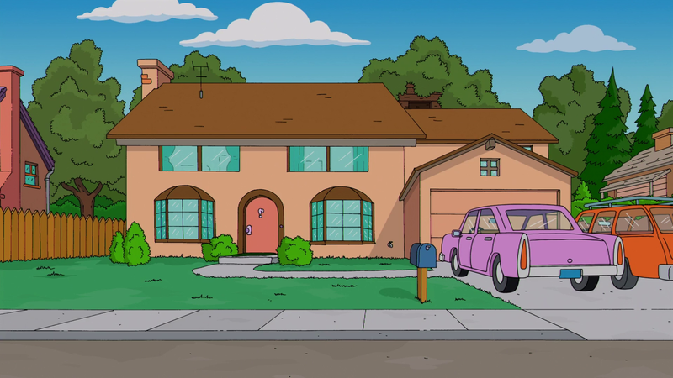
Dans la maison des Simson
I just want to live while I'm alive!

Slide 4
Homer Simpson
And it's now or never

Slide 5
Il veut manger du chocolat
'Cause I ain't gonna live forever!

Slide 6
Il ne trouve pas le chocolat
Luck ain't even lucky, got to make your own breaks

Slide 7
Il panique
You're gonna hear my voice when I shout it out loud

Slide 8
Il prie dieux pour son chocolat
Better stand tall when they're calling you out Don't bend, don't break, baby, don't back down

Slide 9
Sa femme a trouver le chocolat

Slide 10
Elle lui donne le chocolat

Slide 11
Il a manger son chocolat et donc il est content
It’s my life

