Slide 1
StoryBoard par Justin Villeneuve

Slide 2
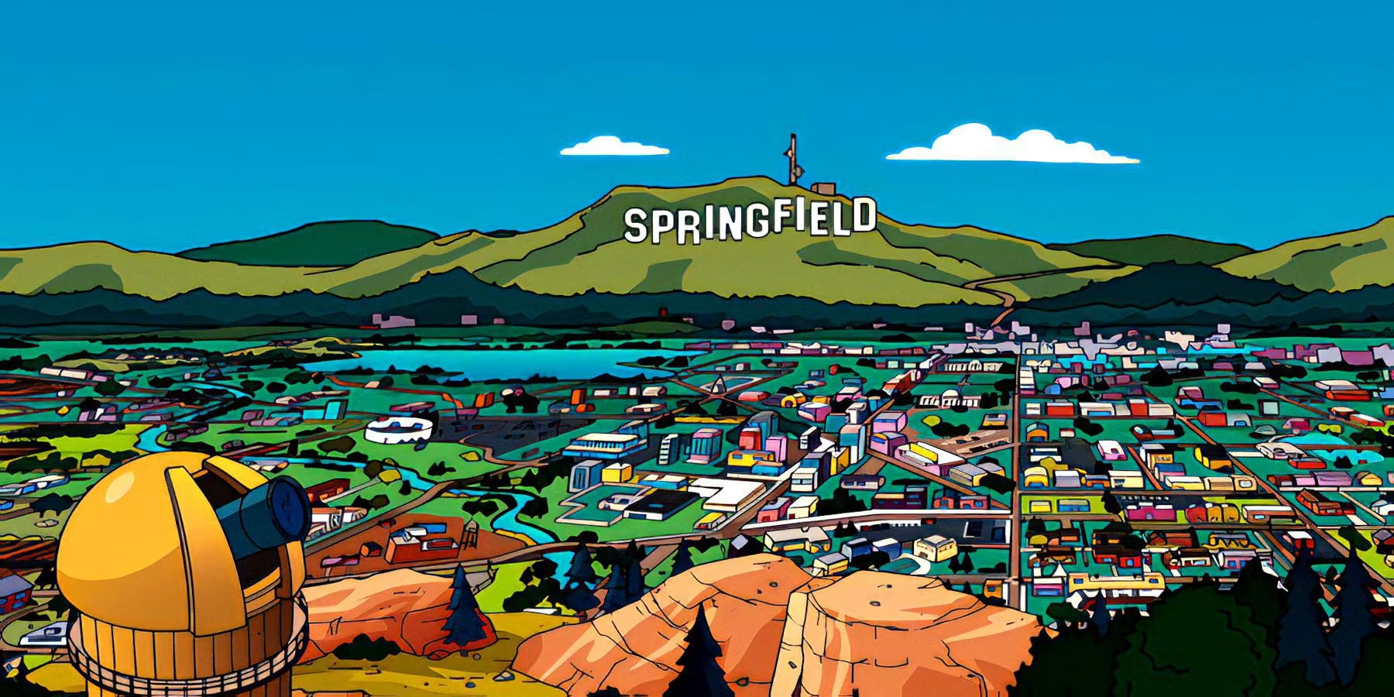
You run, run, run away

Slide 3
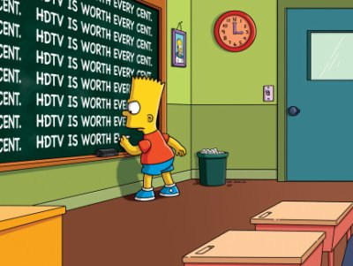
Shootin' at the walls of heartache

Slide 4
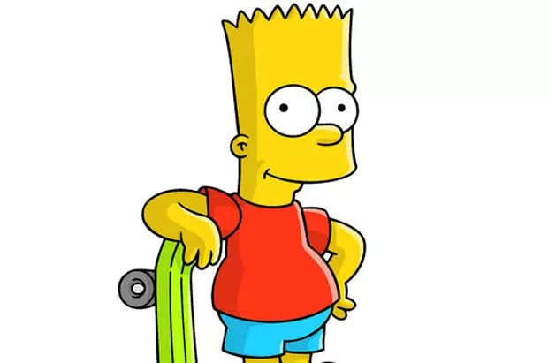
I bet you're not so civilized

Slide 5
Well isn't love primitive

Slide 6
You're heart's still wild

Slide 7
Well I am the warrior

Slide 8
You talk, talk, talk to me

Slide 9
Who's the hunter who's the game

Slide 10
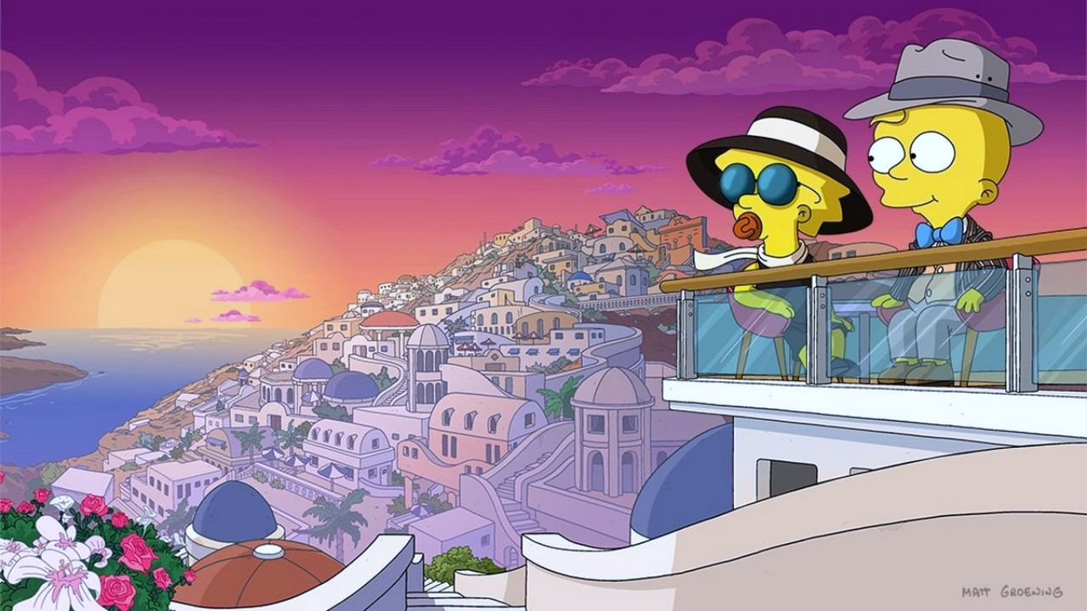
I am the warrior

