Slide 1
Storyboard fait par Edouard Lambert

Slide 2
It's my life

Slide 3
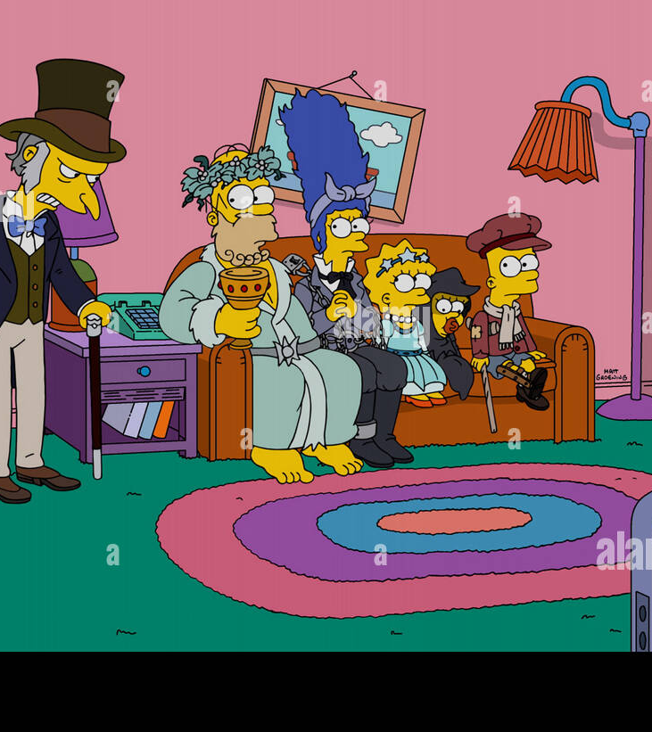
It's now or never

Slide 4
I ain't gonna live forever

Slide 5
I just want to live while I'm alive

Slide 6
Like Frankie said

Slide 7
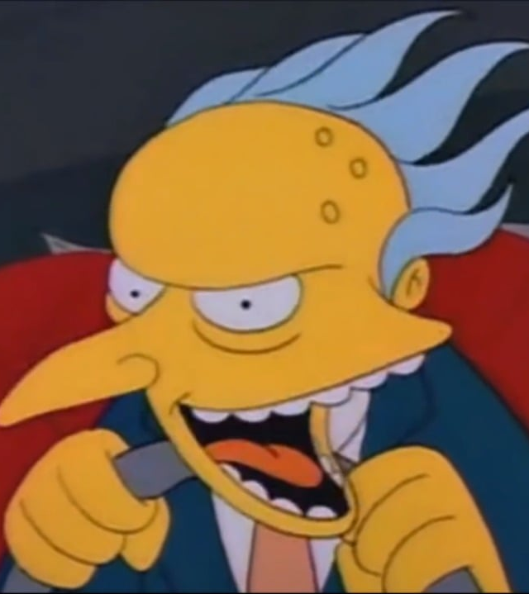
My heart is like an open highway

Slide 8
No silent prayer for the faith-departed

Slide 9
My heart is like an open highway

Slide 10
'Cause I ain't gonna live forever

Slide 11
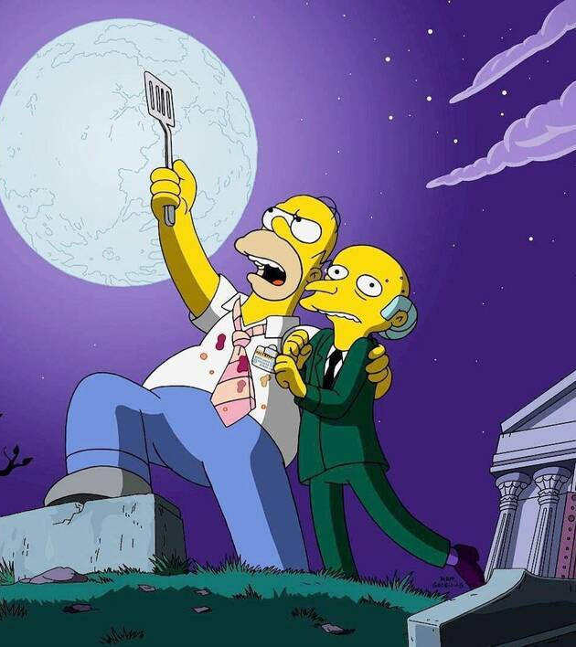
I just want to live while I'm alive

